Slide 1
Upstream 3
3rd Intermediate
Unit 5
5c. Dos &Don'ts

Slide 2
Objectives
At the end of this lesson the student will be able to:
identify the use of modals.
practice reading for detailed comprehension .
practice listening for specific information.
write a short paragraph using present and past modals correctly.

Slide 3
What does each traffic sign mean?
Note: click for the answer
You mustn’t /can’t park here
You mustn’t/can’t turn right here
You must/have to stop

Slide 4
Task 1

Slide 5
Match the sentences with their uses
Expresses obligation
Expresses prohibition
Expresses absence of necessity
Expresses ability present / past
Expresses inability present/ past
Gives permission
1- You have to stop when the traffic light is red.
2- You don’t have to wear a uniform at the university.
3- You can drive for a year with an international licence.
4- You can’t /mustn’t smoke here.
5- I must leave now, my plane is at 9.
6- I can play the piano, my brother can play it too.
7- Fatima could ride a bike when she was seven.
8- I couldn’t (wasn’t able to) go to Ali’s party. I had to work on the weekend.

Slide 6
Suggested Answer Key
Expresses obligation
Expresses prohibition
Expresses absence of necessity
Expresses ability present / past
Expresses inability present/ past
Gives permission
1- You have to stop when the traffic lights are red.
2- You don’t have to wear a uniform at the university.
3- You can drive for a year with an international licence.
4- You can’t /mustn’t smoke here.
5- I must leave now, my plane is at 9.
6- I can play the piano, my brother can play it too.
7- Fatima could ride a bike when she was seven.
8- I couldn’t (wasn’t able to) go to Ali’s party. I had to work on the weekend.

Slide 7
Modals …..
don’t take s, ing or ed.
followed by a bare infinitive.
they don’t have tenses but they refer to a complete action or a state when followed by a bare perfect infinitive.
Modals are divided to
Present modals | Past modals
have to, don’t have to, must | had to
can, can’t | could
able to | was able to

Slide 8
Present modals
Modal | Meaning | Example
have to | expresses strong obligation ( rules ) | You have to stop when the traffic light is red.
don’t have to | absence of necessity | You don’t have to wear a uniform at the university.
must | expresses obligation | I must leave now, my plane is at 9.
mustn’t/ can’t | expresses prohibition | You can’t /mustn’t smoke here.
can | expresses ability gives permission | I can play the piano, my brother can play it too. You can drive for a year with an international licence.

Slide 9
Past modals
Modal | Meaning | Example
had to | expresses strong obligation ( rules ) | I couldn’t (wasn’t able to) go to Ali’s party. I had to work at the weekend.
couldn’t | expresses inability in the past | I couldn’t go to Ali’s party at the weekend.
was able to wasn’t able | expresses ability/inability in the past | I wasn’t able to go to Ali’s party. I had to work at the weekend.

Slide 10
Task 2

Slide 11
Complete the sentences using the appropriate modal
1- You ............... drive on the right-hand side in Bahrain.
2-My grandfather travels a lot. He ……………. speak three languages.
3- I’m tired. I ............... stay up late.
4- Children ............... go to school until the age of 18.
5-I ............... ride a bike when I was six.
6- You …………… leave until you are done.
7- You ............... to leave a tip in restaurants.
8- Alia was too sick last week. She ............... do the required work.

Slide 12
Suggested answer key
1- You must drive on the right-hand side in Bahrain.
2-My grandfather travels a lot. He can speak three languages.
3- I’m tired. I mustn’t stay up late.
4- children have to go to school until the age of 18.
5-I could ride a bike when I was six.
6- You can't leave until you are done.
7- You don’t have to leave a tip in restaurants.
8- Alia was too sick last week. She ( couldn’t) wasn’t able to do the required work.

Slide 13
Task 3

Slide 14
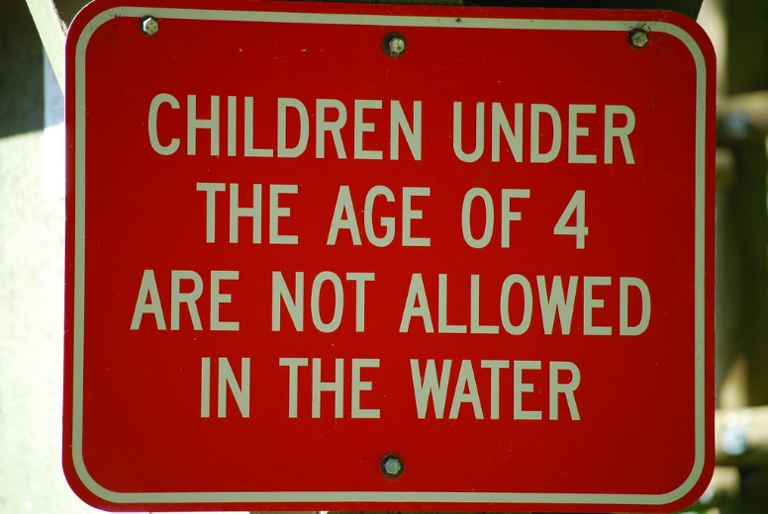
Read the given signs and choose the best answer(a, b, c)
The offer At the footwear section says …..
If you buy one, you can have another one at half price.
If you pay half for one, you can have another one for free.
If you buy two, you can pay half the price .
The sign at the swimming pool says .....
Children under 4 years old must swim here.
Children under 4 years old mustn’t swim here.
Only children under 4 years can swim here .

Slide 15
The sign at the fitting room says …..
You cannot buy more than four items.
You mustn’t try on more than four items at a time.
You can only try on 4 items.
The sign at jeweler's means .....
If you touch these items, they may get damage.
You may hurt yourself if you touch these items.
You mustn’t touch these items.
No more than 4 items in the fitting rooms

Slide 16
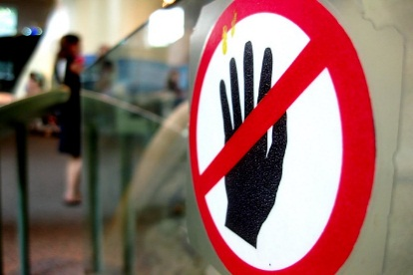
Suggested Answer Key
The offer At the footwear section says …..
If you buy one, you can have another one at half price.
The sign at the swimming pool says .....
Children under 4 years old mustn’t swim here.
The sign at the fitting room says …..
b. You mustn’t try on more than four items at a time.
The sign at jeweler's means .....
c. You mustn’t touch these items.
No more than 4 items in the fitting rooms

Slide 17
Task 4

Slide 18
Look at the picture and read the sentences.
Which one talks about something that : | is possible | is impossible | was possible in the past | we are quite sure about
They must be students in class.
They may / might be friends.
They might have been working on a project.
They can’t be sitting in a canteen.

Slide 19
Suggested Answer Key
Which one talks about something that: | is possible | is impossible | was possible in the past | we are quite sure about
They must be students in class |  |  |  | √
They may / might be friends | √
They might have been working on a project since morning |  |  | √
They can’t be sitting in a canteen. |  | √

Slide 20
Task 5

Slide 21
Look at the picture and make assumptions

Slide 22
Suggested Answer Key
She must be happy and surprised.
She might have got something she wants.
She might have received some good news.

Slide 23
Task 6

Slide 24
Read the two exchanges carefully, then write an exchange for the given situations on the next slide.
Informal
A: Can you help me in the garden, Ahmed?
B: I’m sorry, I can’t now. I’m working on my project.
Formal
A: Could you please send me an e-mail?
B: Certainly.

Slide 25
Now, write an exchange for each of the below situations.
1- You want your friend to give you a lift to school tomorrow.
2- You want your boss to give you a day off work.

Slide 26
Suggested Answer Key
You want your friend to give you a lift to school tomorrow.
A: Can you give me a lift to school tomorrow?
B: Sure.
You want your boss to give you a day off work.
A: May I please have a day off work?
B: I’m afraid not.

Slide 27
Task 7

Slide 28
Before you listen, read the table carefully
B
A
 | Must/ have to | Can’t | Don’t have to | Can
be polite and patient
wear expensive clothes
wear scrubs and a white coat
take short breaks
eat or drinks while working
keep mobile phone on

Slide 29
Listen to Mariam talking about her job and
tick(√) the correct column
B
A
 | Must/ have to | Can’t | Don’t have to | Can
be polite and patient
wear expensive clothes
wear scrubs and a white coat
take short breaks
eat or drinks while working
keep mobile phone on

Slide 30
 | Must/ have to | Can’t | Don’t have to | Can
be polite and patient | √
wear expensive clothes |  |  | √
wear scrubs and a white coat | √
take short breaks
eat or drinks while working |  | √
keep mobile phone on

Slide 31
Write a short paragraph about Mariam, using the information and the modals in the table below. In your writing include the following points: name /job /personal qualities/job routine
Self Assessment | Mark | My Score
I write the name and job | 1
I write about personal quality | 1
I write about the job routine | 2
I use suitable modals | 2
I write between (40-60) words | 1
I use correct spelling and grammar | 2
I use correct punctuation marks | 1
 | Must/ have to | Can’t | Don’t have to | Can
Be polite and patient | √
Wear expensive clothes |  |  | √
Wear scrubs and white coat | √
Take short breaks
Eat or drinks while working |  | √
keep mobile phone on

Slide 32
A suggested answer
Mariam is a doctor. She works in the ER in her town’s main hospital. Because she meets lots of patients every day, Mariam has to be polite and patient. During work, she must wear her uniform (scrubs and white coat). Mariam works long hours and can only take short breaks during the day. She also has to keep her phone on as they might need her for emergency cases. She likes her job and finds it interesting but she hates that she can’t eat or drink while working so she has to work for a long time without eating.

Slide 33
End of the lesson
Thank You

