Slide 1
Upstream 3
3rd Intermediate
Unit 5
5a. On offer

Slide 2
Objectives
At the end of this lesson the student will be able to:
practice reading for specific information.
practice listening for specific information.
write a short paragraph describing the best place pick up bargains in Bahrain.

Slide 3
Introduction
Think of words that are related to
The title “On Offer “

Slide 4
Suggested Answer Key
On sale.
Less price
Reduced price
50% off
Limited time offer
Best deal
Hot offer or hot deal
Big sale.

Slide 5
Task 1

Slide 6
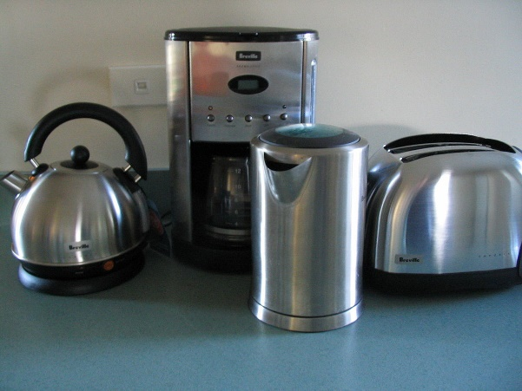
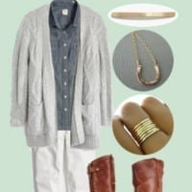
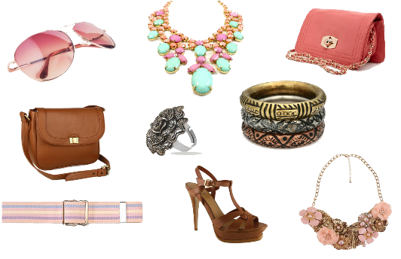
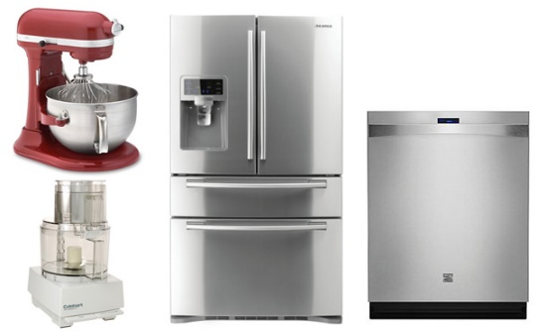
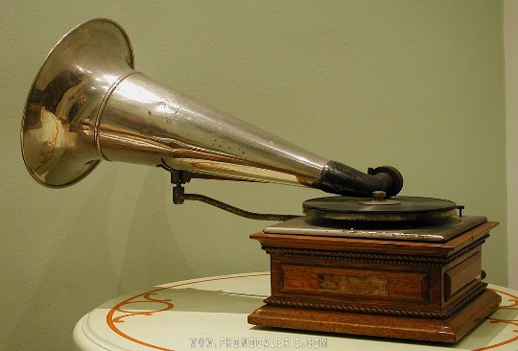
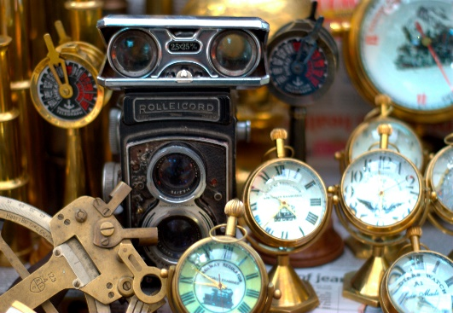
Match the items in the picture with the shops
1
Charity Shop
Department Store
2
4
Electrical Store
Second-Hand Shop
3
5
Antique Shop
6

Slide 7
Suggested Answer Key
1
Charity Shop
Department Store
2
3
2
3
2
4
Electrical Store
Second-Hand Shop
3
1
4
4
1
3
5
5
Antique Shop
6
5
6

Slide 8
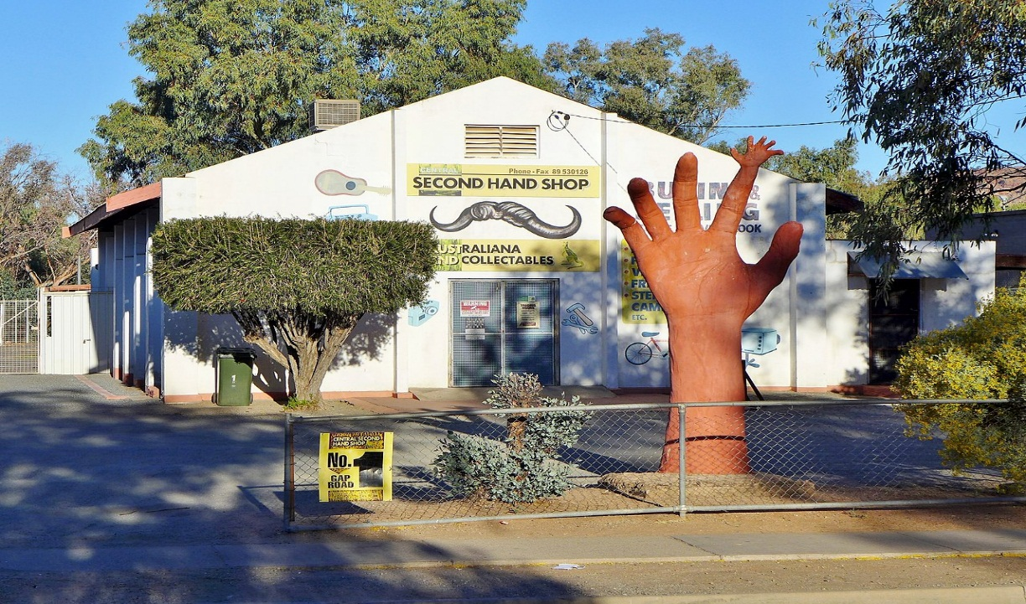
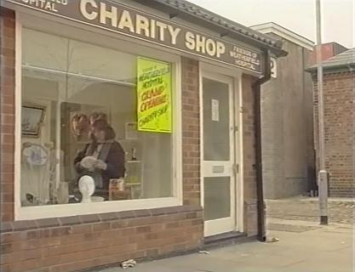
Think
Look at the pictures and think:
What is the difference between the second –hand shop and the charity shop?
Why do people go to these shops?

Slide 9
Suggested Answer
What are the differences between the second –hand shop and the charity shop?
Second –Hand Shops | Charity Shops
Sell used things. Some second- hand shops are specialised in selling certain items. Items are sold as a business risk. | Sell different things people donate( that can be both used or new) Items are sold to raise money for charity.
Why do people go to these shops?
to buy antiques / to find out great unusual or rare things / to buy cheap things / to pick up bargains / to help people in need
Name similar shops in Bahrain?
Wednesday Market/ Traditional Market/ The Second Hand Market

Slide 10
Task 2

Slide 11
Read The Second Hand-Hunters’ Yard
text carefully and complete the activities in the following slides

Slide 12
The Second Hand-Hunters’ Yard
Are you a shopaholic? Do you spend most of your hard – earned cash on buying unnecessary items? If so, you have to consider visiting The Second- Hand Hunter’s Yard and hunt for cheap, second-hand and great options. You can look at many shopping alternatives and can find wonderful bargains that are lighter on your pocket.
The Second- Hand Hunter’s Yard is a huge mall where you can find four shopping areas. The Car Boot Sale, the Second–Hand markets, the Charity shops and the Pop-Up event Bazaars.
The Car boot Sale takes place in the parking area of the mall at the weekends or on Bank Holidays. People swap unwanted things they brought from their homes with other traders.
The Second –Hand markets Is the biggest area of the mall. The shops can be full of surprises and interesting things to pick up. Each shop is specialized in certain items. There are rare book shops, clothing brand shops and antique furniture shops. You can find great deals but you have to be careful and check items before paying because you can’t exchange them or get a refund later.

Slide 13
The Second Hand-Hunters’ Yard
When ever there is a bazaar at The Pop-Up Event Bazaars area, it is your chance to shop till you drop. The bazaars take place in the open area of the mall that was specified for bazaars that occur on different occasions during the year such as the holidays or the national day. The bazaar is always a wonderful place not only for buying hand-made gifts and lovely items, but is also customized for the event, and shows the beauty behind holding the bazaar and raising money for charity. So there is always a good cause behind shopping at these bazaars.
The Charity Shops sell new and used things that people donate such as toys, clothes, books, furniture and many other miscellaneous items at cheap prices. The collected money at the shops is used to help homeless and hungry people or is sent to help the people in poor countries.

Slide 14
Match each word from the box with the correct meaning in the table
 | Meaning | Answer
A | Different non related things
B | Exchange
C | Money you worked hard for
D | Shop a lot
E | Choose and buy
F | Not very common
G | A person who enjoys shopping a lot
H | People who sell and buy things
I | Other options
J | Things sell at low prices below their values
K | People who don’t have place to live
L | Cheaper
M | Money returned for you from the shop when you return something
1. Rare
2. Refund
3. Pick up
4. Alternatives
5. Swap
6. Homeless
7. Miscellaneous
8. Bargains
9. Shopaholic
10. Traders
11. Shop till you drop
12. Lighter on your pocket
13. Hard-earned cash

Slide 15
Answer Key
 |  | Answer
A | Different non related things | 7. Miscellaneous
B | Exchange | 5.Swap
C | Money you worked hard for | 13.Hard-earned cash
D | Shop a lot | 11.Shop till you drop
E | Buy | 3.Pick up
F | Not very common | 1.Rare
G | A person who enjoys shopping a lot | 9.Shopaholic
H | People who sell and buy things | 10.Traders
I | Other options | 4.Alternatives
J | Things sell at low prices below their values | 8.Bargains
K | People who don’t have place to live | 6.Homeless
L | Cheaper | 12.Lighter on your pocket
M | Money returned for you from the shop when you return something | 2.Refund

Slide 16
Task 3

Slide 17
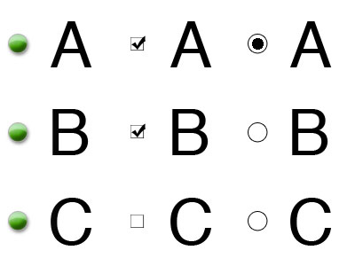
Read the text again and for each question (1-5),
choose the best answer( A,B,C or D)
Note:
Write the question number in your notebook, then write the letter of the correct answer for each.

Slide 18
1.The text main idea is…
Why second – hand items are the best bargains.
Second – hand shops are specialised shops.
Second hand – shops collect money for charity.
Where you can shop for great bargains.
2.What does the writer say about the Car Boot Sale?
Traders exchange things they brought from home.
Are held at the weekends only.
Take place in the biggest area of the mall.
Only things from home can be sold.

Slide 19
3. The writer says that the shops in the Second-Hand Markets ...
sell a range of different items.
allow exchange and refund.
don’t sell brands clothes.
Are full of wonderful bargains and great deals.
4.What does the writer say about the Pop-Up Event Bazaars?
Bazaars take place only twice a year.
Shopping at bazaars is always a perfect thing to do because you shop for a good reason.
You can only buy hand- made gifts at the Bazaars.
Bazaars are held in the Holidays season only.

Slide 20
5. Charity shops and Pop-Up Event Bazaars…..
raise money goes for charity.
both sell handmade gifts.
donate money to poor countries only.
don’t sell second-Hand items.

Slide 21
Answer Key
Question No |  | Answer
1 | The text main idea is… | d
2 | What does the writer say about the Car Boot Sale? | a
3 | The writer says that the shops in the Second-Hand Markets are | d
4 | What does the writer say about the Pop-Up Events Bazaars? | b
5 | Charity shops and Pop-Up Events Bazaars….. | a

Slide 22
Task 4

Slide 23
Listen to the dialogue and complete the sentences below.
1- The woman went to the second-hand shop in the ………… .
2- The woman is looking for …………. ………….. .
3- Shakespeare's collection price is……… BD.
4- The woman paid …. BD for the books collection.
A
B

Slide 24
Answer Key
1- The woman went to the second-hand shop in …………………. .
2- The woman is looking for………………. .
3- Shakespeare's collection price is ………..... BD.
4- The woman paid …………………….BD for the book collection.
the evening
rare books
50 or fifty
37 or thirty seven
A
B

Slide 25
Task 5

Slide 26
Write a short paragraph about the best place to pick up bargains in Bahrain. In your writing include the following points:
Name
Location
Goods
When open /held
Self Assessment | Mark | My Score
I write the name of the place | 1
I write the location of the place | 1
I write about the goods | 1
I write about when open/held | 1
I write between (40-60) words | 2
I use correct spelling and grammar | 2
I use correct punctuation marks | 2

Slide 27
A suggested answer
The best place to pick up bargains in Bahrain is Wednesday Market. It is held every Wednesday in different areas around Bahrain’s cities. There, you can find everything you want from clothes, cosmetics and accessories to fresh fruits and vegetables. My favourite stall is the second-hand book stall where you can find rare books for next to nothing.

Slide 28
End of the lesson
Thank You

