Slide 1
Third Intermediate
Upstream 3
Unit 1/ 1St Semester

Slide 2
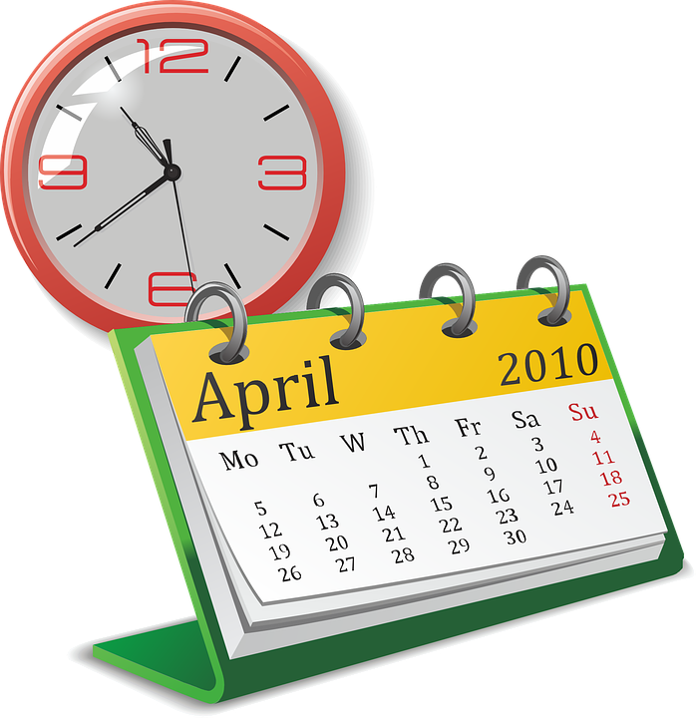
Lesson 1c/ Page 10
How often do you…?

Slide 3
Objectives
At the end of this lesson the student will be able to:
use present simple and present continuous tenses in sentences.
use the two tenses correctly in different situations.
write an informal email using the two tenses accurately.

Slide 4
Task 1

Slide 5
5 min
Read Fatima’s email and find examples of:
Dear Rawan,
Thanks for your lovely email. I’m happy to receive an email from you. As for me, I’m really busy. Being a student is very tiring, but it’s filled with new experiences.
I wake up at 5 o’clock on weekdays as school starts too early. I have my breakfast before I wear my school uniform. I always go to school by my father’s car. My classes start at 7.20. This course I’m having Biology which is my favourite subject. At the weekend I take art classes to improve my drawing skills. These days I’m working hard on my History subject because I want to have the highest mark in the class. Tonight is my sister’s birthday so I’m having a special dinner with my family in a big restaurant. I can’t wait!
I’d better stop now because my mother is calling me to go with her to arrange for my sister’s birthday party. Miss you so much, I hope to see you soon!
Fatima
a. a fixed future arrangement.
b. an action happening around the time of speaking.
c. a timetable.
d. a permanent state.
e. a temporary situation.
f. a habit/ routine
g. an action happening now.
Notes:
Is (descriptions) the right word here? Am not sure about it!

Slide 6
Task 2

Slide 7
2 min
Now, let’s look closer at the sentences:
Underline the verbs in the sentences and define their tense.
1. I’m having a special dinner with my family.
Present continuous
2. These days I’m working hard on my History subject.
Present continuous
3. My classes start at 7.20.
Present simple
4. Being a student is very tiring.
Present simple
5. This course I’m having Biology.
Present continuous
Present simple
6. I wake up at 5 o’clock./ I have breakfast then I wear my school uniform.
7. I always go to school by my father’s car.
Present simple
8. My mother is calling me.
Present continuous

Slide 8
How often do you…?
Adverbs of frequency
always | 100%
usually | 90%
frequently | 80%
often | 70%
sometimes | 50%
occasionally | 30%
seldom | 10%
rarely | 5%
never | 0%
Present Simple
I/ you/ they/ we + verb
she/ he/ it + verb (s)
When to use present simple:
facts
Athletes eat healthy food.
a timetable
The film starts at 8 pm.
a habit/ routine
She goes to her grandfather’s house every Friday.
a permanent state
They live in Bahrain.
adverb of frequency
He always plays basketball with his friends.

Slide 9
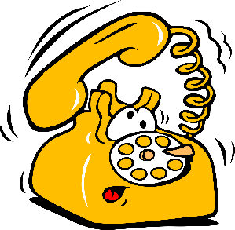
Present continuous
she/ he/ it + is verb (ing)
you/ they/ we + are verb (ing)
I + am verb (ing)
When to use present continuous:
a temporary situation
I am learning French this month.
fixed future arrangement
They are meeting tonight.
an action happening now
Look! It is raining.
an action happening around the time of speaking
Just a minute, the telephone is ringing.

Slide 10
Task 3

Slide 11
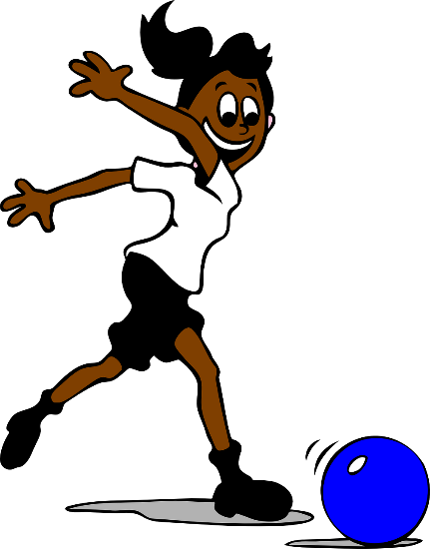
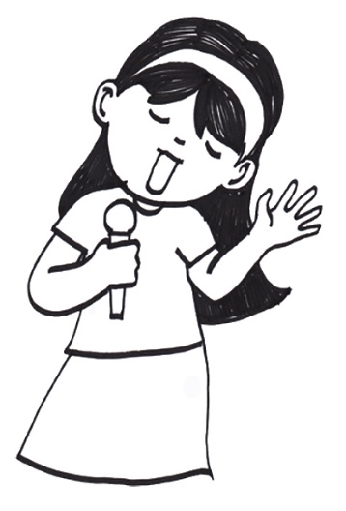
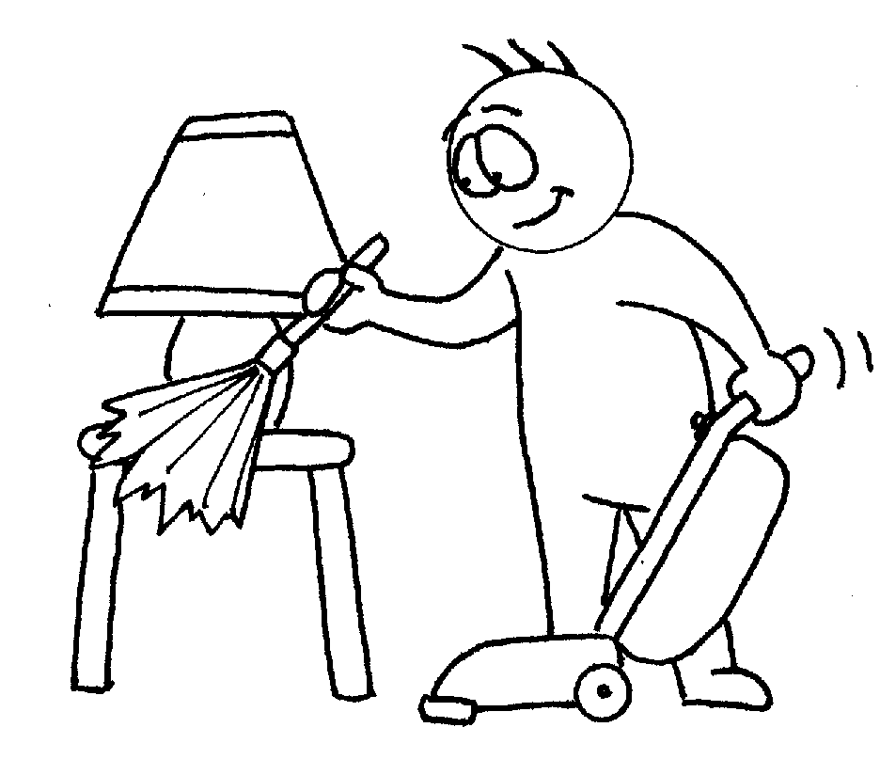
2 min
Look at the pictures and write sentences using the present simple or present continuous tenses.
---------------------------------------------------------------------------
---------------------------------------------------------------------------------------------------------
She is taking singing classes this month. Or
She sings very well.
She usually plays football. Or She is playing football now.
--------------------------------------------------------------------------------------------------------------------------------------------
Sofia is doing her exercise. Or
Sofia does her exercise every morning.
--------------------------------------------------------------------------------------------------------------------------------------------
Ahmed is cleaning his room. Or
Ahmed sometimes cleans his room.

Slide 12
Task 4

Slide 13
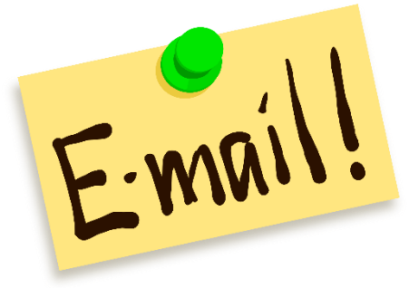
The main parts of an informal email are:
Opening
Dear Rawan,
Thanks for your lovely email. I’m happy to receive an email from you. As for me, I’m really busy. Being a student is very tiring, but it’s filled with new experiences.
I wake up at 5 o’clock on weekdays as school starts too early. I have my breakfast before I wear my school uniform. I always go to school by my father’s car. My classes start at 7.20. This course I’m having Biology which is my favourite subject. At the weekend I take art classes to improve my drawing skills. These days I’m working hard on my History subject because I want to have the highest mark in the class. Tonight is my sister’s birthday so I’m having a special dinner with my family in a big restaurant. I can’t wait!
I’d better stop now because my mother is calling me to go with her to arrange for my sister’s birthday party. Miss you so much, I hope to see you soon!
Fatima
Paragraph 1
Greeting &
reason for writing
Paragraph 2
The email content
(your routine/timetable/ fixed arrangement/ temporary or permanent situation)
Paragraph 3
Conclusion
ending

Slide 14
Task 5

Slide 15
15 min
greeting & reasons for writing
your daily routine/ any plans for the weekend/
what you are doing these days.
conclusion/ ending
Write an email to your friend:
Paragraph 1
Write 120-140 words
------------------------------------------------------------------------------------------------------------------------------------------------------------------------------------------------------------------------------------------------------------------------------------------------------------------------------------------------------------------------------------------------------------------------------------------------------------------------------------------------------------------------------------------------------------------------------------------------------------------------------------------------------------------------------------------------------------------------------------------------------------------------------------------------------------------------------------------------------------------------
Paragraph 2
Paragraph 3

Slide 16
Put a (a) if your answers are correct:
Self Assessment
I write about all the points.
I use the correct tense.
I write 3 paragraphs.
I write 120-140 words.
I use correct spelling.
I use correct punctuation marks & the right capitalisation.
I follow the correct layout.

Slide 17
A suggested answer
Dear Mona,
Thanks for your email. Nothing makes me happier than receiving an email from you. As for me, I’m really busy these days as it’s my last year in the university.
I wake up at 7 o’clock on weekdays as my first class starts at 8:00. I’m always late so I have my breakfast at the university, but I arrive on time of my first class. This course I’m working on my graduation assignment, wish me good luck. At the weekend I go out with my friends to release stress and have some fun. These days I’m studying hard because I want to score the highest marks in the section. Tonight I’m meeting my old friend Mariam because It’s her birthday. I can’t wait till I see her, it has been a long time since we met!
I’d better stop now, my sister is waiting for me in the car because we’re going to buy Mariam a present. Miss you so much, hope to see you soon!
Ameena

Slide 18
Remember
Read the email in your class book P.10

Slide 19
Good luck

