Slide 1
Third Intermediate
Upstream 3
Unit 10

Slide 2
Lesson 10e
Time to Complain

Slide 3
Objectives
To identify faulty issues in different items.
To identify a complaint letter layout.
To write a complaint letter following the right layout.
_________________________________________________________________________________________________________________________________________________
Ministry of Education-2020

Slide 4
Task 1
_________________________________________________________________________________________________________________________________________________
Ministry of Education-2020

Slide 5
Read the dialogue between a mother and her daughter and think how this problem can be solved.
Mom!
What’s wrong Mariam?
The pair of trainers that I've ordered last week arrived in a wrong size!
_________________________________________________________________________________________________________________________________________________
Ministry of Education-2020

Slide 6
What shall I do Mom?
Don’t worry honey! We can solve that easily.
That’s great! How can we do that?
All we have to do is to …..
They will write a complaint letter.
_________________________________________________________________________________________________________________________________________________
Ministry of Education-2020

Slide 7
Task 2
_________________________________________________________________________________________________________________________________________________
Ministry of Education-2020

Slide 8
Tick the possible fault(s), For each item in the table on the next slide.
Note: You might tick more than one fault.
_________________________________________________________________________________________________________________________________________________
Ministry of Education-2020

Slide 9
2:00
What might be wrong?
 | smart phone | T-shirt | tablet | pizza | vase | bag | smart watch
The touch screen is responding slowly.
There are some missing buttons.
It is over cooked.
It is torn.
It had some missing parts/ accessories.
The colour has faded.
The screen is cracked/ scratched.
It doesn’t charge accurately.
It shrank when I washed it.
It isn’t what I’ve ordered!
There are holes in it.
Its camera is damaged.
_________________________________________________________________________________________________________________________________________________
Ministry of Education-2020

Slide 10
Now check your answers.
_________________________________________________________________________________________________________________________________________________
Ministry of Education-2020

Slide 11
Answer key
 | smart phone | T-shirt | tablet | pizza | vase | bag | smart watch
The touch screen is responding slowly. | ✓ |  | ✓ |  |  |  | ✓
There are some missing buttons. |  |  | ✓ |  |  | ✓
It is over cooked. |  |  |  | ✓
It is torn. |  | ✓ |  |  |  | ✓
It has some missing parts/ accessories. | ✓ |  | ✓ |  |  | ✓ | ✓
The colour has faded. |  | ✓
The screen is cracked / scratched. | ✓ |  | ✓ |  |  |  | ✓
It doesn’t charge accurately. | ✓ |  | ✓ |  |  |  | ✓
It shrank when I washed it. |  | ✓
It isn’t what I’ve ordered! | ✓ | ✓ | ✓ | ✓ | ✓ | ✓ | ✓
There are holes in it. |  | ✓ |  |  | ✓ | ✓
Its camera is damaged. | ✓ |  | ✓
_________________________________________________________________________________________________________________________________________________
Ministry of Education-2020

Slide 12
Now, let’s look closer at the following letter:
_________________________________________________________________________________________________________________________________________________
Ministry of Education-2020

Slide 13
0:30
Read, then answer the questions.
Paragraph 1
Dear Sir/Madam,
I am writing to complain about a laptop which I recently bought from your shop in Aurora Mall.
Why is Mona writing a letter of complaint?
Where did she buy it from?
_________________________________________________________________________________________________________________________________________________
Ministry of Education-2020

Slide 14
0:30
Read, then answer the questions.
Paragraph 2
On 19th April, I bought Teen Laptop from your shop. Unfortunately, it seems to be faulty. When I tried to use the charger, it did not work.
When did she buy it?
What make is it?
What’s the problem?
_________________________________________________________________________________________________________________________________________________
Ministry of Education-2020

Slide 15
0:30
Read, then answer the questions.
Paragraph 3
I would appreciate it if you could replace it with another one of the same make. I have enclosed copies of my invoice and guarantee. I look forward to your reply. Please contact me on 9876544321, Monday to Wednesday, 10:00 am - 4:00 pm.
What does she want to be done?
What’s her contact number/ address?
When?
_________________________________________________________________________________________________________________________________________________
Ministry of Education-2020

Slide 16
A complaint letter
Dear Sir/Madam,
I am writing to complain about a laptop which I recently bought from your shop in Aurora Mall.
1
On 19th April, I bought Teen Laptop from your shop. Unfortunately, it seems to be faulty. When I tried to use the charger, it did not work.
2
I would appreciate it if you could replace it with another one of the same make. I have enclosed copies of my invoice and guarantee. I look forward to your reply. Please contact me on 9876544321, Monday to Wednesday 10:00 am - 4:00 pm.
Yours faithfully,
Mona Adel
Mona Adel
3
_________________________________________________________________________________________________________________________________________________
Ministry of Education-2020

Slide 17
Task 3
_________________________________________________________________________________________________________________________________________________
Ministry of Education-2020

Slide 18
2:00
Now, match the parts of the complaint letter with the ideas
Dear Sir/Madam
I am writing to complain about a laptop which I bought recently from your shop in Aurora Mall
Para 1:
Opening Remarks
Information of how they can contact.
What you want to be done about the problem.
On 19th April, I bought Teen Laptop from your shop. Unfortunately, the laptop seems to be faulty. When I tried to use the charger, it did not work
Para 2:
Main Body
The reason why you are writing.
I would appreciate it if you could replace it with another laptop of the same make. I have enclosed copies of my invoice and guarantee. I look forward to your reply. Please contact me on 9876544321, Monday to Wednesday 10:00 am - 4:00 pm.
Yours faithfully,
Mona Adel
Mona Adel
Important facts about your purchase.
Para 3:
Closing Remarks
Details about what the problem is.
_________________________________________________________________________________________________________________________________________________
Ministry of Education-2020

Slide 19
Now check your answers
Information of how they can contact you
Para 1
What you want to be done about the problem
The reason why you are writing
Para 2
Important facts about your purchase
Para 3
Details about what the problem is
_________________________________________________________________________________________________________________________________________________
Ministry of Education-2020

Slide 20
Task 4
_________________________________________________________________________________________________________________________________________________
Ministry of Education-2020

Slide 21
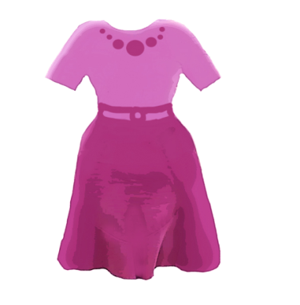
3:00
Use the information in the box to complete the letter of complaint.
On 20th March, you bought a dress from The Teen’s Shop in the Sunshine Mall, but when you washed it, the colour had faded. Write a letter of complaint to the shop manager asking for a refund.
Dear Sir/Madam,
I am writing to complain about …................. I bought …................. from …................. in ….................
The …................. is ….................and made of …................. I have only worn it once but…………………………………………….. I took it back to the shop but the manager was rude and refused to help me.
I would appreciate if you could ….................….................….................…................. I have enclosed a copy of my invoice. I look forward to your reply. Please contact me on ….................….................from …................. to …................., ….................- ….................
Yours faithfully
….................
item
when
shop
place
item
colour
material
problem
what you want to be done
phone No.
day
day
time
time
Name
_________________________________________________________________________________________________________________________________________________
Ministry of Education-2020

Slide 22
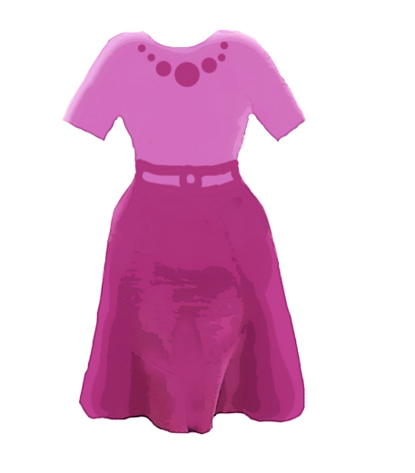
Answer Key
Dear Sir/Madam,
I am writing to complain about …a dress... I bought …20th March... from …the Teen’s Shop.... in …the Sunshine Mall.
The …dress... is …purple...and made of …cotton... I have only worn it once but its colour had faded when I washed it. I took it back to the shop manager, but he was rude and refused to help me.
I would appreciate if you could ..refund my money in full ... I have enclosed a copy of my invoice. I look forward to your reply. Please, contact me on …01234567....from …Sunday...to …Thursday..., ...8:00 am...- …4:00 pm....
Yours faithfully
…Mariam Isa...
_________________________________________________________________________________________________________________________________________________
Ministry of Education-2020

Slide 23
Task 5
_________________________________________________________________________________________________________________________________________________
Ministry of Education-2020

Slide 24
Read the following problem, then write a letter of complaint.
1. You recently bought a Nintendo from Teen’s Technology
Shop in the Sunshine Mall. When you used it for a week; you realized that it doesn’t charge accurately. Write a letter of complaint to the shop manager asking for a refund or an exchange.
_________________________________________________________________________________________________________________________________________________
Ministry of Education-2020

Slide 25
Use the following plan:
Dear Sir/ Madam,
Opening Remarks (Paragraph 1)
Why are you writing the letter?
Main body (Paragraph 2)
What did you buy?
Where/ How/ When?
What is the problem?
Closing Remarks (Paragraph 3)
What do you want to be done?
What is your contact number/ address?
Yours faithfully,
Signature
(Your full name)
Write 100 -120 words
_________________________________________________________________________________________________________________________________________________
Ministry of Education-2020

Slide 26
Self Assessment
I use past tense.
I write 3 paragraphs.
I write 100-120 words.
I use correct spelling.
I use correct punctuation marks & the right capitalization.
I follow the correct layout:
I write about all the points below:
I write Dear Sir/ Madam - yours faithfully/ full name.
I write the reasons for writing.
I write what, when, how, where I bought from.
I describe the item (colour, material, shape, etc…).
I write what the problem is , what I want to do.
I write the contact number/ address.
Put a (a) if your answers are correct:
_________________________________________________________________________________________________________________________________________________
Ministry of Education-2020

Slide 27
Thank you
_________________________________________________________________________________________________________________________________________________
Ministry of Education-2020

