Slide 1
Family and Friends
Grade 6
unit 8
We are fishing!
Lesson 4: Phonics
(ea – e)

Slide 2
Lesson Objectives
To differentiate words spelled with "ea" and "e “.
To write sentences using words spelled with "ea" and "e" .
Ministry of Education - 2020

Slide 3
Read the following sentences, look at the red words, and find out how they are differently spelled but have similar sound for the letters e / ea.
e
Jane spends her money at the shop.
My family sleeps in a tent when they are camping.
Sally’s friends are going to buy a present for her birthday.
A poor man asked me for help on the street.
ea
Jack’s got a blue feather on his head.
I always have a loaf of bread for breakfast.
Mike’s backpack is very heavy.
Ministry of Education - 2020

Slide 4
From the previous slide, write the words in the correct place.
spend
head
help
heavy
feather
tent
present
bread
ea
e
Check your answers
feather
spend
head
tent
bread
present
heavy
help
Use an online dictionary to listen to the sound of e and ea in the words above.
Ministry of Education - 2020

Slide 5
More words with e and ea
Spin and complete the words with (e) or (ea).
br__kfast
b__ll
t__n
l___g
h___n
sh___ll
h___d
oc___n
Start/stop
Ministry of Education - 2020

Slide 6
Check your answers
bell
hen
breakfast
head
ten
ocean
leg
shell
Ministry of Education - 2020

Slide 7
Practice
Re-order the following words and write complete sentences on your mini board.
❶walks / My brother / everyday / his health / for.
My brother walks everyday for his health.
❷terrible / The weather / was / yesterday.
The weather was terrible yesterday.
❸always / Jim / homework / sends / by email / his.
Jim always sends his homework by email.
❹I / the smell / love / these flowers / of.
I love the smell of these flowers.
Check your answers
Ministry of Education - 2020

Slide 8
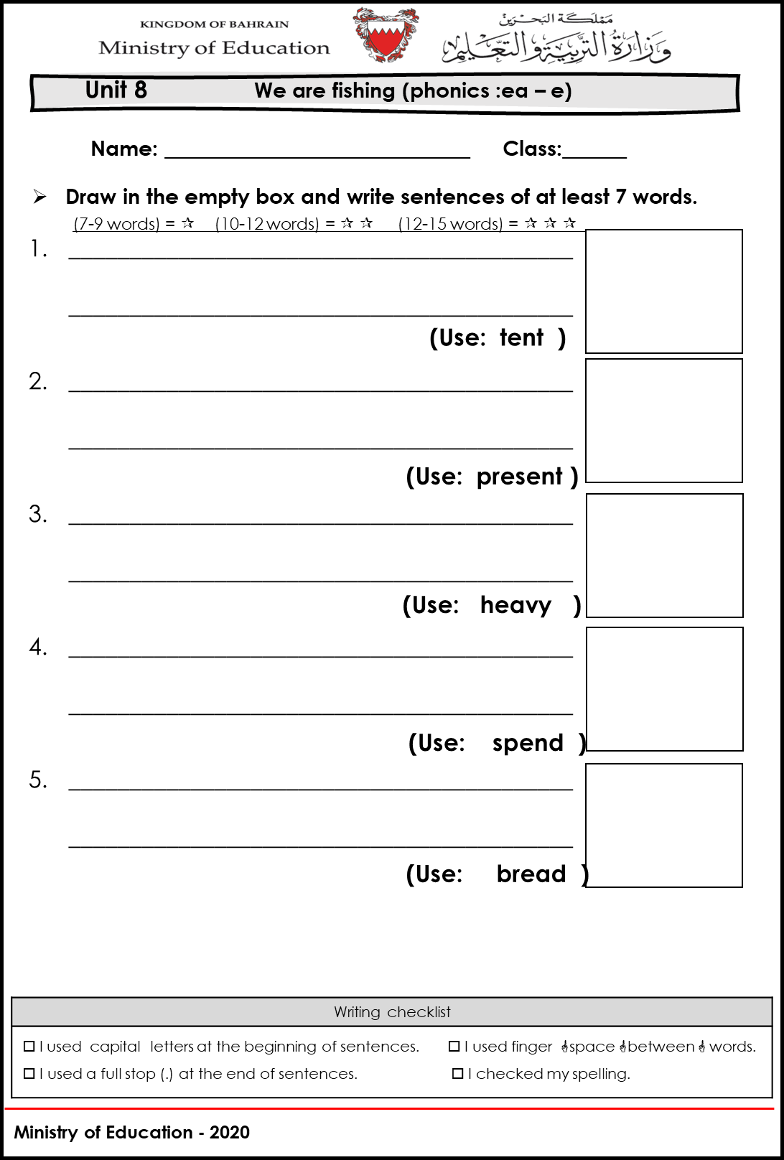
Worksheet Time!
Now, check the worksheets and write sentences using the words you have learnt.
Ministry of Education - 2020

Slide 9
End of the Lesson
Ministry of Education - 2020

