Slide 1
English
Family and Friends
Grade 6
Semester 1
Unit 5
Have you ever been…?
Lesson 2 : Grammar

Slide 2
Lesson Objectives
To identify the use of present perfect with “ever”
To use present perfect with “ever” correctly
To write questions and answers using present perfect with “ever”
Ministry of Education – 2020 -
English-Grade 6- Unit 5- lesson 2 (Grammar)

Slide 3
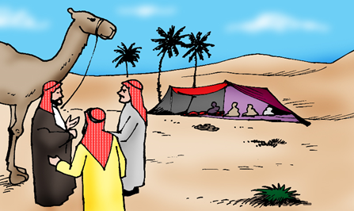
Presentation
Click, read and learn about present perfect with “ever”.
1
2
Q:
Has she ever been to London?
Q:
Have you ever been to the desert?
A:
No, she hasn’t. (-)
Yes, she has. (+)
No, I haven’t. (-)
Yes, I have. (+)
A:
Remember!
The past participle (pp) of the verb (go) is (been).
We use it to mean in your life up to now.
What does it mean when we say “Have you ever….”?
English-Grade6 – Unit 5 – Lesson2 (Grammar)

Slide 4
Presentation
Click, read and learn about present perfect with “ever”
I’ll show you how. Look at this example.
Jane
ever
an oasis before?
Now look at the structure.
Has
seen
( + )
Yes,
she
has.
( - )
No,
she
has
Remember!
When we use yes as an answer, it’s affirmative ( + ). We use No when our answer is negative ( -).
How do we write questions using the present perfect with (ever)?
Have
Has
+
I/you/we/they/he/she/it
+
ever
+
pp
verb
+
question completion?
Yes,
+
I/you/we/they
he/she/it
+
have.
has.
( + )
No,
+
I/you/we/they
he/she/it
+
have
has
+
not (-n’t).
( - )
Ministry of Education - 2020
English-Grade6- Unit 5-Lesson 2 (Grammar)

Slide 5
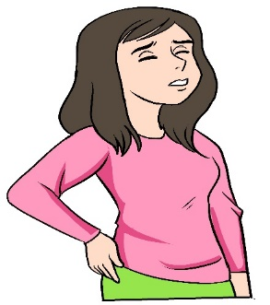
Check your answers
Answer the following questions.
Q1:Have you ever visited the U.K.? ( + )
Ans: Yes, I have / we have.
Q2:Has he ever been to an island? ( - )
Ans: No, he hasn’t.
Q3: Have they ever seen a shark ? ( - )
Ans: No, they haven’t.
Q4: Has she ever had a backache? ( + )
Ans: Yes, she has.
English-Grade 6- Unit 5- lesson 2 (Grammar)

Slide 6
Write suitable questions for the following answers.
Check your answers
- No, she hasn’t.
- Has she ever entered a cave?
cave
- No, I haven't.
- Have you ever climbed a volcano?
volcano
- Yes, they have.
- Have they ever swum in an ocean?
ocean
English-Grade 6- Unit 5- lesson 2 (Grammar)

Slide 7
Write questions using the following words and answer them using Yes/ No.
Check possible answers.
camp/ desert
Have you ever camped in the desert?
Yes (I) / (we) have.
No(I) / (we) haven’t.
see/
website
Have they ever seen our website?
Yes, they have.
No , they haven’t.
see/
shooting
star
Has she ever seen a shooting star?
Yes, she has.
No, she hasn’t.
English-Grade 6- Unit 5- lesson 2 (Grammar)

Slide 8
End of the Lesson
Ministry of Education - 2020
English-Grade 6- Unit 5- lesson 2 (Grammar)

