Slide 1
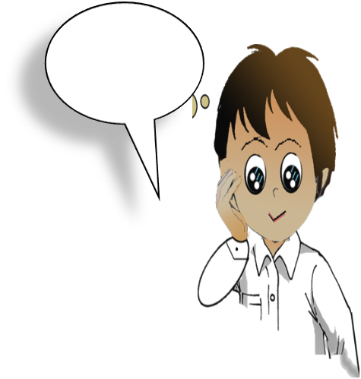
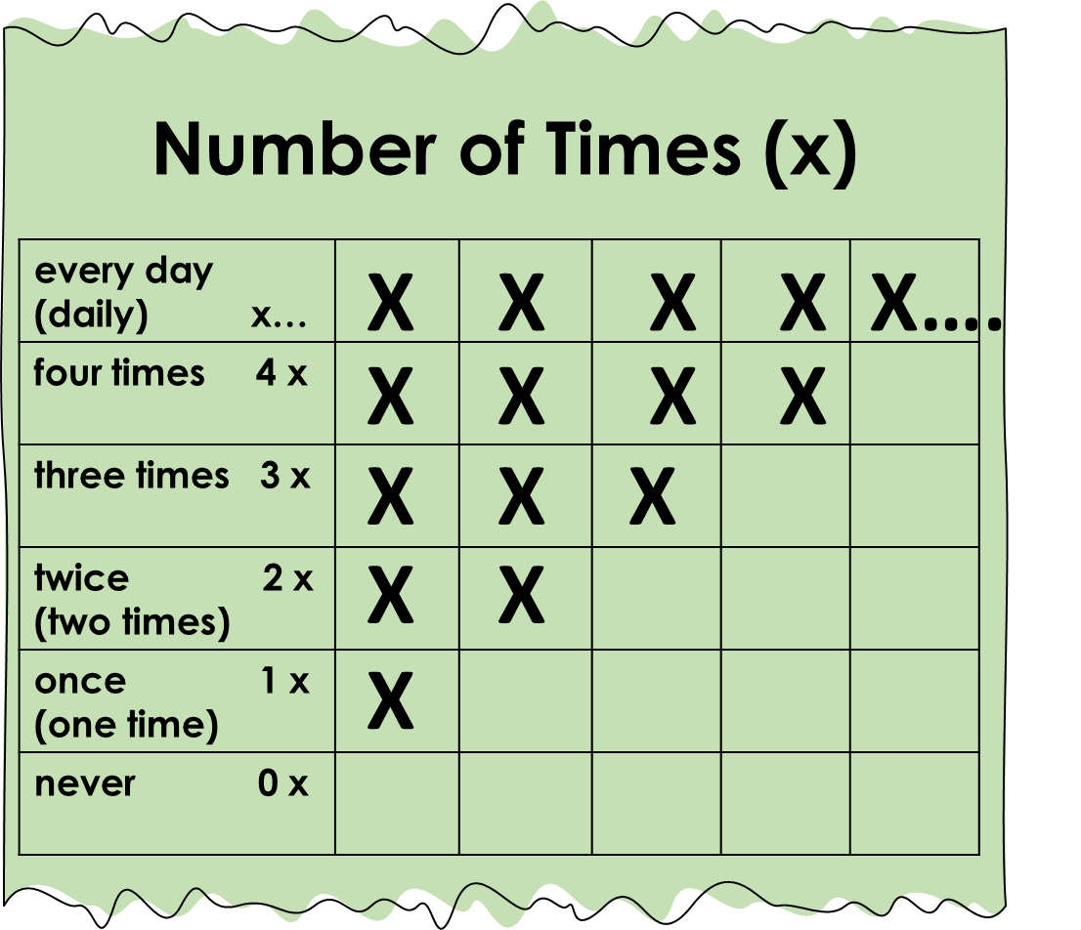
English
Family and Friends
Grade 6
Semester 1
Unit 3
Something new to watch!
Lesson 3: Grammar

Slide 2
Lesson Objectives
To identify the uses of the question (How often?) and the adverbs/ adverbials of frequency.
To use the question (How often?) and the adverbs/ adverbials of frequency accurately.
Ministry of Education - 2020
English-Grade6- Unit 3-Lesson3- (Grammar)

Slide 3
Presentation
Read and learn about adverbs of frequency and adverbials of frequency.
Type | Examples | Why we use them | Where we put them (in a sentence)
Adverbs of frequency | always usually sometimes rarely never | to say how often we do an activity | before the main verb like (read, play, do, etc.) and after verbs to be ( is – am– are )
Adverbials of frequency | every day once a week twice a day three times a year four times a month | to say the number of times we do an activity | at the end of a sentence before words/phrases like (day, a day, week, a week, etc.)
English-Grade6- Unit 3-Lesson3- (Grammar)

Slide 4
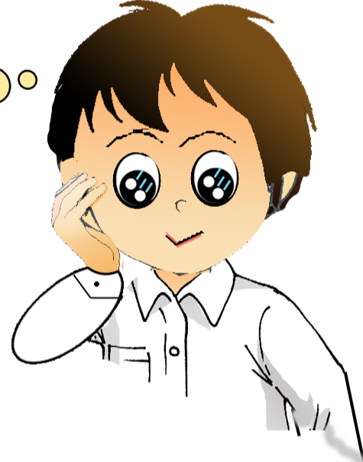
Frequency Percentage %
Presentation
Read and learn more about the adverbs of frequency.
Adverbs of frequency show how often we do something.
always 100%
usually 70%
sometimes 50%
rarely 10%
never 0%
English-Grade6- Unit 3-Lesson3- (Grammar)

Slide 5
Number of Times (x)
Presentation
Read and learn more about the adverbials of frequency.
Adverbials of frequency show the number of times we do something.
X X X X X...
every day (daily) x…
four times 4 x
three times 3 x
twice 2 x (two times)
once 1 x (one time)
never 0 x
X X X X
X X X
X X
X
English-Grade6- Unit 3-Lesson3- (Grammar)

Slide 6
Introduction
Read the following questions and learn.
How often
does
Sara
watch
TV
How often
do
you
play
football
subject
he
she
it
Ali
Sara
helping verb
does
main verb
watch
play
go
object
TV
football
the beach
How often
+
+
+
+
+
subject
I
you
we
they
helping verb
do
How do we ask a question using (How often)?
Ministry of Education - 2020
English-Grade6- Unit 3-Lesson3- (Grammar)

Slide 7
Introduction
Read the following sentences and learn.
Sara
never
watches
TV
.
You
always
play
football
.
subject
He
She
It
Ali
Sara
main verb
watches
plays
goes
object
TV
football
the beach
adverbs of frequency
never
always
sometimes
.
+
+
+
+
main verb
watch
play
go
+
subject
I
You
We
They
+
How do we answer the question (How often) with adverbs of frequency?
Ministry of Education - 2020
English-Grade6- Unit 3-Lesson3- (Grammar)

Slide 8
Introduction
Read the following sentences and learn.
We
play
football
three times a week
.
He
watches
TV
every day
.
subject
He
She
It
Ali
Sara
main verb
watches
plays
goes
adverbial of frequency
ever day
twice a week
three times a month
object
TV
football
the beach
.
+
+
+
subject
I
You
We
They
main verb
watch
play
go
+
How do we answer the question (How often) with adverbials of frequency?
Ministry of Education - 2020
English-Grade6- Unit 3-Lesson3- (Grammar)

Slide 9
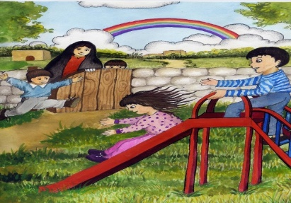
Read the answers and write the questions.
Practice
Check your answers.
Q1: ---------------------------------------------------?
Yousef rides his bike three times a day.
How often does Yousef ride his bike?
1
Q2: ------------------------------------------------?
It never snows in Bahrain.
How often does it snow in Bahrain?
2
Q3: ------------------------------------------?
She goes for a walk in the park twice a week.
How often does she go for a walk in the park?
3
Q4: --------------------------------------------------?
They go to the playground once a week.
How often do they go to the playground?
4
English-Grade6- Unit 3-Lesson3- (Grammar)

Slide 10
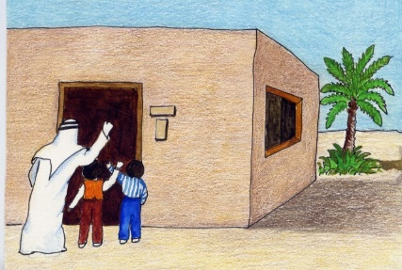
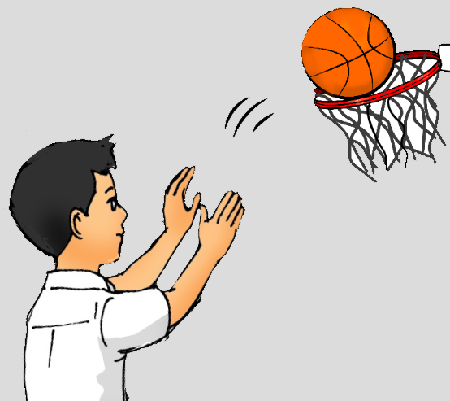
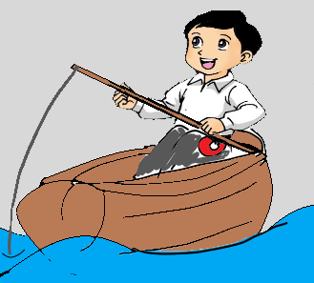
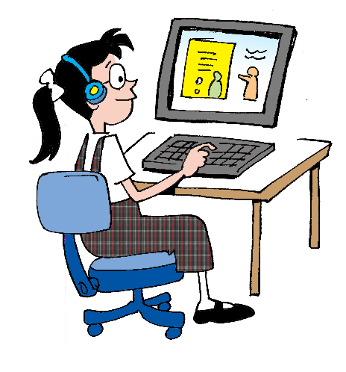
Answer the following questions using adverbials of frequency.
Practice
Check your answers.
Q1: How often do you visit your relatives? (1 x / week)
-----------------------------------------------------------------------------------
I visit my relatives once a week /one time a week.
1
Q2: How often does he play basketball? (2 x / week)
-----------------------------------------------------------------------------------
He plays basketball twice / two times a week.
2
Q3: How often does he go fishing? (3 x / month)
----------------------------------------------------------------------------
He goes fishing 3 times a month.
3
Q4: How often does she use the computer? (x… )
----------------------------------------------------------------------------
She uses the computer every day / daily .
4
English-Grade6- Unit 3-Lesson3- (Grammar)

Slide 11
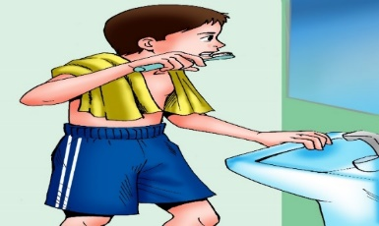
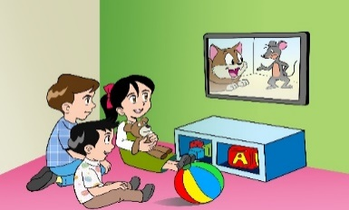
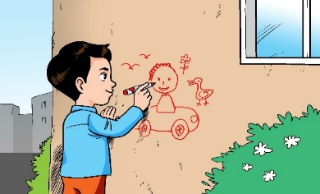
Write sentences using adverbs /adverbials of frequency.
Assessment
Check possible answers.
I brush my teeth three times a day.
---------------------------------------------------------------------------.
The kids watch cartoon every day.
----------------------------------------------------------------------------.
Ali reads a novel once a month.
----------------------------------------------------------------------------.
Sam never writes on the wall.
----------------------------------------------------------------------------.
Writing checklist
I used capital letters at the beginning of sentences. □ I used finger space between  words. □ I used the correct tense. I used a full stop (.) at the end of sentences. □ I checked my spelling. □ I used adverbs and adverbials of frequency.
English-Grade6- Unit 3-Lesson3- (Grammar)

Slide 12
End of the Lesson
Ministry of Education - 2020
English-Grade6- Unit 3-Lesson3- (Grammar)

