Slide 1
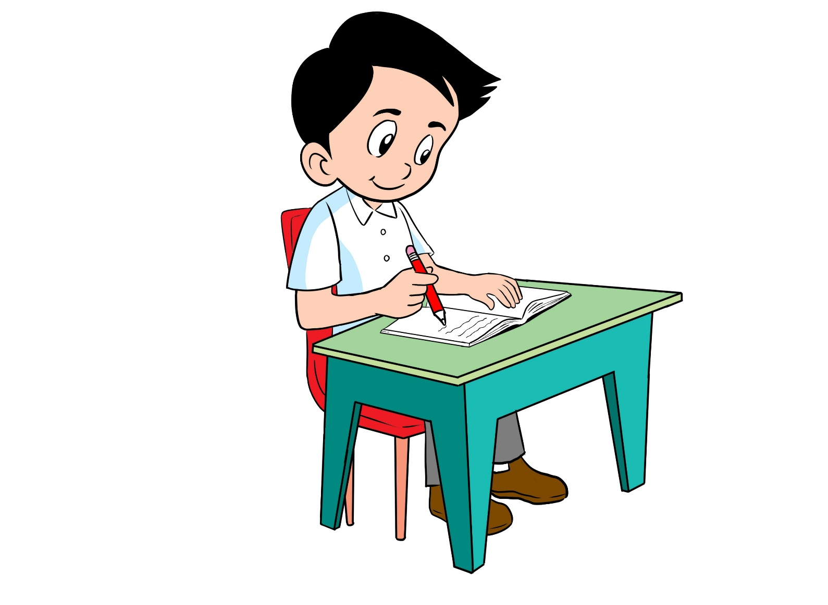
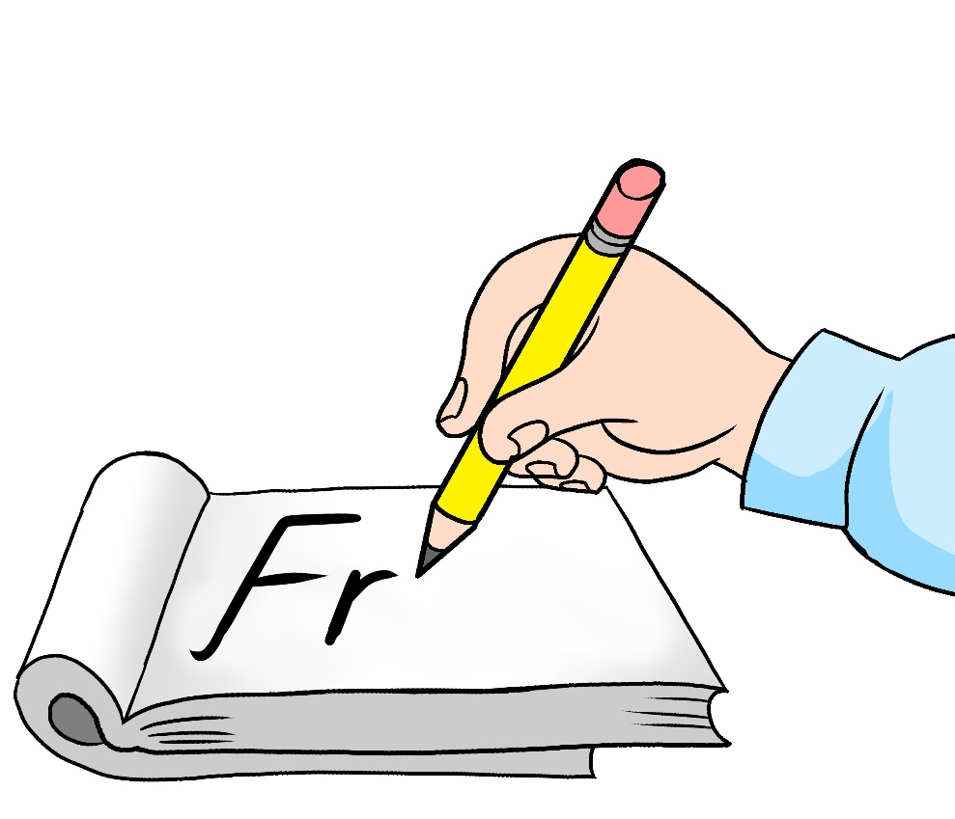
English
Family and Friends
Grade 6
Semester 1
Unit 2
Will it really happen?
Lesson 6- Writing

Slide 2
Lesson Objectives
To identify compound words.
To review the use of will/ won’t in forming sentences.
To write a paragraph about schools in the future using compound words and will /won’t.
Ministry of Education - 2020
English-Grade6- Unit 2-Lesson 6 (Writing)

Slide 3
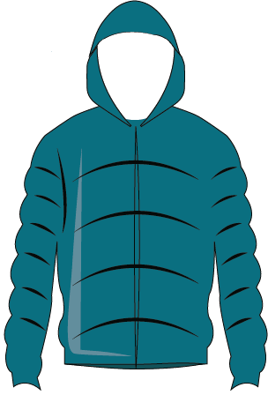
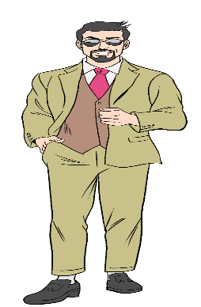
Compound Words
Read and learn
Compound words are formed when two or more words are joined together to create a new word that has a totally new meaning.
Ex: - fire + man fireman - make + up makeup
+
raincoat
rain
coat
+
snowman
snow
man
Ministry of Education - 2020
English-Grade6- Unit 2-Lesson 6 (Writing)

Slide 4
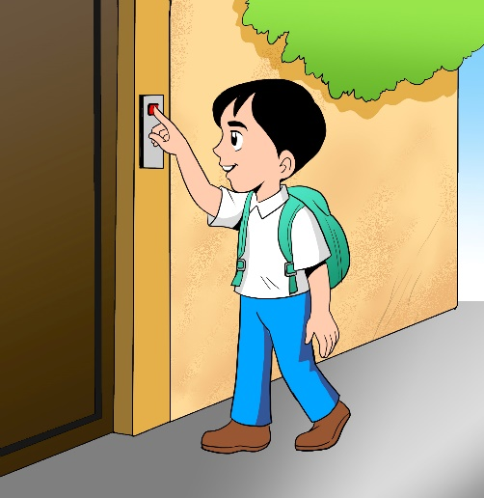
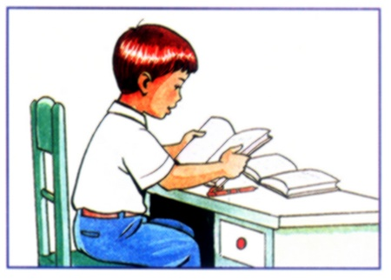
Write the correct compound word.
Check your answer
 | bell | door
 | cake | cup
 | work | home
 | flower | sun
+
doorbell
+
cupcake
+
homework
+
sunflower
Ministry of Education - 2020
English-Grade6- Unit 2-Lesson 6 (Writing)

Slide 5
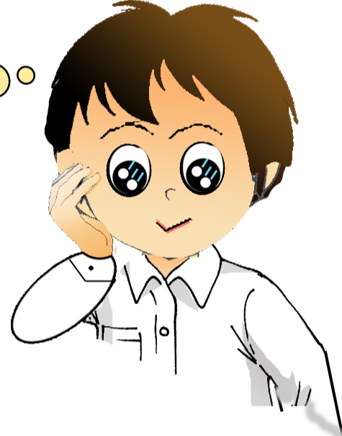
Remember!
People
will
travel
by spaceships.
They
won’t
wear
normal clothes.
I
win
the 1st place.
’ll
will
is used to predict the future.
Short form
I’ll = I will
won’t = will not
Affirmative
Negative
Ministry of Education - 2020
English-Grade6- Unit 2-Lesson 6 (Writing)
Why do we use will?

Slide 6
Remember!
We
will
wear
astronauts’ clothes.
They
won’t
wear
normal clothes.
I
You
We They
He
She
It
will
.
+
+
verb
+
sentence completion
won’t
How do we use will /won’t in a sentence?
Ministry of Education - 2020
English-Grade6- Unit 2-Lesson 6 (Writing)

Slide 7
Read to match the ideas with the paragraphs. Then underline will/won’t sentences and circle compound words.
Check the answers.
planet-home-animals
robots-school
weather-food
In 100 years’ time, I think people will be living on other planets and will travel in spaceships and rockets. I think they will live in electronic houses with glass walls. I also think that animals will stay on Earth and people will visit them whenever they want to see them.
I think there will be lots of airplanes and cars, so the weather will be polluted badly. People will have little of fresh fruit and vegetables, so they will eat more junk food. There will be food pills as well.
I think the robots will talk and help people so much but they won’t do students’ homework. Students won’t go to school, but will meet their teachers and friends in cool virtual places to learn.
Ministry of Education - 2020
English-Grade6- Unit 2-Lesson 6 (Writing)

Slide 8
Describe your own school of the future. Use the following notes:
Schools of the future
In 200 years’ time…
robot teachers - no books
video homework
laptops - electronic desks
travel to school –flying cars, spaceships
virtual reality playground
flying furniture- electronic with G.P.S system
------------------------------------------------------------------------------------------------------------------------------------------------------------------------------------------------------------------------------------------------------------------------------------------------------------------------------------------------------------------------------------------------------------------------------------------------------------------------------------------------------------------------------------------------------------------------------------------------------------------------------------------------------------------------------------------------------------------------------------------------------------------------------------------------------------------------------------------------------------------------------------------------------------------------------------------------------------------------------------------------------------------------------------------------
- Use compound words
Check possible answer.
In 200 years’ time, there will be robot teachers in virtual reality schools and classes. There won’t be books. Students will download information direct from the electronic desk and will have their own laptops to use for school.
There won’t be written homework. There will be video homework instead. Students will travel to school by flying cars and spaceships. The school won’t have real playgrounds, it will have virtual reality ones where students can play virtual reality exercises and games. There will be flying electronic chairs and desks with a G.P.S. system.
Writing Checklist
I used capital letters at the beginning of sentences. I checked my spelling. I used a full stop (.) at the end of sentences. I used finger  space  between  words.
Ministry of Education - 2020
English-Grade6- Unit 2-Lesson 6 (Writing)

Slide 9
End of the Lesson
Ministry of Education - 2020
English-Grade6- Unit 2-Lesson 6 (Writing)

