Slide 1
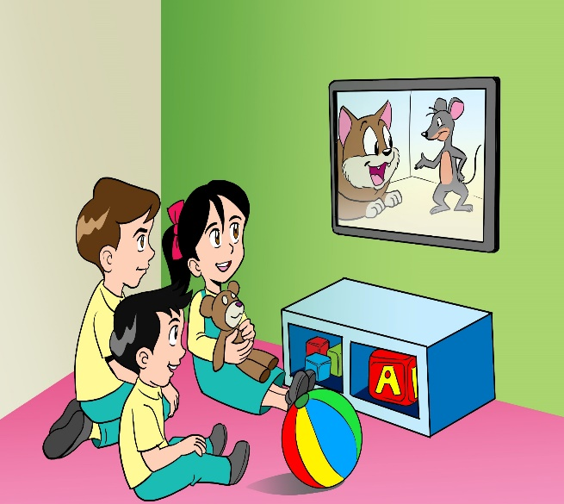
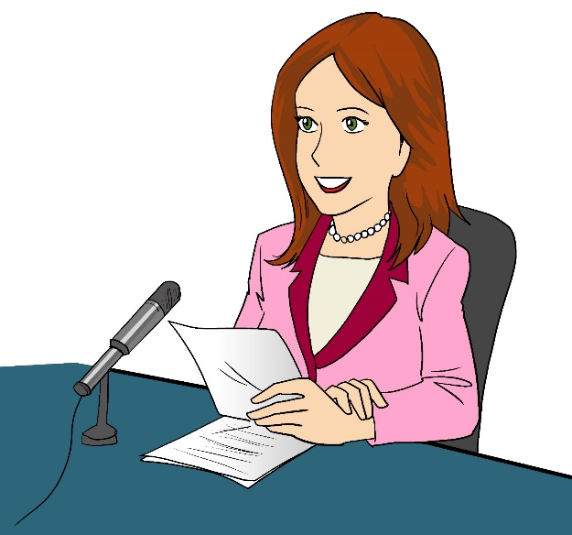
English
Family and Friends
Grade 6
Semester 1
Unit 3
Something new to watch!
Lesson1: Words
Today’s News

Slide 2
Lesson Objectives
To identify 10 new words.
To use the new words accurately.
To write accurate sentences using some of the new words.
Ministry of Education - 2020
English-Grade6- Unit 3-Lesson1- (Words)

Slide 3
Click, listen and read.
BUY NOW
cartoon
radio
camcorder
advert
Today’s News
channel
the news
mobile phone
remote control
Ministry of Education - 2020
English-Grade6- Unit 3-Lesson1- (Words)

Slide 4
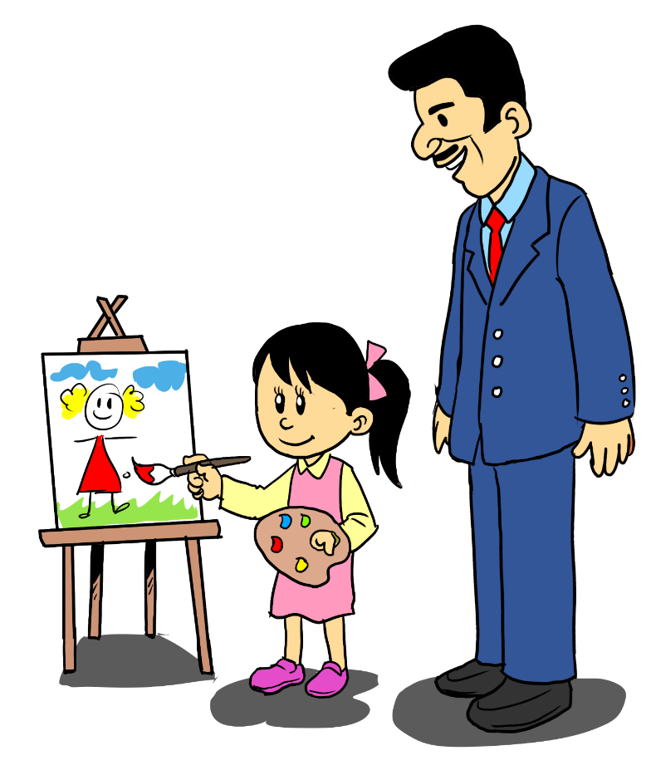
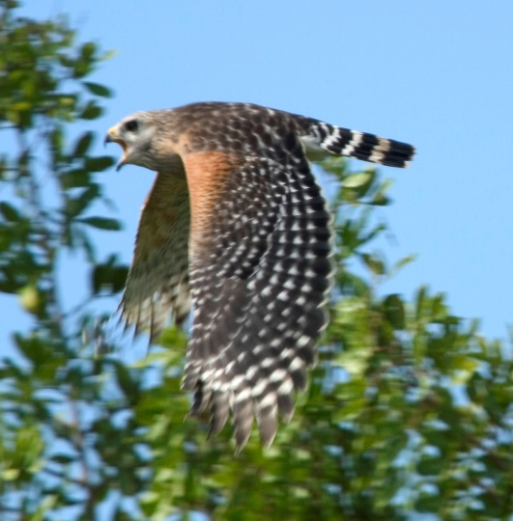
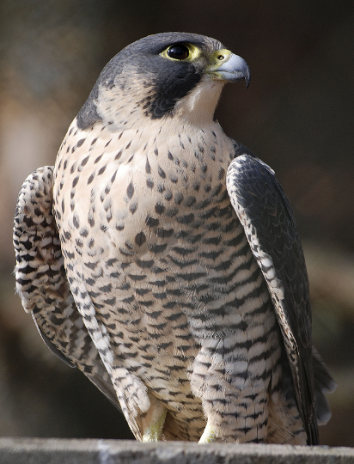
Click, listen and read.
The Art Show programme
TV programme
documentary
Ministry of Education - 2020
English-Grade6- Unit 3-Lesson1- (Words)
Ministry of Education - 2020

Slide 5
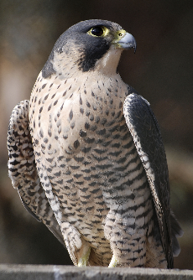
Look at the picture and choose the correct word. The correct answer will grow with colour.
Check your answers
camcorder
the news
BUY NOW
radio
advert
TV programme
remote control
documentary
channel
Ministry of Education - 2020
English-Grade6- Unit 3-Lesson1- (Words)

Slide 6
Try to guess what it is. There are extra words that you don’t need.
I’m in your hand. Sometimes I ring. Sometimes I vibrate. You talk through me.
Check your answers
the news
I’m two in one. I can be a video camera and a video cassette recorder.
documentary
camcorder
When you switch on the TV you get me. You can change me from one to another.
advert
mobile
phone
cartoon
When you watch me you get to know the latest of what is happening in the world.
channel
Ministry of Education - 2020
English-Grade6- Unit 3-Lesson1- (Words)

Slide 7
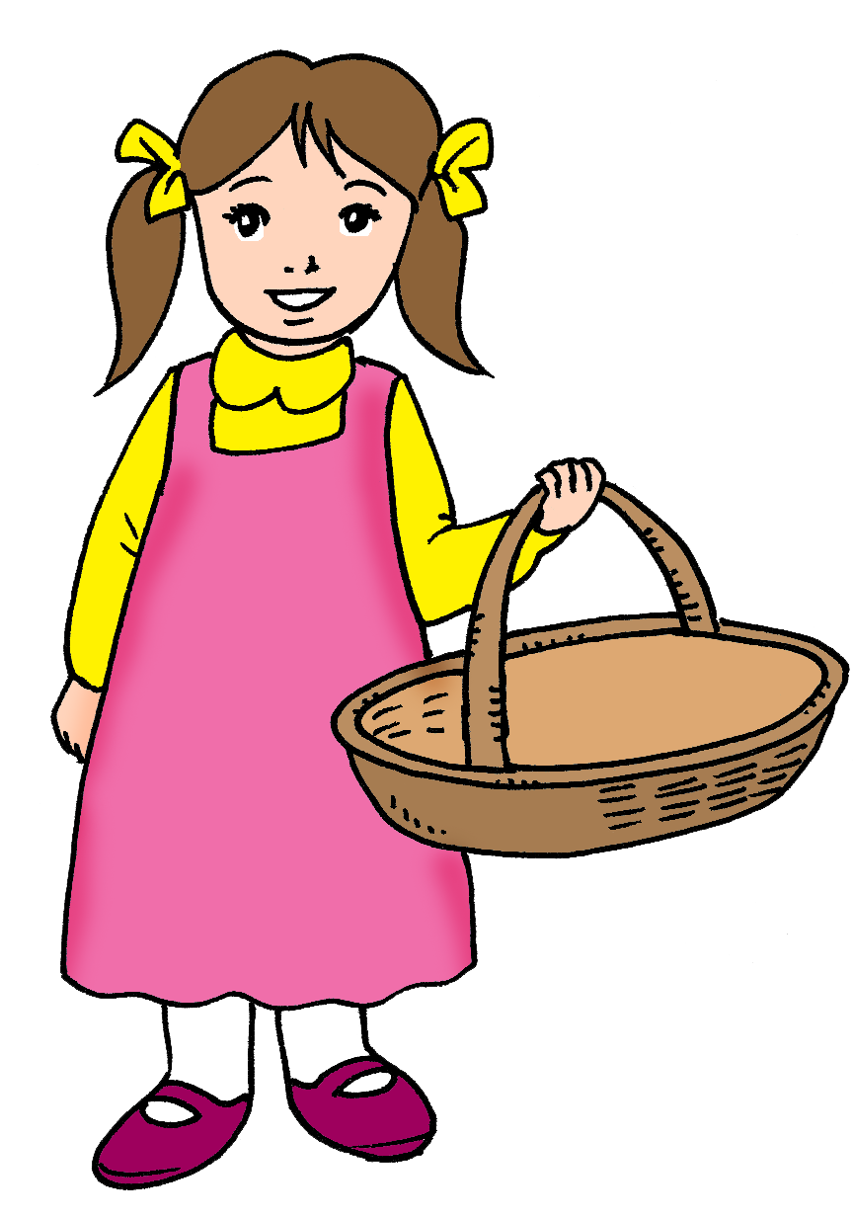
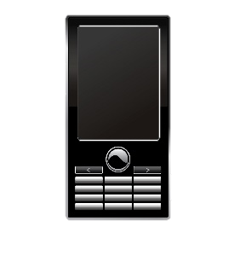
Read and complete using the correct words.
Check your answers.
camcorder
documentaries
channel
adverts
TV programmes
remote control
the news
mobile phone
In the basket, there is a _______________ , a ____________ , and a __________________.
On TV, you can watch_____________ , ___________________ , __________________ , and ______________.
Ministry of Education - 2020
English-Grade6- Unit 3-Lesson1- (Words)

Slide 8
Possible answers
Look at the pictures and write sentences.
4-5words 6-7words 8-9 words
I like watching cartoon with my
little brother.
My dad bought a new camcorder.
When my mother watches the news, she doesn’t like to be disturbed.
Yesterday, I watched a documentary about falcons.
Writing checklist
I used capital letters at the beginning of sentences. □ I used finger space between  words. □ I used the correct tense. I used a full stop (.) at the end of sentences. □ I checked my spelling. □ I used the new words.
Ministry of Education - 2020
English-Grade6- Unit 3-Lesson1- (Words)

Slide 9
End of the Lesson
Ministry of Education - 2020
English-Grade6- Unit 3-Lesson1- (Words)

