Slide 1
English
Family and Friends 6
Grade 6
Semester 1 Unit 1
The food here is great! Lesson 1: Words

Slide 2
Lesson Objectives
1-To identify 10 new words connected with restaurants.
2-To use the new words connected with restaurants correctly.
3-To identify waiter/customer conversation pattern.
Ministry of Education - 2020
English-Grade 6- Unit 1- Lesson 1 (Words)

Slide 3
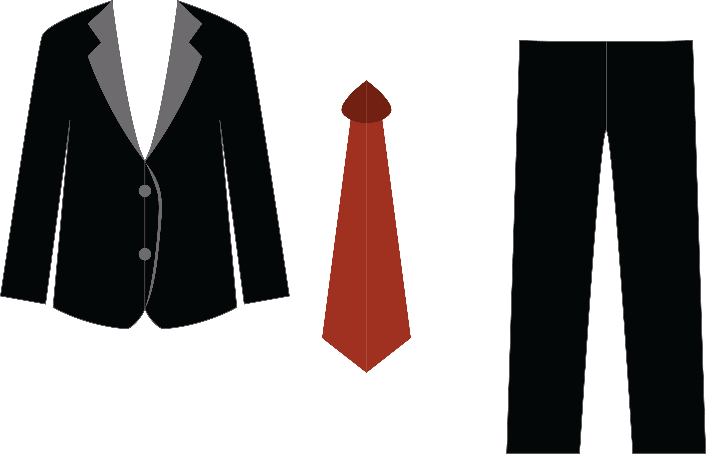
Look at the pictures and learn new words connected to restaurants.
waiter
waitress
uniform
Ministry of Education - 2020
English-Grade 6- Unit 1- Lesson 1 (Words)

Slide 4
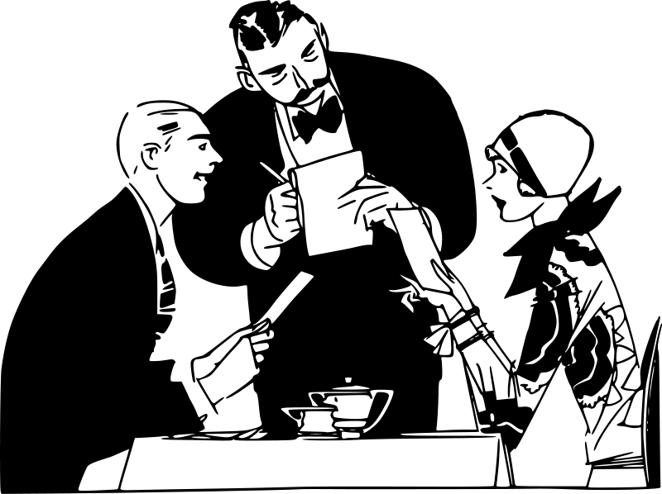
Look at the pictures and learn new words connected to restaurants.
bottle of water
menu
customer
Ministry of Education - 2020
English-Grade 6- Unit 1- Lesson 1 (Words)

Slide 5
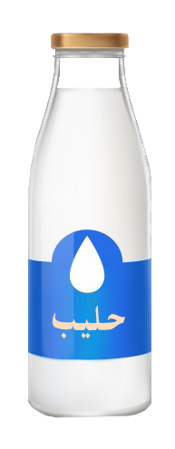
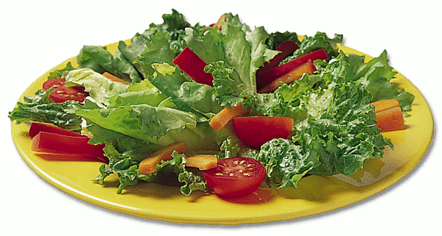
Look at the pictures and learn new words connected to restaurants.
cup of coffee
glass of milk
bowl of soup
plate of salad
milk
Ministry of Education - 2020
English-Grade 6- Unit 1- Lesson 1 (Words)

Slide 6
Now check your answers
Practice (Crossword Puzzle)
Down:
1: You pour water, milk and juice into this.
2: These people eat at the restaurant.
3: A list of the foods that may be ordered at a restaurant.
6: A person who serves at tables as in a restaurant.
8: It is used for serving foods and soups.
Across:
4: Coffee and tea come in this.
5: You eat your salad from this.
7: The clothes that waiters wear.
8: Water comes in this.
Ministry of Education - 2020
English-Grade 6- Unit 1- Lesson 1 (Words)

Slide 7
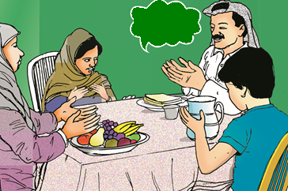
Read and fill in the blanks using the correct
word.
Click to check your answers
Excuse me!
Yesterday, I went with my family to a restaurant. The ________ gave us the ________. I only ordered a ________ of coffee. My father ordered a bowl of ________. My brother wanted a cheese sandwich with a glass of ________ and my mother wanted a ________ of fruit. The waiter offered us a free ________ of water.
cup
bottle
waiter
soup
plate
menu
milk
Ministry of Education - 2020
English-Grade 6- Unit 1- Lesson 1 (Words)

Slide 8
Read and match to (waiter) or to (customer).
Click to check your answers
I’d like a plate of spaghetti, please.
Would you like a bottle of water?
Can I have a cup of coffee, please?
Here is the menu, sir.
Here’s your soup.
I would like to have some salad, please.
Waiter | Customer
Ministry of Education - 2020
English-Grade 6- Unit 1- Lesson 1 (Words)

Slide 9
End of the Lesson
Ministry of Education - 2020
English-Grade 6- Unit 1- Lesson 1 (Words)

