Slide 1
Grade 6
English
Family and Friends
Unit 8 – We were fishing
Lesson 3 - Grammar

Slide 2
Lesson Objectives
To write dates correctly.
To write sentences using was born+ dates correctly.
Ministry of Education - 2020

Slide 3
How to say dates in English?
Read the following dates:
3rd October 2019
the third of October, two thousand and nineteen.
20th April 2007
the twentieth of April , two thousand and seven.
Sequence
day
month
year
1st
First
January
July
2nd
second
2007 - two thousand and seven
February
August
3rd
third
March
September
4th
1997 - Nineteen ninety-seven
fourth
October
April
14th
fourteenth
May
November
2019 - two thousand and nineteen
20th
twentieth
June
December
21st
twenty first

Slide 4
More examples
Read the following examples.
When is their birthday?
It’s on the third of April , nineteen ninety-five.
3rd April 1995
It’s on the fourteenth of June , two thousand and ten.
14th June 2010

Slide 5
Practice
Now try to say the dates of the followings.
Fifth
August
two thousand and one
__________________________________________
It’s on the fifth of August , two thousand and one. ( 5th August 2001)
second
December
ninetieth ninety-one.
__________________________________________
It’s on the second of December , nineteen ninety-one. ( 2nd December 1991)
Seventieth
February
ninetieth eighty-four.
__________________________________________
It’s on the Seventieth of February , nineteen eighty-four. ( 17th February 1984)

Slide 6
Practice
Write the dates correctly. Then click to check your answers.
22nd September 1967
Its on the twenty second of September, nineteen sixty-seven.
Its on the twenty ninth of January, two thousand and eleven.
29th January 2011
30th May 2012
Its on the thirtieth of May, two thousand and twelve.
9th March 1997
Its on the ninth of March, nineteen ninety- seven.

Slide 7
How do you answer the following question ?
When were you born?
month
You can say…
I was born in October.
day
OR
I was born on the first of October , two thousand and one.
Ministry of Education - 2020

Slide 8
Practice
Look at the pictures and write sentences.
Example : He was born on the first of May, two thousand and ten.
1st/ 5/2010
Now Write sentences for the following pictures.
He was born on the third of July, two thousand and twelve.
3rd/7/2012
She was born on the fourth of August, two thousand and seventeen.
4th/ 8/2017
They were born on the sixtieth of February, two thousand and six.
16th/ 2 /2006
Notes:
v

Slide 9
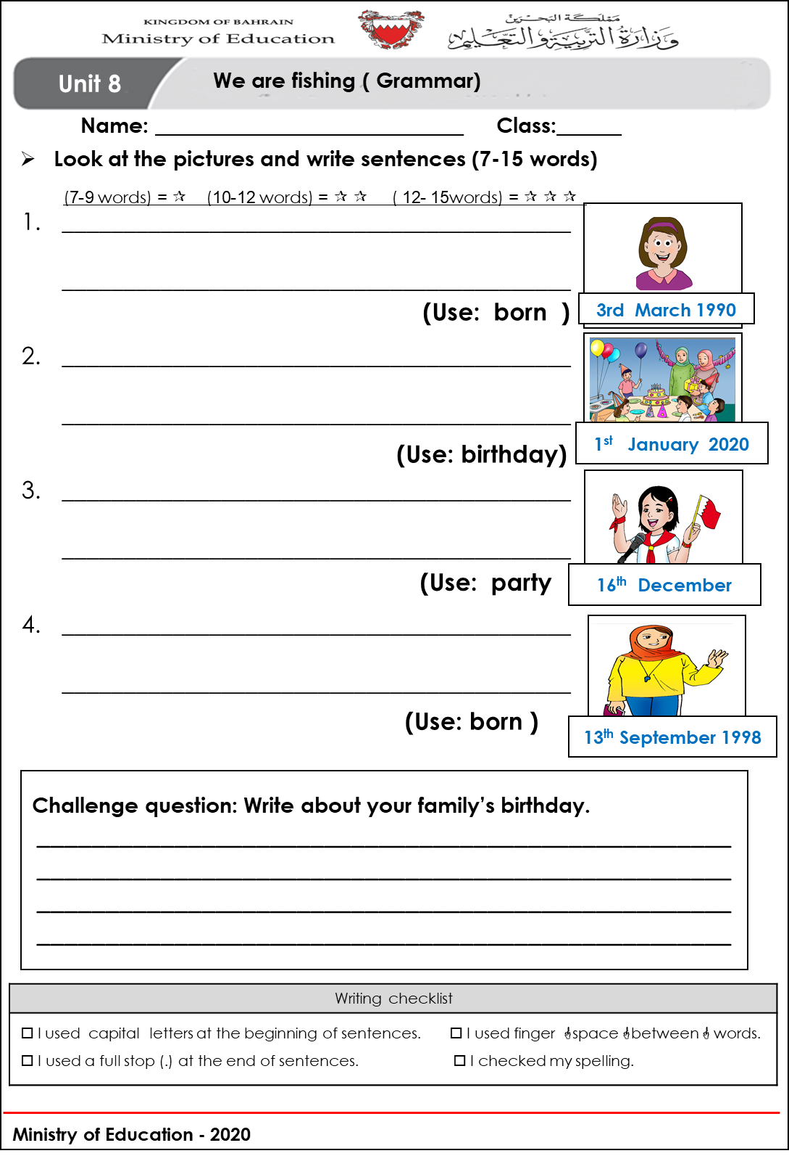
Worksheet time ! Check the worksheet and write sentences
Notes:
v

Slide 10
Possible answers ☺
She was born on the third of March , nineteen ninety-nine.
Mohammed’s birthday is on the first of January, two thousand and twenty.
We celebrate the national day on the sixteenth of December every year.
My teacher was born on the thirteenth of September, nineteen ninety-eight.
Notes:
v

Slide 11
End of the Lesson
Notes:
v

