Slide 1
English Family and Friends 6 Grade 6 Semester 1 Unit 3 Something new to watch! Review

Slide 2
Lesson Objective:
- To review key language and grammar of unit 3.

Slide 3
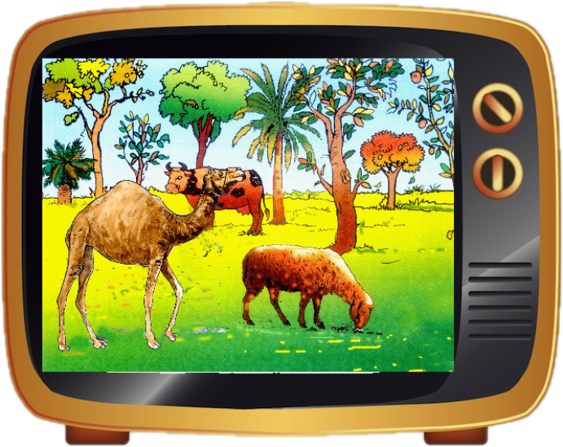
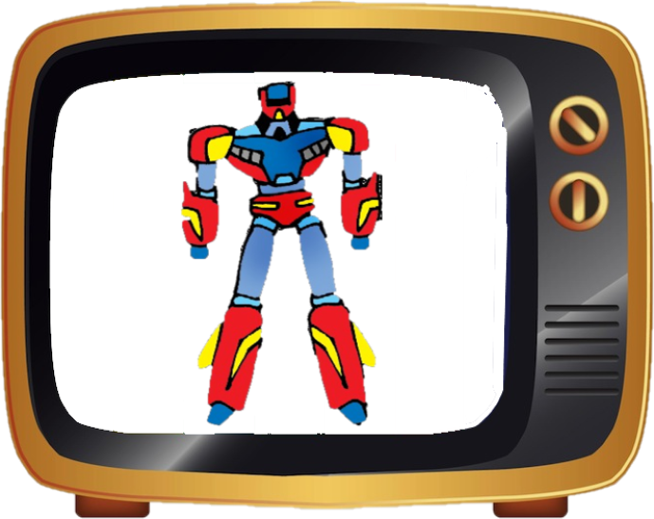
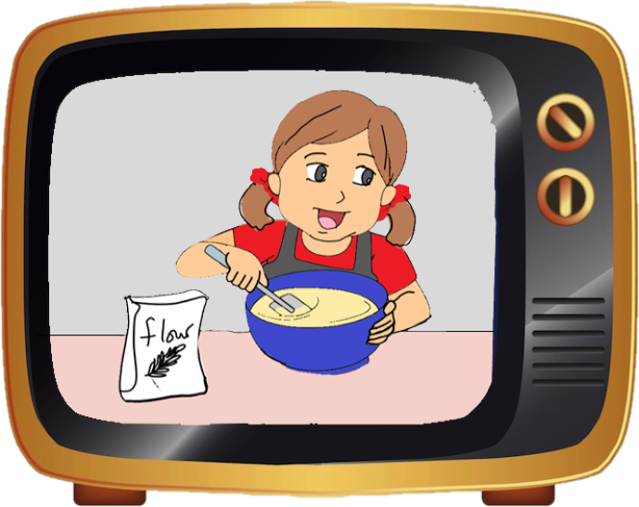
Circle the correct answer.
Click for answers.
1
t | a | d | c | c | a | r | t | o | o | n | m | m
v | g | h | k | l | z | a | d | v | e | r | t | b
p | l | l | o | m | t | d | c | x | y | u | i | l
r | n | l | m | f | h | i | o | o | s | c | u | r
o | p | h | d | r | e | o | e | w | q | a | z | p
g | x | c | f | e | n | m | s | d | e | r | t | t
r | e | m | o | t | e | c | o | n | t | r | o | l
a | h | e | w | q | w | x | v | h | n | m | l | p
m | x | q | n | d | s | o | p | s | q | b | e | r
m | o | b | i | l | e | p | h | o | n | e | m | k
e | d | o | c | u | m | e | n | t | a | r | y | l
5
2
6
3
7
4
8
Ministry of Education - 2020
English-Grade6- Unit 3- (Review)

Slide 4
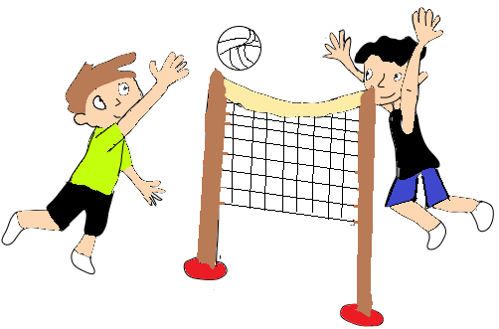
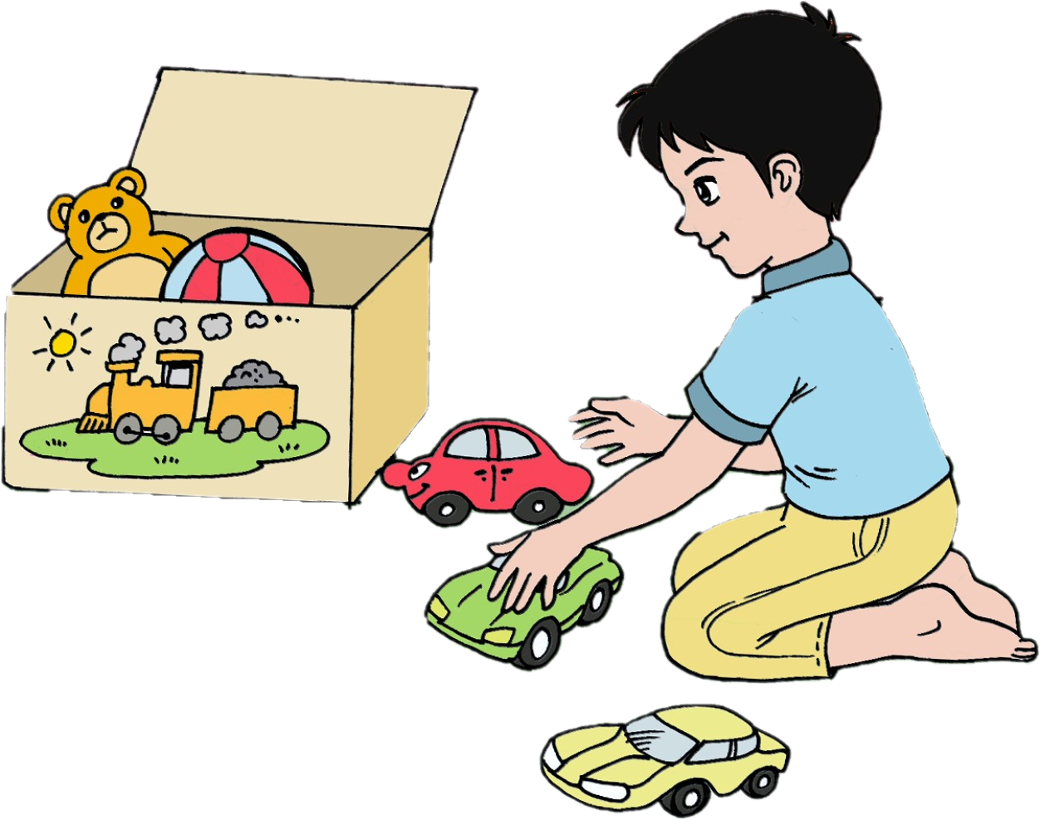
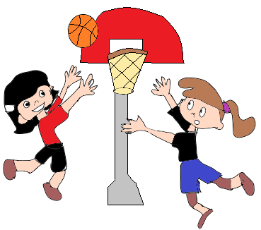
Put the words in the right order and write how often things happen in reference to the pictures.
Click for answers
1
Every Monday and Tuesday
2
Everyday
1- They / play / volleyball.
____________________________________
2- He / play / with his toys.
_____________________________________
3- He / water / plants.
______________________________________
4- They / play / basketball.
______________________________________
They play volleyball twice a week.
He plays with his toys everyday.
3
Every Friday, Tuesday and Sunday
4
Every Friday
He waters the plants three times a week.
They play basketball once a week.
Ministry of Education - 2020
English-Grade6- Unit 3- (Review)

Slide 5
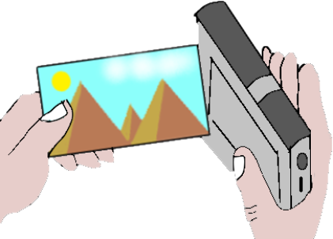
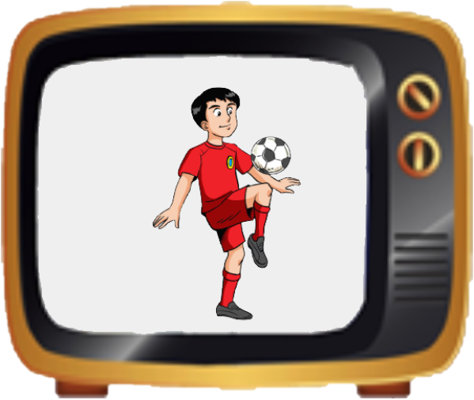
Fill in the gaps with the right words from the box.
Click for answers.
football programme
mobile phone
camcorder
documentary
cartoon
channel
1
2
3
4
5
6
Ministry of Education - 2020
English-Grade6- Unit 3- (Review)

Slide 6
Put the words in the right order and use the infinitive of purpose.
Click for answers
1- uses the TV / watch movies / Martin. ________________________________________________________________________
2- learn about animals / Hanna / reads the book.
________________________________________________________________________
3- Anna / cook dinner / use the oven.
________________________________________________________________________
4- change the channel / uses the remote control / Ahmed.
________________________________________________________________________
5- I / take videos / use the camcorder.
________________________________________________________________________
Martin uses the TV to watch movies.
Hanna reads the book to learn about animals.
Anna uses the oven to cook dinner.
Ahmed uses the remote control to change the channel.
I use the camcorder to take videos.
Ministry of Education - 2020
English-Grade6- Unit 3- (Review)

Slide 7
End of the Review Lesson
Ministry of Education - 2020
English-Grade6- Unit 3- (Review)

