Slide 1
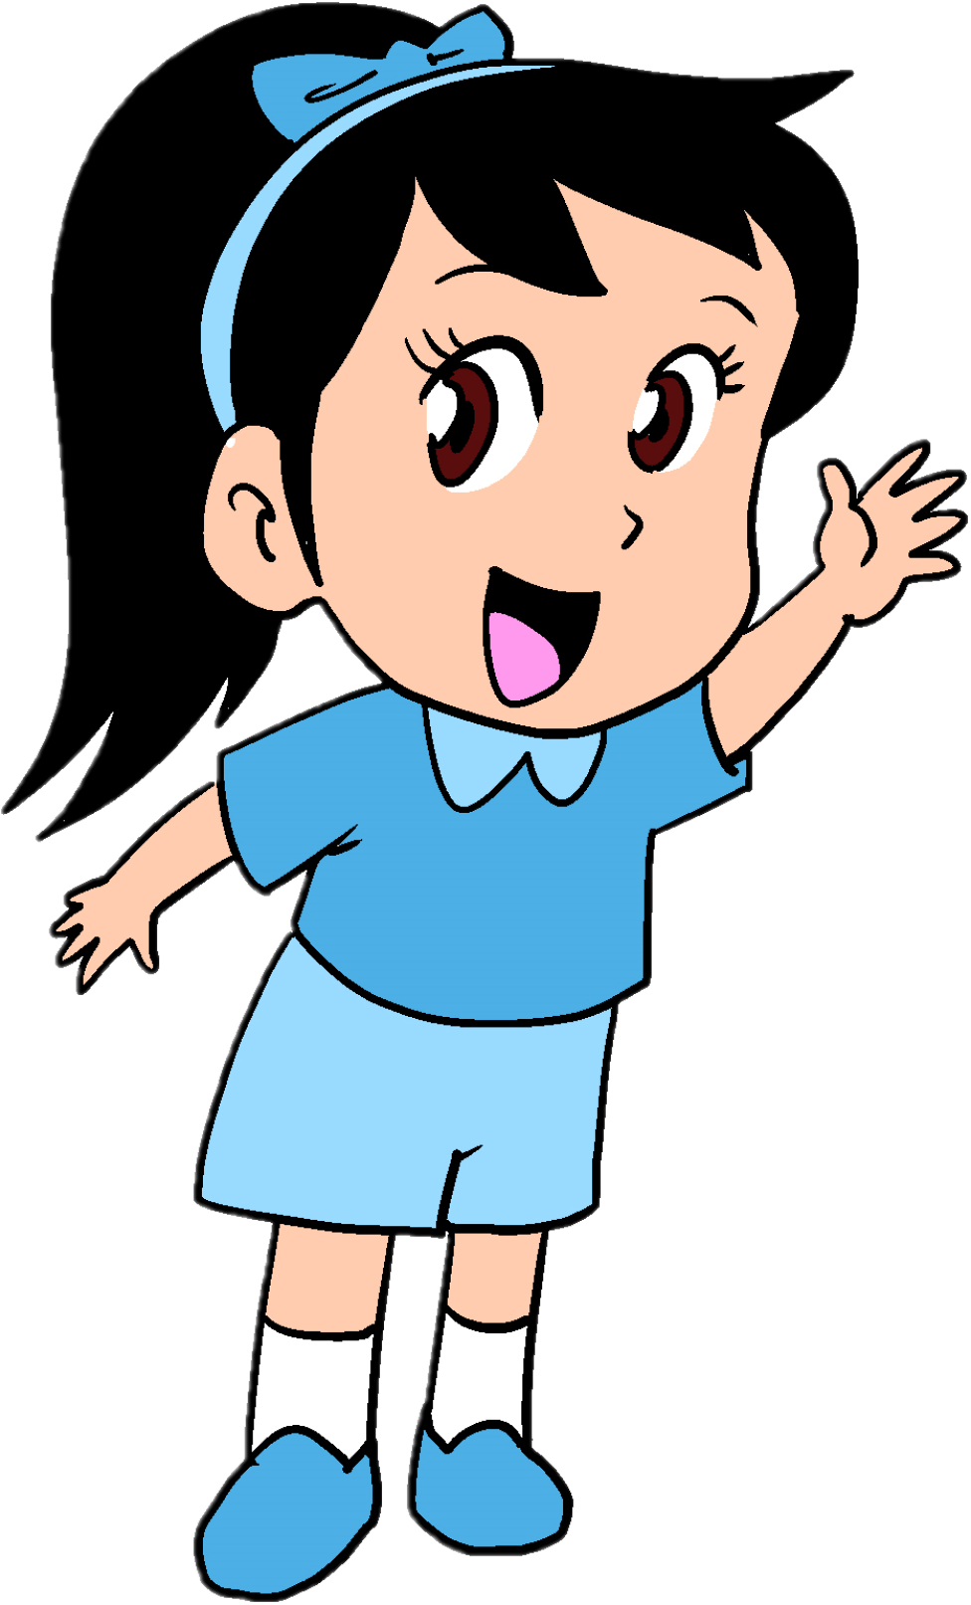
English Family and Friends 6 Grade 6 Semester 2 Unit 9 Good news, bad news Lesson 3 - Grammar

Slide 2
Lesson Objectives
1- To recognise homophones ‘ there’, ‘they’re’ and ‘their’.
2- To use homophones ‘ there’, ‘they’re’ and ‘their’ correctly.
Ministry of Education – Second Semester 2020/2021
English - Grade 6 – Unit 9 – Lesson 3 (Grammar)

Slide 3
Presentation
Read and learn.
Today we are going to learn about homophones there, they’re and their.
What are homophones?
Homophones, are words that sound the same but have a different meaning!
Ministry of Education – Second Semester 2020/2021
English - Grade 6 – Unit 9 – Lesson 3 (Grammar)

Slide 4
Presentation
Read and learn.
there
Look at these 3 words.
They sound the same but are spelt differently.
they’re
their
1. There: a place, or to say what is present.
for example:
- There is a new mall in our city.
- I live there.
Ministry of Education – Second Semester 2020/2021
English - Grade 6 – Unit 9 – Lesson 3 (Grammar)

Slide 5
Presentation
Read and learn.
2. they’re: short form of they are.
For example:
- They’re all my favourite games.
Now, can you use “there” in a sentence?
3. their: shows possession by more than one person.
For example:
- I didn’t know that it was their cat.
Yes, I can!
- There was a bird singing next to my window.
Ministry of Education – Second Semester 2020/2021
English - Grade 6 – Unit 9 – Lesson 3 (Grammar)

Slide 6
Practice
Check your answers
Fill in the blanks with the correct word.
there they’re their
Harry and Sam are ________________ friends.
___________ is my friend, I can see him.
___________ my cousins.
___________ in the garden.
___________ is only one red flower in the vase.
___________ teacher is coming to our class today.
their
There
Remember!
-there: a place, or to say what is present
-their: shows possession by a person or more
-they’re: they are
They’re
They’re
There
Their
Ministry of Education – Second Semester 2020/2021
English - Grade 6 – Unit 9 – Lesson 3 (Grammar)

Slide 7
Practice
Check your answers
Circle the correct word.
The teacher told them to leave books on the desk.
We’ll go to the coffee shop if is time.
They are baking a cake for little sister.
Can you give me mobile number.
Ask them if coming tomorrow.
Sam is always on time.
there - their - they’re
there - their - they’re
there - their - they’re
there - their - they’re
there - their - they’re
there - their - they’re
Ministry of Education – Second Semester 2020/2021
English - Grade 6 – Unit 9 – Lesson 3 (Grammar)

Slide 8
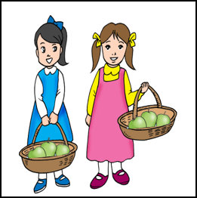
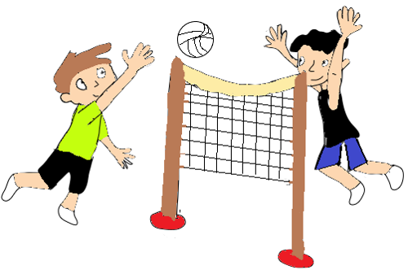
Check your answers
Practice
Look at the pictures and write sentences using there, they’re or their.
are-three-apples-in- each-basket
- There are three apples in each basket.
are-cleaning-the-table
- They’re cleaning the table.
they-were-happy-because- team-won
- They were happy because their team won.
are-two-red-cushions-on the-couch
- There are two red cushions on the coach.
Ministry of Education – Second Semester 2020/2021
English - Grade 6 – Unit 9 – Lesson 3 (Grammar)

Slide 9
Assessment
Check possible answers
Write sentences using (there - their - they’re)
4-5words 6-7words 8-9 words
there
There are over 200 passengers on board.
their
Adam and Flora bought a new house. Their new house is very big.
they’re
I invited my friends. They’re coming to my house tonight
Writing Checklist
I used capital letters at the beginning of sentences. □ I used finger space between  words. I used a full stop (.) at the end of sentences. □ I checked my spelling. I used the correct tense. □ I used there, their, they’re
Ministry of Education – Second Semester 2020/2021
English - Grade 6 – Unit 9 – Lesson 3 (Grammar)

Slide 10
End of the Lesson
Ministry of Education – Second Semester 2020/2021
English - Grade 6 – Unit 9 – Lesson 3 (Grammar)

