Slide 1

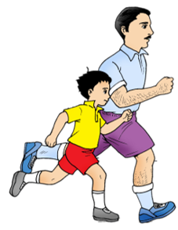
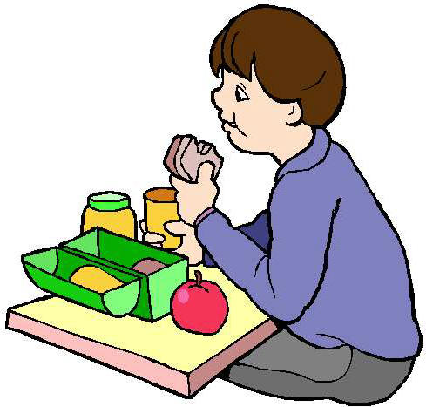
English
Family and Friends
Grade 6
Semester 2
Unit 6
What’s the matter?
Lesson 5 - Reading and Listening

Slide 2

Lesson Objectives
To read an information leaflet about how to stay healthy and extract specific details.
To listen to a text about a healthy lifestyle for general understanding / specific information.
English -Grade 6– Unit 6 – Lesson 5 (Reading and Listening)

Slide 3
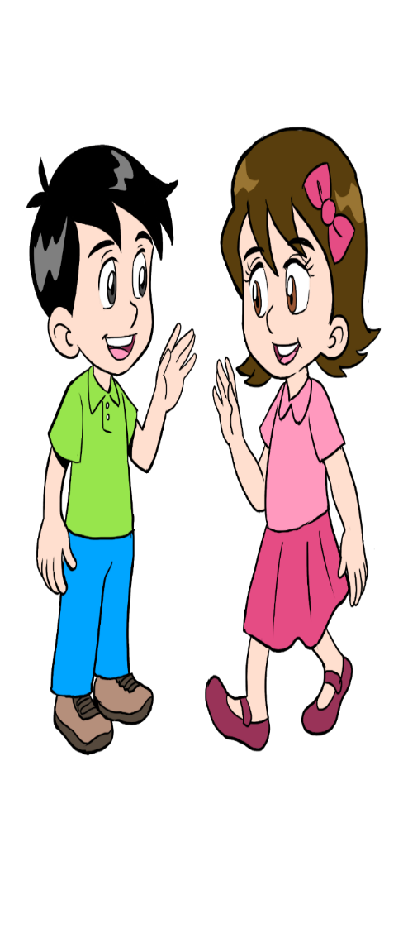

Pre-reading
Click on the word to hear how it’s pronounced.
Use a dictionary to find out the meaning of these new words.
energy
sugar
calcium
healthy
fit
crisps
cabbage
sardines
English -Grade 6– Unit 6 – Lesson 5 (Reading and Listening)

Slide 4
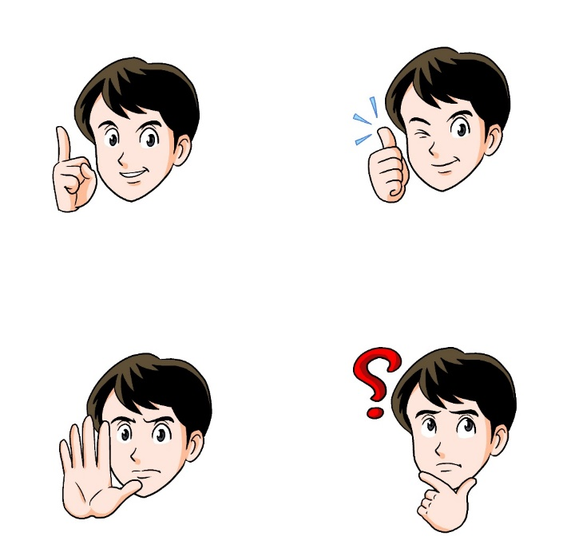
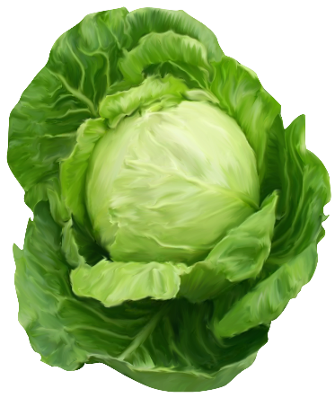
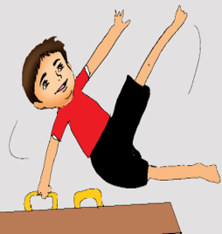
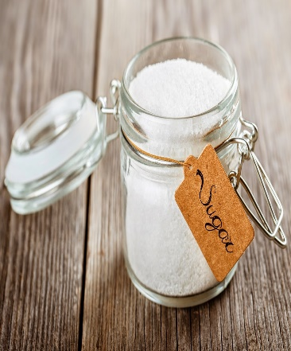
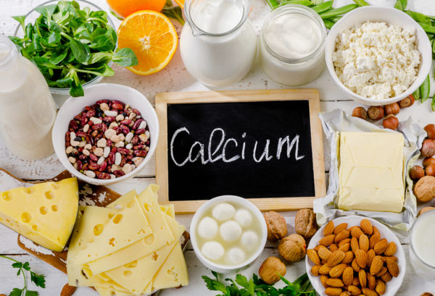
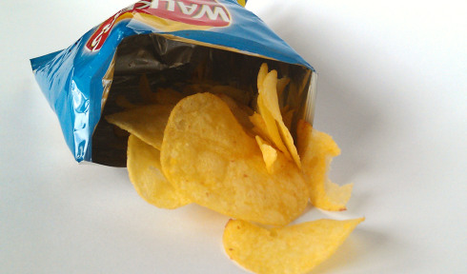
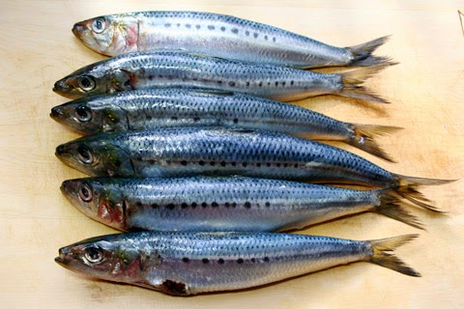
New Words
Check your answers
Match the words with the pictures.
1. healthy
7. cabbage
2. fit
3. energy
4. sugar
5. calcium
2. fit
6. sardines
3. energy
6. sardines
5. calcium
1.healthy
8. crisps
7. cabbage
4. sugar
8. crisps
English -Grade 6– Unit 6 – Lesson 5 (Reading and Listening)

Slide 5
New Words
Check your answers
Read then match each word with its meaning.
Write the correct letter in the box beside each word.
1. healthy | A. When you have energy, you feel strong and want to do lots of exercise.
2. fit | B. A type of food made of very thin, flat pieces of potato.
3. energy | C. A vegetable with big green leaves which you cook.
4. crisps | D. Something that is in some foods, for example, cheese and milk.
5. sugar | E. If you are fit, you can do a lot of exercise without getting too tired.
6. cabbage | F. A type of food that is used to make things sweet.
7. calcium | G. A type of small fish.
8. sardines | H. A person who looks after his/her body, or something which is good for you.
H
E
A
B
F
C
D
G
English -Grade 6– Unit 6 – Lesson 5 (Reading and Listening)

Slide 6
Practice
Check your answers
Use the words given to complete the sentences.
healthy
fit
sugar
cabbage
sardines
crisps
1. Salman and Ahmed go to the gym everyday, they want to be ________________.
fit
2. Some drinks have lots of _________________, they are unhealthy.
sugar
3. Linda is a very _______________ person, she has a good diet system and drinks a lot of water.
healthy
4. Harry prefers home baked potato _______________ because it is lower in fat.
crisps
5. Now, we add fresh _________________on our salad. Then, we serve it.
sardines
6. ______________ is a big green vegetable that could be eaten both ways raw or cooked.
Cabbage
English -Grade 6– Unit 6 – Lesson 5 (Reading and Listening)

Slide 7
Practice
Check your answers.
Write one sentence for each word.
healthy
To have a healthy body, you should eat healthy food.
sugar
Sam would like some sugar for his tea.
fit
We exercise everyday because we want to be fit.
crisps
We don’t like crisps. We prefer baked potato.
English -Grade 6– Unit 6 – Lesson 5 (Reading and Listening)

Slide 8
Read “How to stay healthy?”
Then answer the questions that follow.
Use a dictionary to find out the meaning of the new words.
To have a healthy body is not that easy and is not hard in the same time. Unhealthy people can easily get sick if they do not take enough care of their body and watch out what they eat. Here are some tips to help you be healthy.
Have healthy food:
Eating a lot of unhealthy food that contains a lot of sugar, salt and fat like crisps, chocolate, ice-cream, sweets, and cakes can be very harmful on the long run. You can have some of these foods occasionally and not regularly. Try to have food which has more nutrients and of benefit to your body. You should include fresh fruit and vegetables, dairy and fish in your daily life meals.
2. Do not skip any meal:
Do not skip any of the three main meals. Breakfast, lunch and dinner are important meals for the wellbeing of your body. Skipping one of these regularly will affect your health. This may cause health problems in the future.
3. Drink a lot of water:
Always remember to drink at least 8 glasses of water everyday. If you don’t drink enough water, your body will be dehydrated. This can lead to further health problems in the future too.
English -Grade 6– Unit 6 – Lesson 5 (Reading and Listening)

Slide 9
Post-reading
Check your answers
Answer the questions.
List the three suggested tips to help you be healthy?
1-Have healthy food 2-Do not skip any meal 3-Drink a lot of water.
2. What types of food contains large amount of sugar, salt and fat?
Food like crisps, chocolate, ice-cream, sweets and cakes.
3. What happens if you skip one of the meals regularly?
Skipping one of the important meals regularly will affect our health.
4. What happens if we don’t drink enough water?
Our body will be dehydrated. This can lead to further health problems in the future too.
.
English -Grade 6– Unit 6 – Lesson 5 (Reading and Listening)

Slide 10
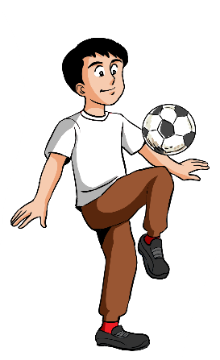
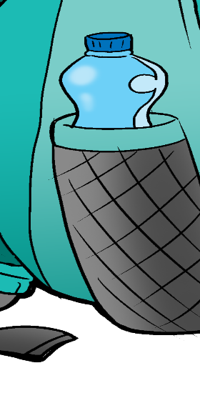
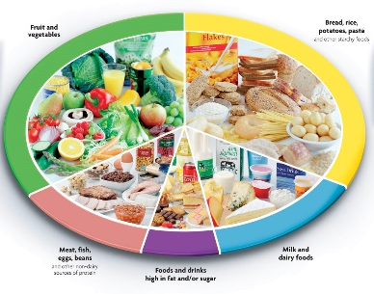
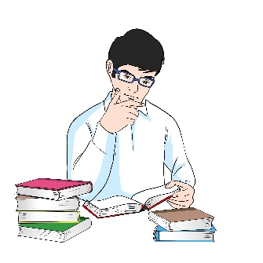
Listen and fill in the blanks
Play your favourite sport.
Check possible answers.
Exercise / fit
diet/fruit and vegetable
Healthy Lifestyle Tips
Drink water.
Read books.
English -Grade 6– Unit 6 – Lesson 5 (Reading and Listening)

Slide 11

Check your answers
Listen again and write true or false.
True
False
 |  | It is not important to start your day with some exercise. | 1
 |  | All three meals are important. | 2
 |  | We should drink at least 1 liter of water daily. | 3
 |  | To have a relaxing lifestyle, we should walk more, keep our self-busy with our hobbies. | 4
False
True
False
True
English -Grade 6– Unit 6 – Lesson 5 (Reading and Listening)

Slide 12
End of the Lesson
English -Grade 6– Unit 6 – Lesson 5 (Reading and Listening)

