Slide 1

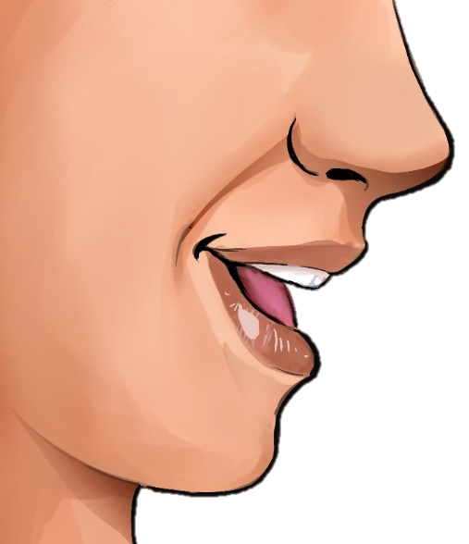

English
Family and Friends
Grade 6
Semester 2
Unit 6
What’s the matter?
Lesson 4: Phonics
er
or

Slide 2

Lesson Objective
- To realise that words ending with ‘er’ and ‘or’ have the same sound.
English -Grade 6– Unit 6 – Lesson 4 (Phonics)

Slide 3
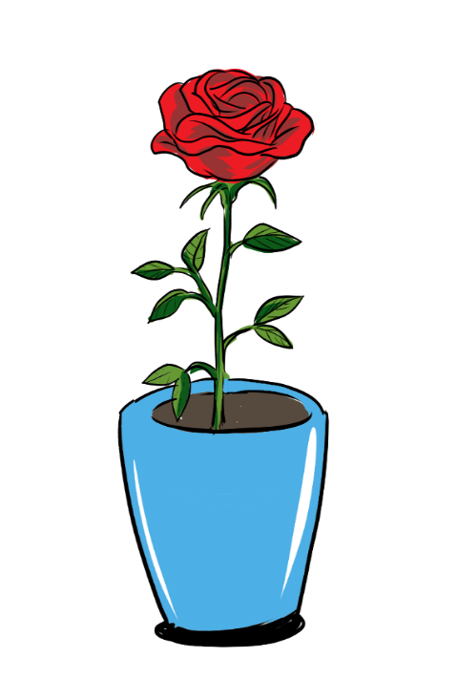
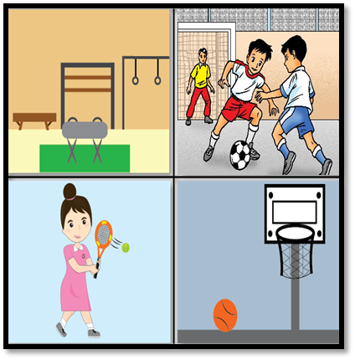
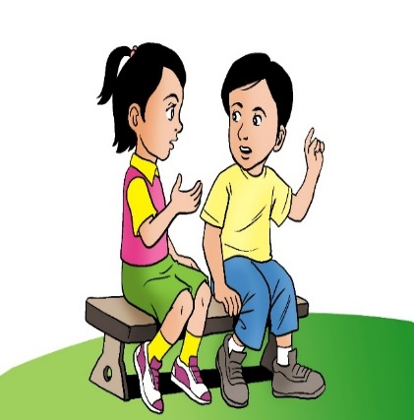

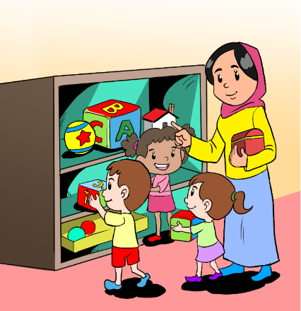
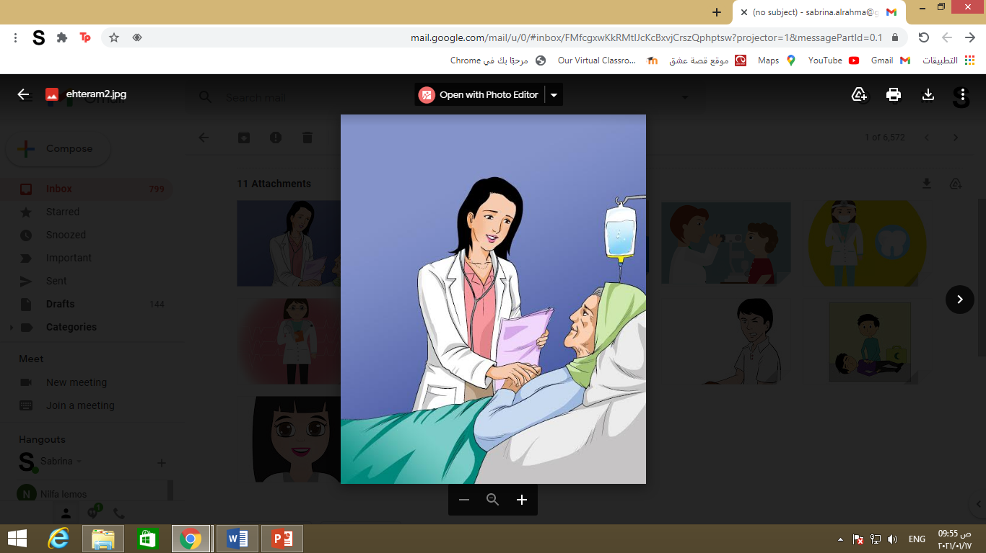
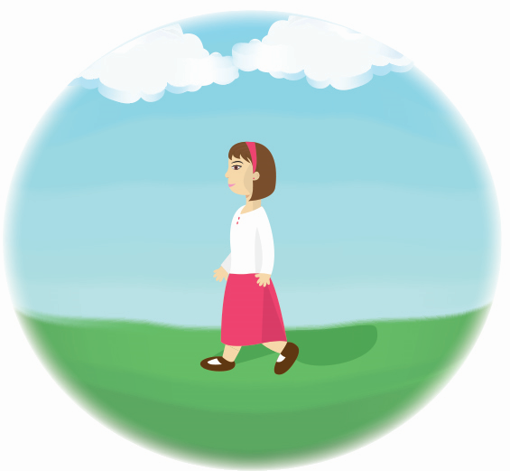
Presentation
Read, click on the word and listen.
flower
player
brother
teacher
doctor
weather
English -Grade 6– Unit 6 – Lesson 4 (Phonics)

Slide 4
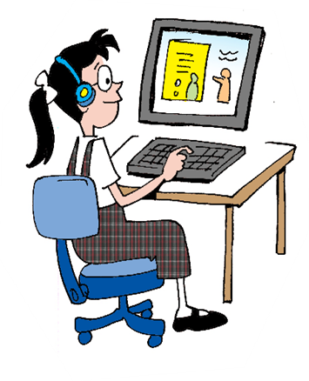
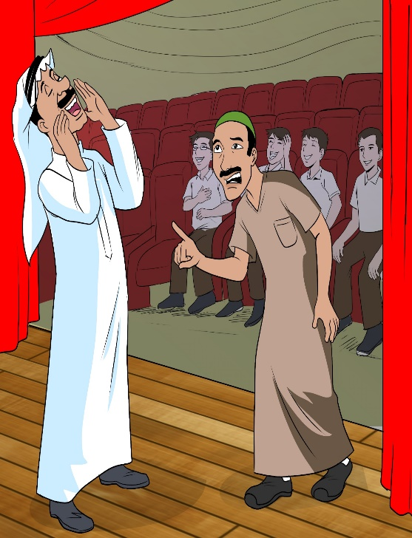
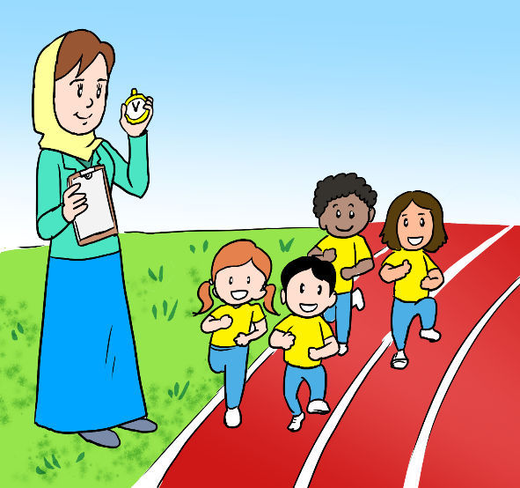

Presentation
Read, click on the word and listen.
computer
actor
December
runner
December
English -Grade 6– Unit 6 – Lesson 4 (Phonics)

Slide 5
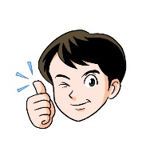


Read, click on the word and classify.
Check your answers.
sister
dinner
number
brother
October
author
mother
doctor
father
actor
summer
visitor
mirror
September
advisor
or
er
author
visitor
mirror
number
brother
October
doctor
actor
September
father
summer
advisor
dinner
mother
sister
English -Grade 6– Unit 6 – Lesson 4 (Phonics)

Slide 6
Check your answers.
Practice
Circle the odd-one-out. Write the word.
1
brother
sister
author
author
actor
mother
mirror
mother
2
dinner
author
doctor
dinner
3
4
number
summer
visitor
visitor
September
doctor
author
September
5
English -Grade 6– Unit 6 – Lesson 4 (Phonics)

Slide 7

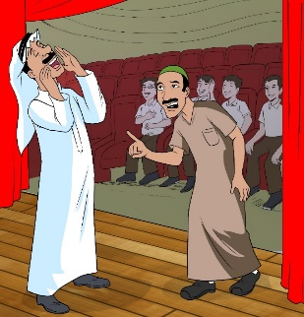
Practice
Check your answers.
Write the words with er or or.
October
flower
actor
a
an
a
a
October
doctor
computer
English -Grade 6– Unit 6 – Lesson 4 (Phonics)

Slide 8
Choose the correct word.
Practice
Check your answers.
1- My mother bought a new ______________ for her bedroom. (mirror – father)
mirror
2-In my country, winter starts in _______________and ends in February. (November-September)
November
3- Harry used my ________________yesterday. (picture-computer)
computer
visitor
4- Who’s there? I think we have a _______________. (visitor-tiger)
5- How are you today? Have you seen the _____________? (mirror-doctor)
doctor
English -Grade 6– Unit 6 – Lesson 4 (Phonics)

Slide 9




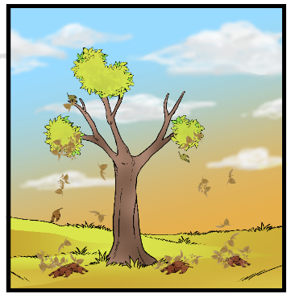
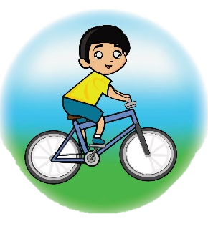
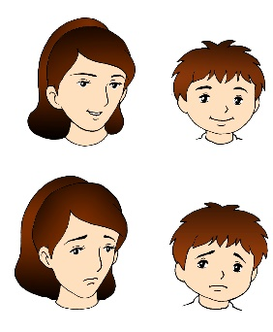
Assessment
Look at the pictures and write sentences using the words below.
6-7 words 8-9 words 9-10 words
Check possibleanswers.
teacher
weather
rider
mother
brother
September
The teacher helped the students arrange the toys,
while Sara helped her brother.
I like the weather in September because I like the colour of the falling leaves.
Ahmed rides his bicycle very well, he’s a skillful rider.
Everyone tells me I look like my mother.
Writing Checklist
I used capital letters at the beginning of sentences. □ I used finger space between  words. □ I used the correct tense. I used a full stop (.) at the end of sentences. □ I checked my spelling. □ I used all the words.
English -Grade 6– Unit 6 – Lesson 4 (Phonics)

Slide 10
End of the Lesson
English -Grade 6– Unit 6 – Lesson 4 (Phonics)

