Slide 1
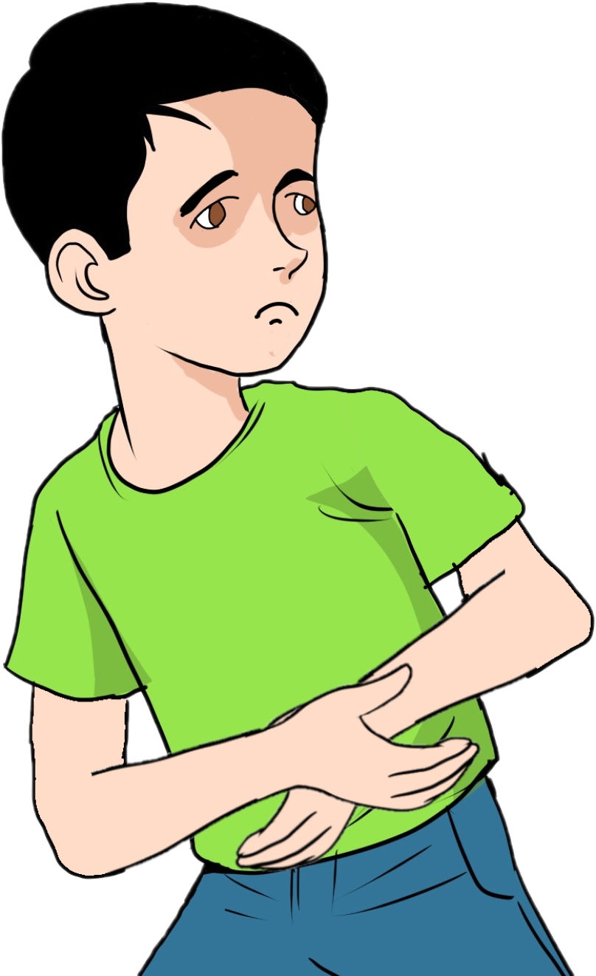
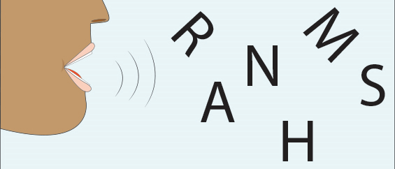
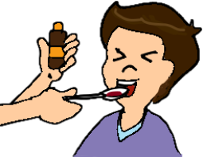
English Family and Friends 6 Grade 6 Semester 2 Unit 6 What’s the matter? Lesson 1: Words

Slide 2
Lesson Objectives:
1- To recognize 9 new phrases about illnesses.
2- To use 9 new phrases about illnesses correctly.
Ministry of Education – Second Semester – 2020-2021
English - Grade 6 – Unit 6 – Lesson 1 (Words)

Slide 3
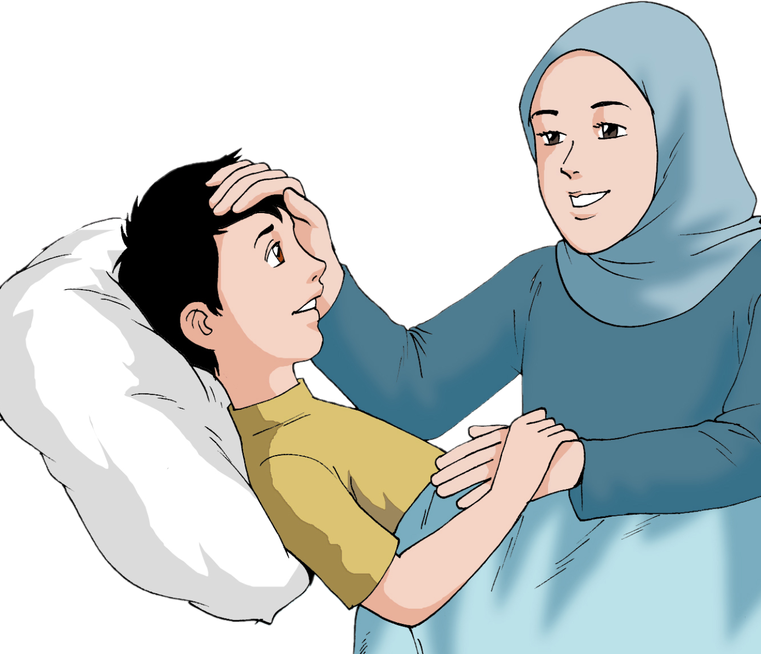
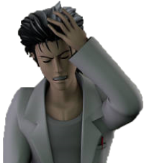
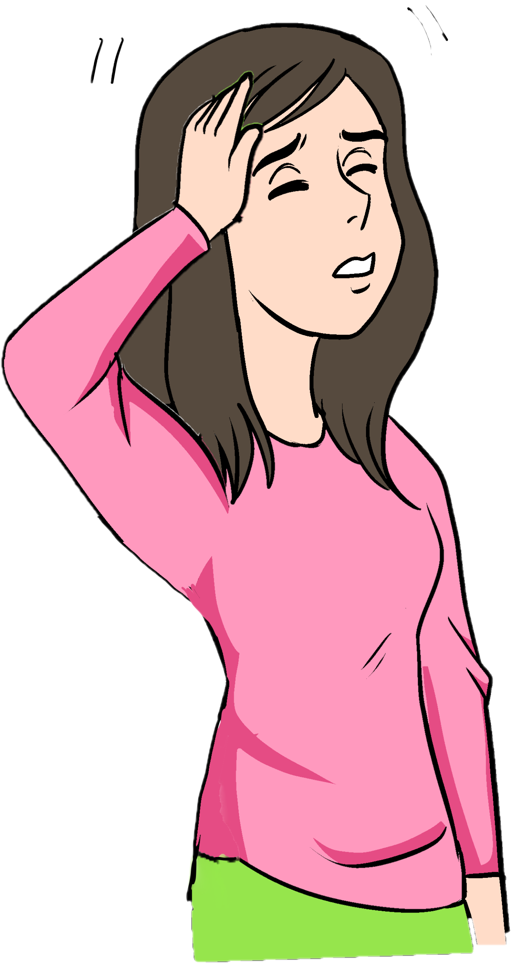
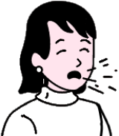
Presentation
Click on the phrase.
Read and learn the following phrases.
a headache
feel sick
feel dizzy
a cold
a cough
Ministry of Education – Second Semester – 2020-2021
English - Grade 6 – Unit 6 – Lesson 1 (Words)

Slide 4
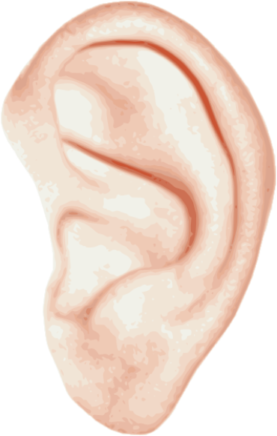
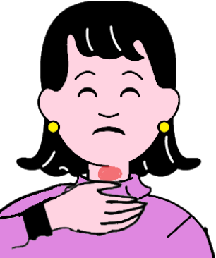
Presentation
Click on the phrase.
Read and learn the following phrases.
an earache
take medicine
a stomach ache
a sore throat
Ministry of Education – Second Semester – 2021
English - Grade 6 – Unit 6 – Lesson 1 (Words)

Slide 5
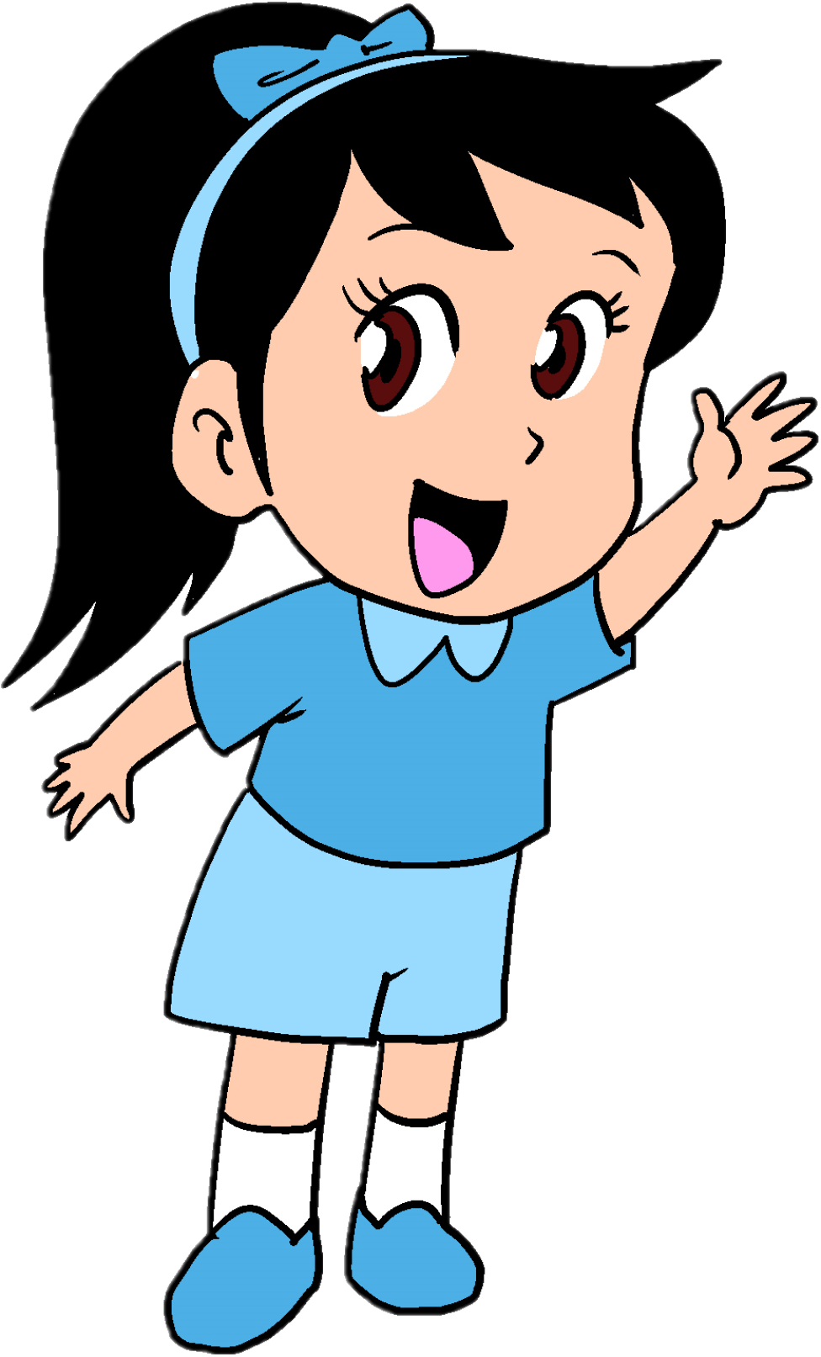
Practice
Look at the picture and choose the correct phrase. The correct answer will grow with colour.
Click the right answer
a stomach ache
a cough
a headache
feel sick
a sore throat
an earache
Ministry of Education – Second Semester – 2020-2021
English - Grade 6 – Unit 6 – Lesson 1 (Words)

Slide 6
Practice
Look at the picture and choose the correct phrase. The correct answer will grow with colour.
an earache
a sore throat
a cough
a cold
a stomach ache
take medicine
Ministry of Education – Second Semester – 2020-2021
English - Grade 6 – Unit 6 – Lesson 1 (Words)

Slide 7
Practice
Look at the picture and choose the correct phrase. The correct answer will grow with colour.
a sore throat
take medicine
a cold
feel dizzy
a cough
a sore throat
Ministry of Education – Second Semester – 2020-2021
English - Grade 6 – Unit 6 – Lesson 1 (Words)

Slide 8
Practice
Look at the picture and choose the correct phrase. The correct answer will grow with colour.
a cold
an earache
feel sick
take medicine
a cough
feel dizzy
Ministry of Education – Second Semester – 2020-2021
English - Grade 6 – Unit 6 – Lesson 1 (Words)

Slide 9
Practice
Check your answers
Read and write the missing phrases.
a headache
feel sick
feel dizzy
a stomach ache
take medicine
My name is Hassan. I live in Manama. Last week, I went to my friend’s birthday and I had a lot of cake and candy. Then, I started to feel ____________. Later, I got into the car on the way back home I started to feel _______________.
When I wanted to sleep my head hurt a lot, my mum said that what I had was _______________. Next morning, when I was having breakfast, my stomach started to hurt a lot. I had ___________________. My mum said that I have to __________________. Finally, that made me feel much better.
sick
dizzy
a headache
a stomach ache
take medicine
Ministry of Education – Second Semester – 2021
English - Grade 6 – Unit 6 – Lesson 1 (Words)

Slide 10
Assessment
Possible answers
Look at the pictures and write sentences. 4-5words 6-7words 8-9 words
Use: sore throat
Use: feel dizzy
When I read in the car, I feel dizzy.
My throat is sore because I had an ice-cream and a milkshake.
Use: a cold
Use: take medicine
When I don’t wear my jacket in the winter, I catch a cold.
When I get sick, I take medicine to feel better.
Writing checklist
I used capital letters at the beginning of sentences. □ I used finger space  between  words. I used a full stop (.) at the end of sentences. □ I checked my spelling. €I used the correct tense.
Ministry of Education – Second Semester – 2020-2021
English - Grade 6 – Unit 6 – Lesson 1 (Words)

Slide 11
End of the Lesson
Ministry of Education – Second Semester – 2020-2021
English - Grade 6 – Unit 6 – Lesson 1 (Words)

