Slide 1


English
Family and Friends
Grade 6
Semester 2
Unit 5
Have you ever been …?
Lesson 5 - Reading and listening

Slide 2

Lesson Objectives
- To read an information text about pearl divers for general understanding.
- To extract specific details from an information text about pearl divers.
- To listen to a text about pearl diving for general understanding and specific information.
Ministry of Education – Second semester 2020- 2021
English -Grade 6– Unit 5 – Lesson 5 (Reading and Listening)

Slide 3

Pre-Reading
Listen, point and repeat.
pearl diving
valuable
rope
equipment
jeweller
oyster
Oxygen
diamonds
Ministry of Education –Second semester - 2020- 2021
English -Grade 6 – Unit 5 - Lesson 5 (Reading and Listening)

Slide 4

New Words
Check your answers
Read then match each word with its meaning using a dictionary. Write the correct letter in the box beside each word.
pearl diving | 1
valuable | 2
rope | 3
equipment | 4
jeweller | 5
oyster | 6
Oxygen | 7
diamonds | 8
the tools, clothing, etc. you need to do sports and other activities. | A
strong, thick string made of long twisted threads. | B
when something is worth a lot of money. | C
a job where people look for pearls in the ocean. | D
a valuable stone used in jewellery. | E
a large, flat sea creature that lives in a shell. | F
a type of gas which people need to breathe and to live. | G
a person who makes or sells jewellery. | H
Ministry of Education –Second semester 2020- 2021
English -Grade 6 – Unit 5 - Lesson 5 (Reading and Listening )

Slide 5
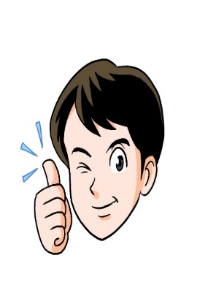
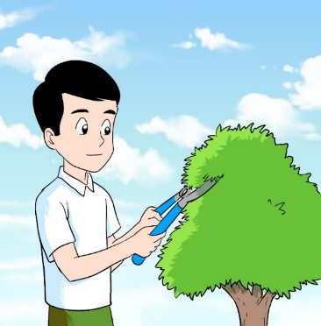
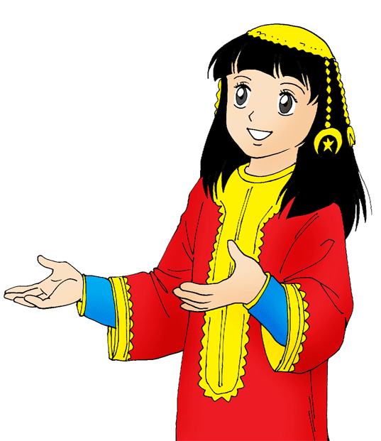
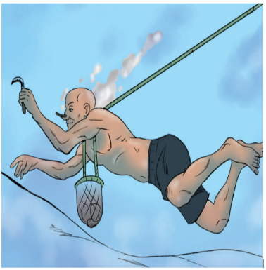
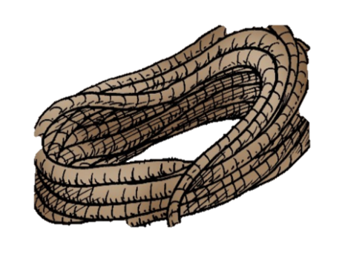
Pre-Reading
Read the sentences and match them with the pictures.
Check your answers!
1. Pearl diving is one of the oldest jobs in Bahrain.
2. You should take care while using sharp equipment's.
3. I tied the trees with a strong rope.
4. The young girl is wearing valuable jewelery for the national day celebration.
2
4
1
1
3
Ministry of Education - Second semester 2020- 2021
English -Grade 6 – Unit 5 - Lesson 5 (Reading and Listening)

Slide 6
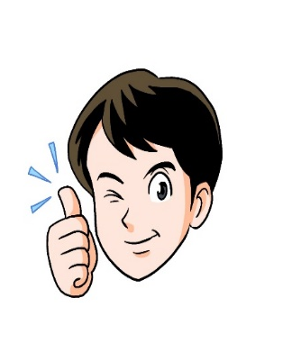
Pre-Reading
Possible Answers!
Write a sentence for each word.
 | pearl diving | 1
 | valuable | 2
 | rope | 3
 | equipment | 4
 | jeweller | 5
 | oyster | 6
 | oxygen | 7
 | diamonds | 8
Pearl diving was my great grandfather’s job.
I keep my valuable things locked up.
My father showed me how to tie a rope.
Ahmed needs to buy new diving equipment.
My uncle is a jeweler. He has his own jewellery.
Harry likes to eat raw oysters. But my mother likes them cooked.
Water contains hydrogen and oxygen.
I didn’t know that diamonds can be used in surgeries.
Ministry of Education –Second semester 2020- 2021
English -Grade 6 – Unit 5 - Lesson 5 (Reading and Listening)

Slide 7
Read then answer the questions on the next slide.
Pearl Diving
The Kingdom of Bahrain has always been famous for its natural pearls. In the past, many Bahraini people worked as pearl divers and ship-builders. Also, there were people who worked as jewellers. They sold and bought pearls. Bahraini pearls grow in salt and fresh water which makes them very special. The pearl diving season, lasted from June to September. Ships used for diving, known as ‘Banoosh’ or ‘Boom’, carried on board more than 60 divers, pullers, a couple of ship boys, a cook, a captain and a captain’s mate. Each person has a special job to do. These days there are not many pearl divers in Bahrain. However, you can still experience what life was like for pearl divers by taking a pearl-diving tour.
Ministry of Education –Second semester 2020- 2021
English -Grade 6 – Unit 5 - Lesson 5 (Reading and Listening)

Slide 8
Post-reading
Check your answers!
Answer these questions.
1. What did Bahraini people work as before?
_________________________________________________________________________
Bahraini people worked as pearl divers, ship-builders and jewellers.
2. What makes Bahraini pearls very special?
Because they grow in salt and fresh water .
3. For how long did the diving season last for?
The pearl diving season, lasted from June to September.
4. When was the pearl diving season?
Pearl diving season, lasted from June to September. It lasted for four months.
5. What were the diving ships known as?
Diving ships were known as ‘Banoosh’ or ‘Boom’.
Ministry of Education –Second semester - 2020- 2021
English -Grade 6 – Unit 5 - Lesson 5 (Reading and Listening)

Slide 9
Listening Activity
Check your answers!
Listen Sara talking about pearl diving.
Put (√ ) for the right sentences and (X) for the wrong ones.
 | Pearl divers didn’t use any equipment to dive for pearls. | 1
 | Sara’s grandfather was a jeweller. | 2
 | Sara’s grandfather was called “Lucky Yousif” because he could stay underwater for a long time. | 3
 | Pearl oysters could be opened with a knife. | 4
 | Sara went on a real diving tour. | 5
(√ )
(X )
(√ )
(√ )
(X )
Ministry of Education –Second semester 2020- 2021
English -Grade 6 – Unit 5 - Lesson 5 (Reading and Listening)

Slide 10
End of the Lesson
Ministry of Education –Second semester 2020- 2021
English -Grade 6 – Unit 5 - Lesson 5 (Reading and Listening)

