Slide 1
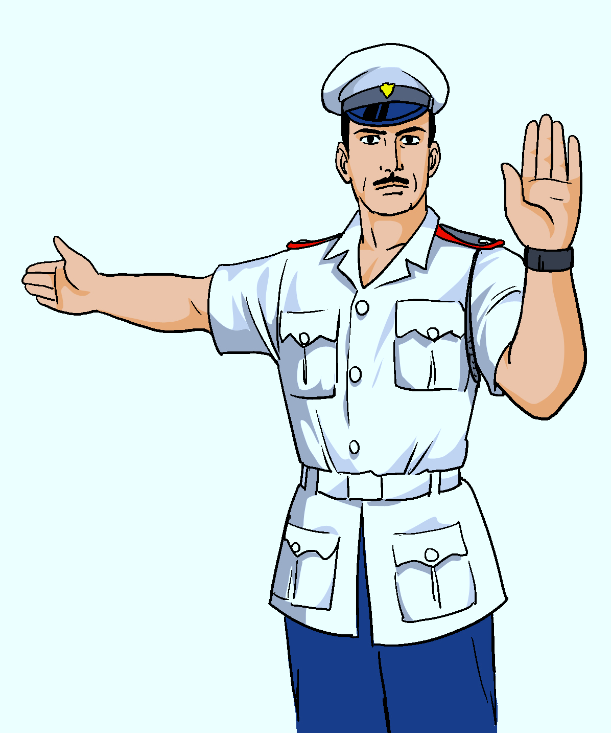
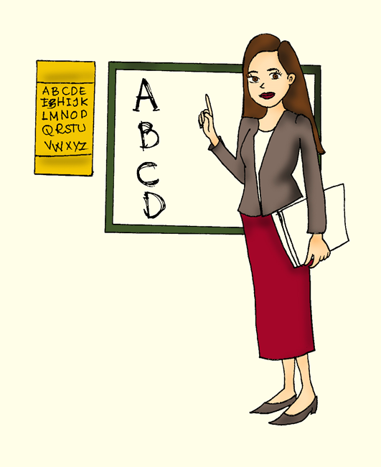
English
Family and Friends 6
Grade 6
Semester 2
Unit 7
Can you help me?
Review

Slide 2
Lesson Objectives
1- To recall unit 7 vocabulary.
3- To use object and relative pronouns correctly.
______________________________________________________________________________________________________
Ministry of Education- Second Semester 2020/2021
English-Grade6-Unit7-Review

Slide 3
Game
What do you need to make……? Click on the words.
milk
water
oil
onions
strawberries
chocolate
blender
mango
tomatoes
lid
oven
butter
a fruit smoothie.
______________________________________________________________________________________________________
Ministry of Education- Second Semester 2020/2021
English-Grade6-Unit7-Review

Slide 4
Game
Complete the following sentence with the correct word.
peel
grate
chop
fry
grill
bake
cook
mango
pour
bake
whisk
break
I _______ a mongo to make a smoothie.
______________________________________________________________________________________________________
Ministry of Education- Second Semester 2020/2021
English-Grade6-Unit7-Review

Slide 5
Game
Complete the following sentence with the correct word.
peel
grate
chop
fry
grill
bake
cook
mango
pour
bake
whisk
break
I _______ some milk into the blender.
______________________________________________________________________________________________________
Ministry of Education- Second Semester 2020/2021
English-Grade6-Unit7-Review

Slide 6
Game
Click on the stars, read the sentences and complete. Then, click on the white boxes to check your answer.
She is in the park. Can you see____?
He is chopping the strawberries. Can you help__?
h
e
r
h
i
m
Take the apple out of the fridge and wash____.
We’re playing volleyball. Do you want to play with____?
i
t
u
s
______________________________________________________________________________________________________
Ministry of Education- Second Semester 2020/2021
English-Grade6-Unit7-Review

Slide 7
Read the following sentence and choose True if the sentence is correct OR False if it is incorrect. If the answer is correct , it will flash green.
This is the shop which sells MP3 players.
True
False
______________________________________________________________________________________________________
Ministry of Education- Second Semester 2020/2021
English-Grade6-Unit7-Review

Slide 8
Read the following sentence and choose True if the sentence is correct OR False if it is incorrect. If the answer is correct , it will flash green.
She’s the girl which won the competition.
True
False
______________________________________________________________________________________________________
Ministry of Education- Second Semester 2020/2021
English-Grade6-Unit7-Review

Slide 9
Read the following sentence and choose True if the sentence is correct OR False if it is incorrect. If the answer is correct , it will flash green.
That is the library who has good books.
True
False
______________________________________________________________________________________________________
Ministry of Education- Second Semester 2020/2021
English-Grade6-Unit7-Review

Slide 10
Read the following sentence and choose True if the sentence is correct OR False if it is incorrect. If the answer is correct , it will flash green.
This is the chef who makes banana smoothies.
True
False
______________________________________________________________________________________________________
Ministry of Education- Second Semester 2020/2021
English-Grade6-Unit7-Review

Slide 11
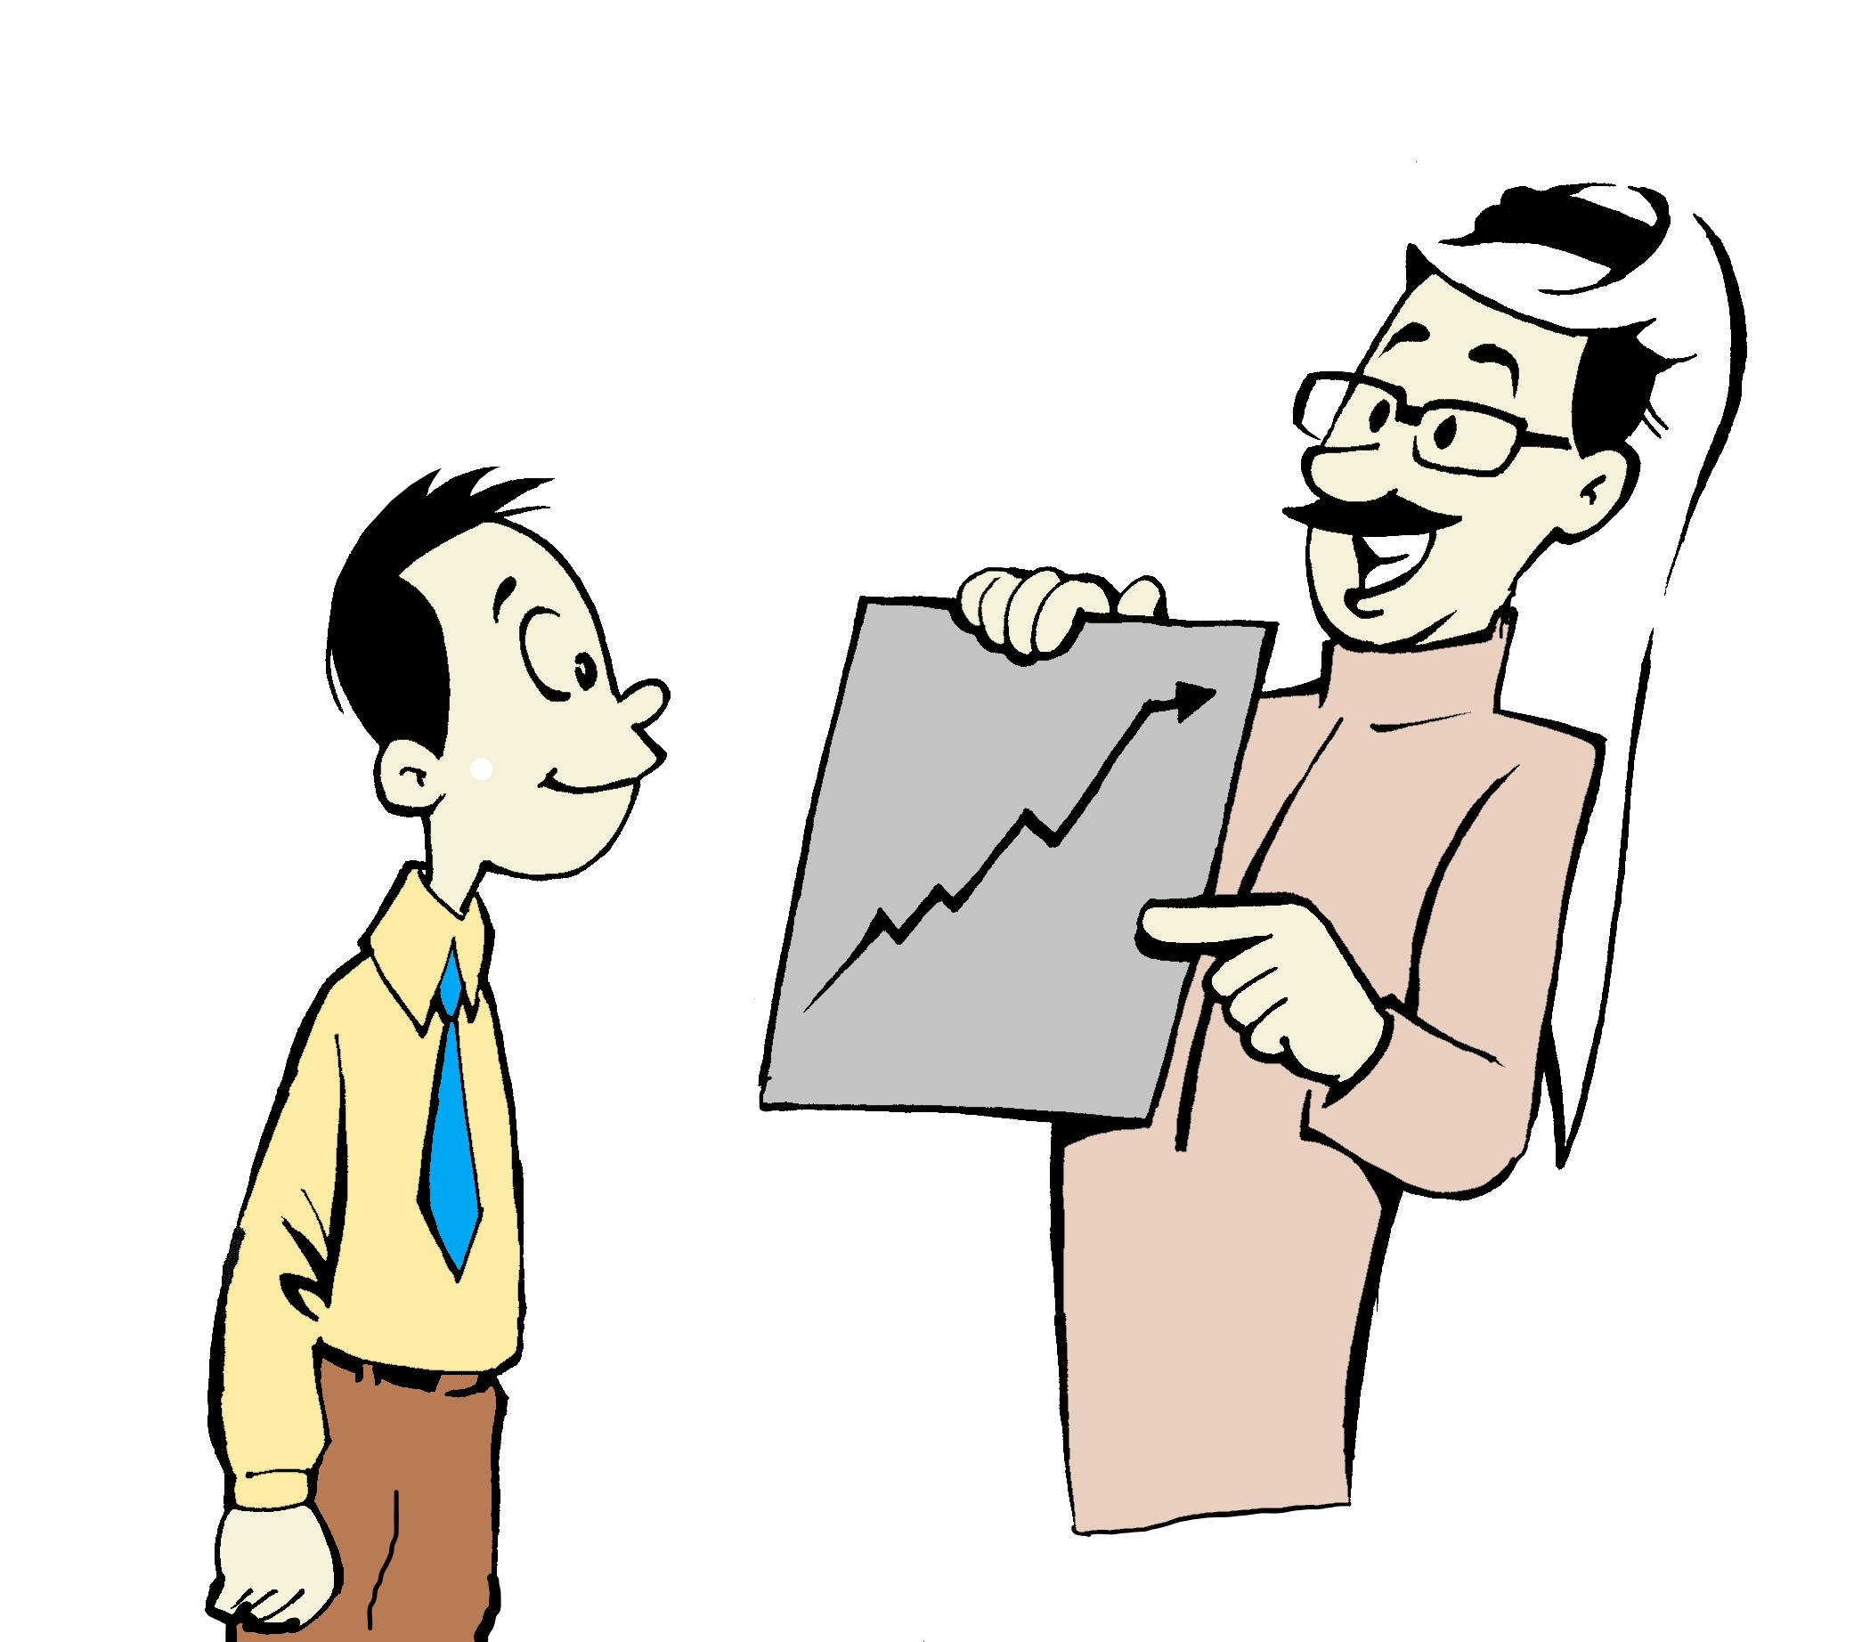
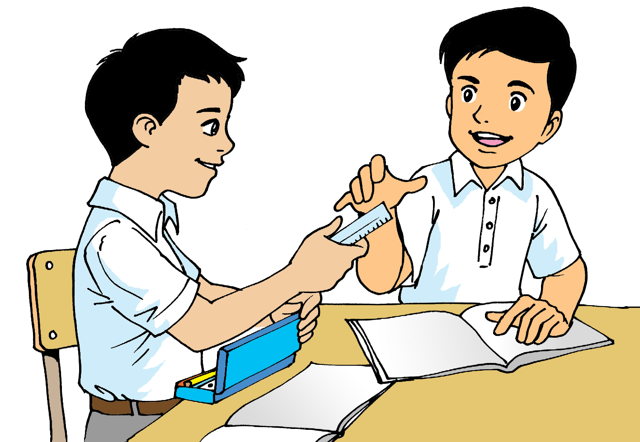
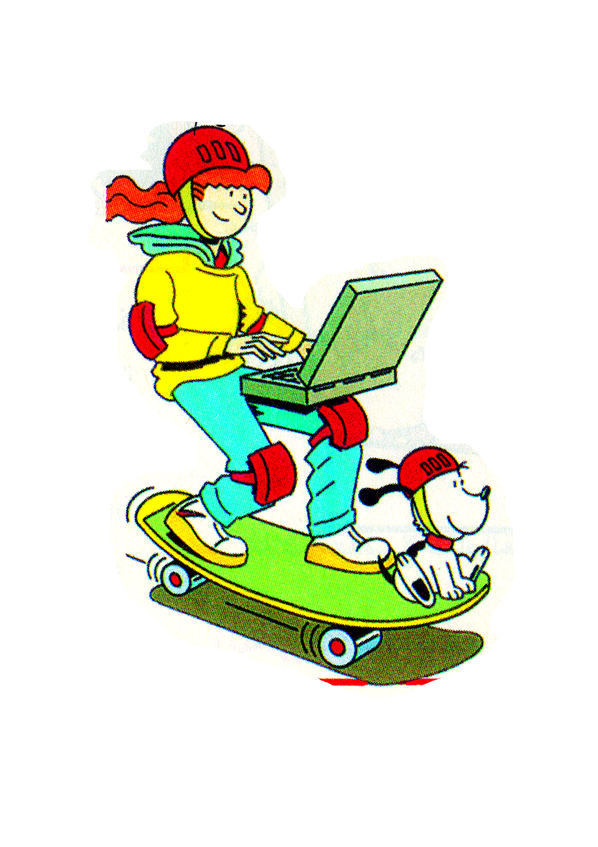
Look at the pictures and write sentences using the words between brackets. (7-12 words).
Possible answers
(Use: me)
(Use: which)
________________________________________________________________________________________.
________________________________________________________________________________________.
My science teacher always helps me in doing my homework.
This is the boat which I’ve told you about.
(Use: who)
(Use: it)
My friend Ahmed is the one who lent me his ruler for the math class.
________________________________________________________________________________________.
________________________________________________________________________________________.
This is my laptop. I can use it while skateboarding.
______________________________________________________________________________________________________
Ministry of Education- Second Semester 2020/2021
English-Grade6-Unit7-Review

Slide 12
Write an email to your friend telling her/him about how to make a smoothie. ( 35-50 words)
You made a delicious smoothie last night.
Write an email to your friend.
In your email include:
the ingredients.
how to make it.
how it tastes.
Possible answer
___________________________________________________________________________________________________________________________________________________________________________________________________________________________________________________________________________________________________________________________________________________________________________________________________________________________________________________________________________________.
Hello,
I am writing this email to tell you about the smoothie I made last night. It tasted so good. If you want to make it at home, you will need to have some frozen strawberries, mangoes, and bananas. Also, you’ll need some milk, and sugar. First, peel the mangoes and the bananas, and chop the strawberries. Then, pour some milk into a blender and add some sugar. Next, put the lid on the blender and switch it on. Finally, pour the smoothie into glasses and serve it while it’s still cold.
Best,
Kate
______________________________________________________________________________________________________
Ministry of Education- Second Semester 2020/2021
English-Grade6-Unit7-Review

Slide 13
End of the Review Lesson
______________________________________________________________________________________________________
Ministry of Education- Second Semester 2020/2021
English-Grade6-Unit7-Review

