Slide 1
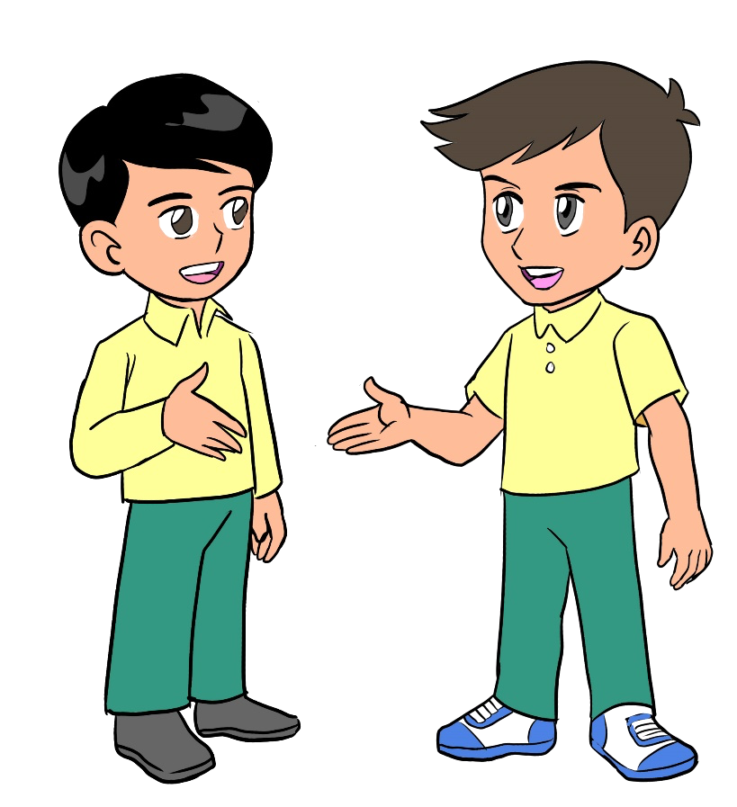
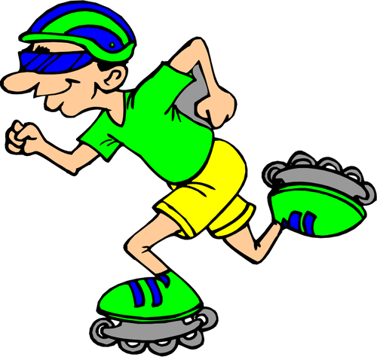
Unit 9
I can ride a bike!
Family and Friends 2
Grade 2
Lesson (5)
P. 84
Semester (1)
وزارة التربية والتعليم –الفصل الدراسي الثاني 2020-2021م

Slide 2
OBJECTIVES
By the end of the lesson, you will be able to
recall some words.
answer questions correctly.
وزارة التربية والتعليم –الفصل الدراسي الثاني 2020-2021م

Slide 3
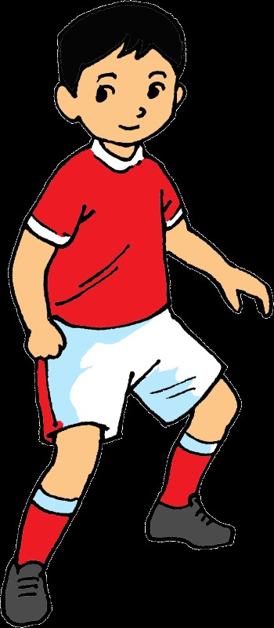
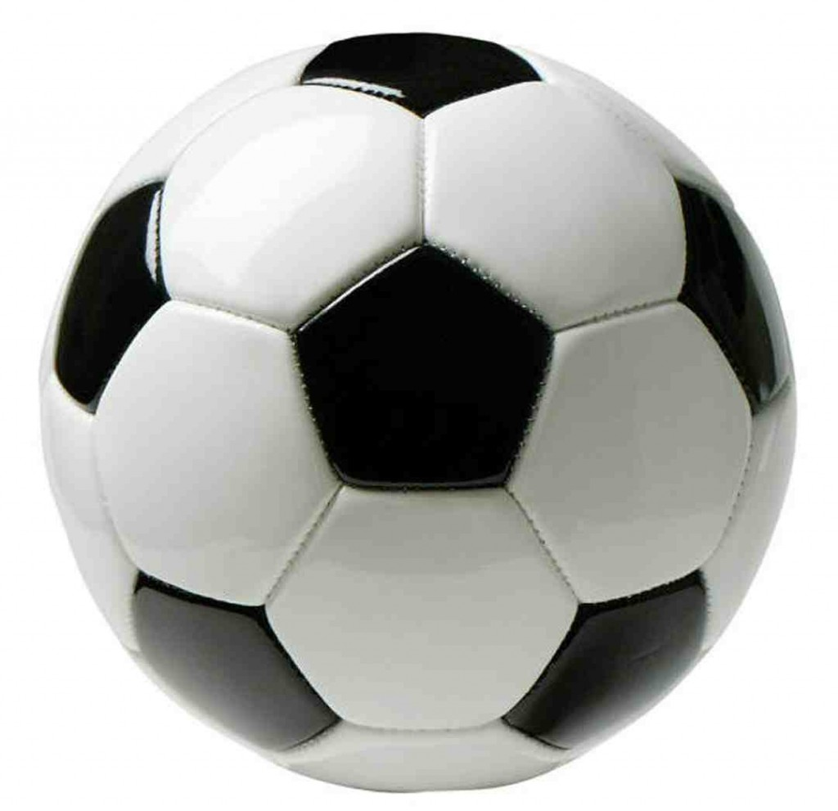
Grade (2) unit (9) lesson (5)
Read and match.
ride a bike
Click to check answer
play tennis
skateboard
skate
play football
ride a horse
وزارة التربية والتعليم –الفصل الدراسي الثاني 2020-2021م

Slide 4
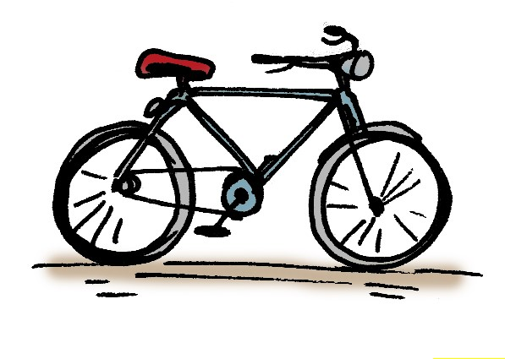
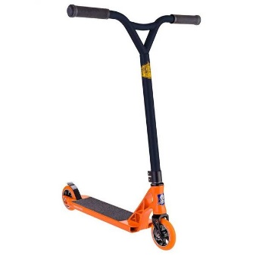
Read the text.
During the weekend, I like to go to the park to ride my bike. I like my bike, it’s got two big wheels. My brother likes to play with scooters. Scooters are a lot of fun! His scooter is orange and it has got two small wheels. Our friend Mohamed likes skateboards. Skateboards are fun too! His skateboard is blue and it has got four small wheels.
Read Me!
وزارة التربية والتعليم –الفصل الدراسي الثاني 2020-2021م

Slide 5
Put true (T) or false (F).
The bike has got two big wheels.
His brother likes scooters.
The scooter has got three big wheels.
Mohamed doesn’t like skateboards.
The skateboard is blue and it has four wheels.
T
T
F
F
T
Click to check your answers
وزارة التربية والتعليم –الفصل الدراسي الثاني 2020-2021م

Slide 6
Answer the following questions.
1. How many wheels has the bike got?
It’s got
two wheels.
2. How many wheels has the scooter got?
It’s got two wheels.
3. How many wheels has the skateboard got?
It’s got four wheels.
Click to check your answers
وزارة التربية والتعليم –الفصل الدراسي الثاني 2020-2021م

Slide 7
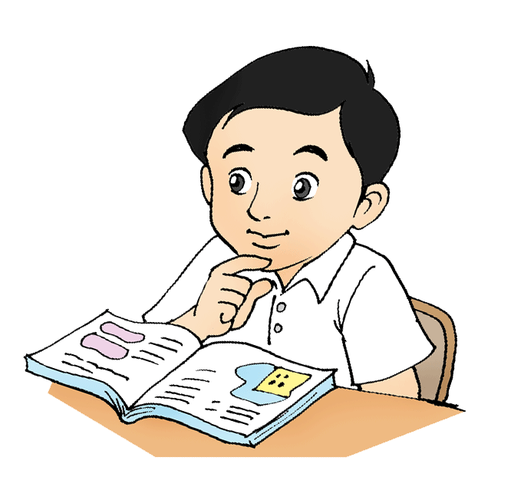
Open p. 83 in your workbook
and answer the questions
وزارة التربية والتعليم –الفصل الدراسي الثاني 2020-2021م

Slide 8
End of lesson 5
Good job dear !
وزارة التربية والتعليم –الفصل الدراسي الثاني 2020-2021م

