Slide 1
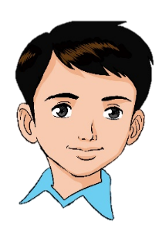
Unit 6
A new friend!
Family and Friends 2
Grade 2
Lesson (2)
P. 54
Semester (2)

Slide 2
Grade (2) unit (6) lesson (2)
OBJECTIVES
By the end of the lesson, you will be able
to recall some words.
to write sentences correctly using ’s got and hasn’t got.

Slide 3
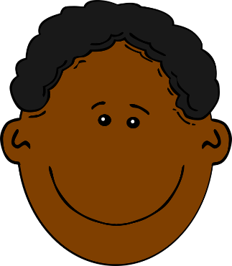
Look and read.
short
blond
brown
long
Click on the words to listen
curly
Straight

Slide 4
blond
Read and match
long
brown
short
curly
Straight
Click to check your answers

Slide 5
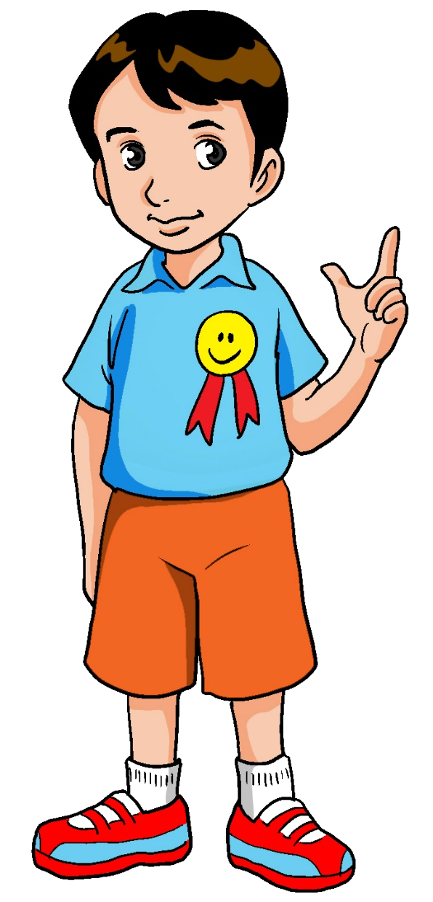
Let’s learn!
He’s got short hair.
He hasn’t got
blond hair.
وزارة التربية والتعليم –الفصل الدراسي الثاني 2020-2021م

Slide 6
Let’s learn!
He’s got blue eyes.
He hasn’t got
brown eyes.

Slide 7
‘s got
hasn’t got
when you have something
when you don’t have something

Slide 8
or
hasn’t got
Read and write
’s got
1. He ____________ blond hair.
’s got
2. she___________ straight hair.
hasn’t got
3. It _____________ brown eyes.
’s got
4. He ____________curly hair.
’s got
5. She ___________ short hair.
hasn’t got
click to check your answers
وزارة التربية والتعليم –الفصل الدراسي الثاني 2020-2021م

Slide 9
Look and reorder
’s got
short
.
He
hair
’s got
He
short
hair
.
click to check your answers

Slide 10
Look and reorder
got
hair
She
.
blond
hasn’t
got
hair
She
blond
.
hasn’t
Click to check your answers
وزارة التربية والتعليم –الفصل الدراسي الثاني 2020-2021م

Slide 11
Can you write the whole sentence?
_
Click to check your answers
وزارة التربية والتعليم –الفصل الدراسي الثاني 2020-2021م

Slide 12
Can you write the whole sentence?
_
Click to check your answers

Slide 13
Grade (2) unit (6) lesson (2)
Can you write the whole sentence?
She’s got brown hair.
She hasn’t got long hair.
_
brown
long
Click to check your answers
وزارة التربية والتعليم –الفصل الدراسي الثاني 2020-2021م

Slide 14
Grade (2) unit (6) lesson (2)
Can you write the whole sentence?
_
long
black
Click to check your answers
وزارة التربية والتعليم –الفصل الدراسي الثاني 2020-2021م

Slide 15
Open p. 53 in your workbook
and answer the questions
وزارة التربية والتعليم –الفصل الدراسي الثاني 2020-2021م

Slide 16
End of lesson 2
Good job dear !

