Slide 1


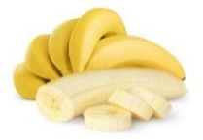

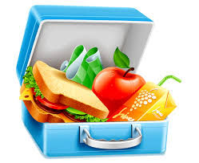



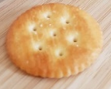
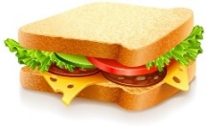

Unit 5
Lunchtime!
Semester (2)
Family and Friends 2
Grade 2
Lesson (5)
P. 50
وزارة التربية والتعليم –الفصل الدراسي الثاني 2020-2021م

Slide 2

OBJECTIVES
By the end of the lesson, you will be able to
answer questions correctly.
Write sentences accurately.
وزارة التربية والتعليم –الفصل الدراسي الثاني 2020-2021م

Slide 3
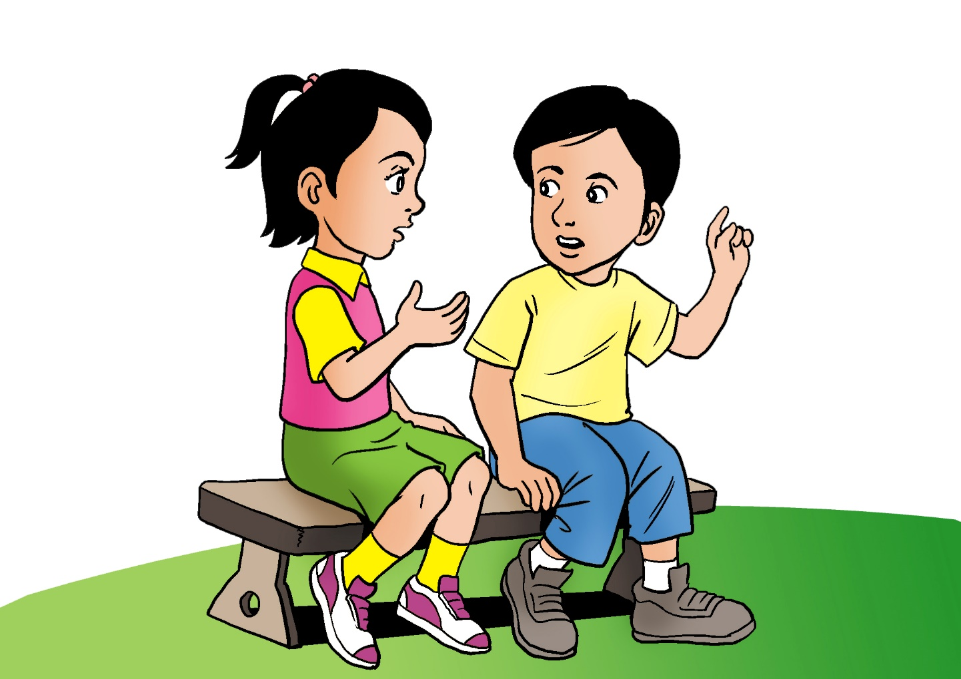
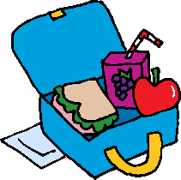


Read the text
  Hello Abdulla, let me show you what I have in my lunch box.
  In my lunch box, I’ve got a cheese sandwich and an orange juice.
  I haven’t got a banana but I’ve got an apple.
  How about you Abdulla? What’s in your lunch box?
Hello Eman, in my lunch box
I’ve got an apple and an orange juice.
I haven’t got a sandwich today but I’ve got some milk and biscuits, I like it.
وزارة التربية والتعليم –الفصل الدراسي الثاني 2020-2021م

Slide 4

What’s in Eman’s lunch box? ( ) or ( ).
Click to check your answers
1. bananas
2. biscuits
3. cheese sandwich
4. orange juice
5. apples
وزارة التربية والتعليم –الفصل الدراسي الثاني 2020-2021م

Slide 5
What’s in Abdulla’s lunch box? ( ) or ( ).
Click to check your answers
milk
2. yogurt
3. grapes
4. biscuits
5. orange juice
وزارة التربية والتعليم –الفصل الدراسي الثاني 2020-2021م

Slide 6
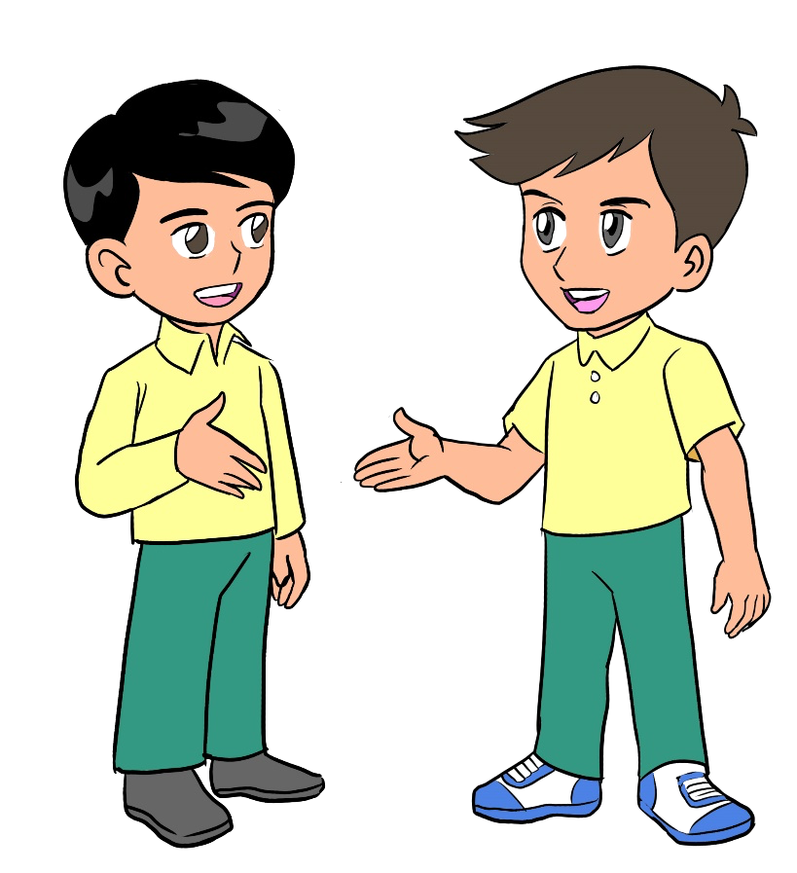
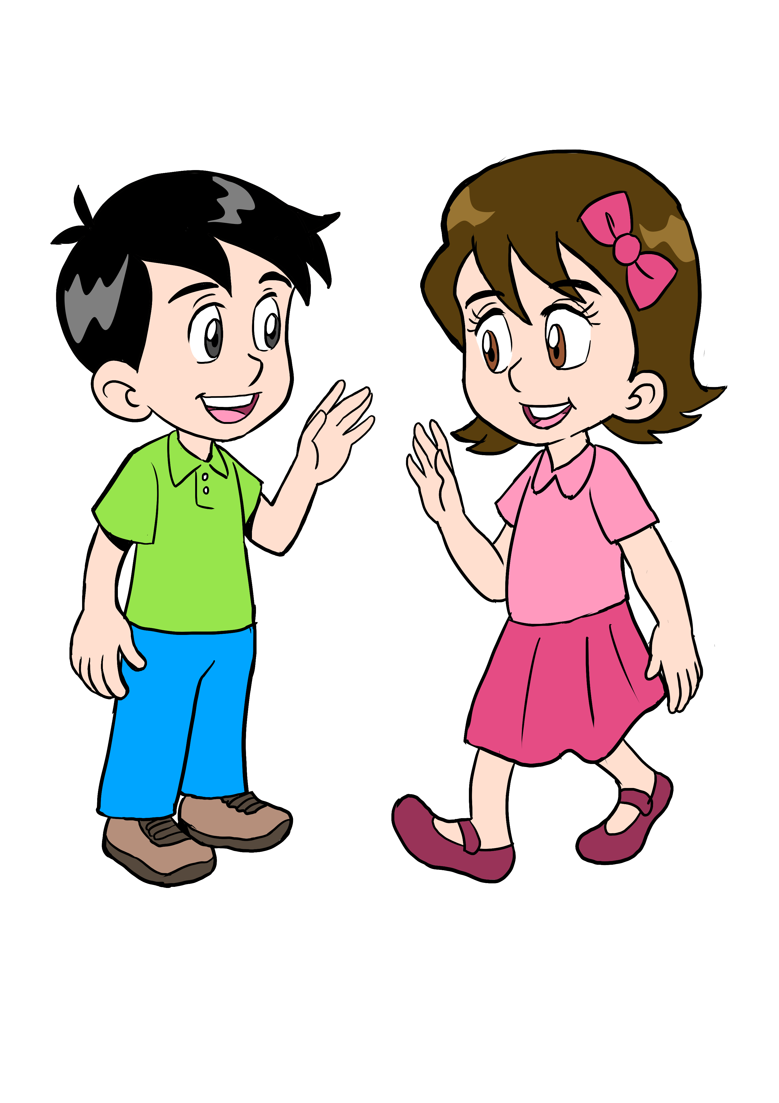
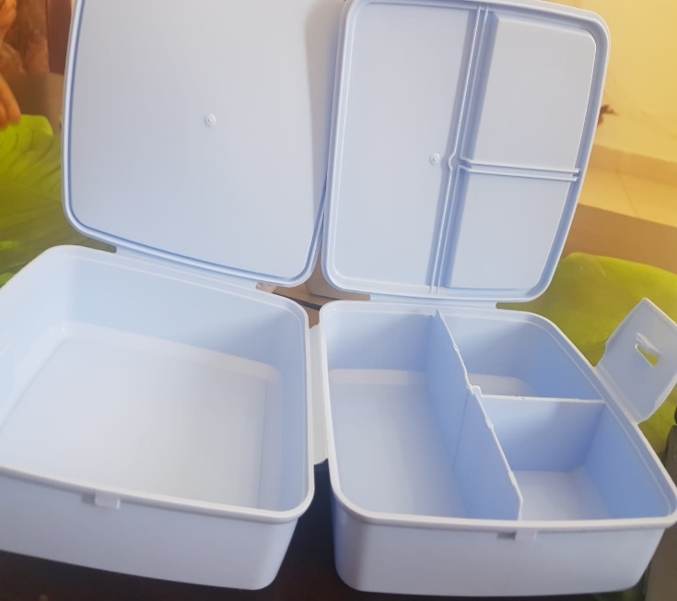

Ask and answer
____________________
I‘ve got a sandwich.
Reem, what have you got in your lunch box?
Click to check your answers
وزارة التربية والتعليم –الفصل الدراسي الثاني 2020-2021م

Slide 7
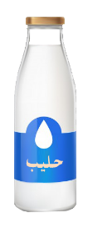

Answer the questions.
I‘ve got an apple and milk.
____________________
Khalid, what have you got in your lunch box?
Click to check your answers
وزارة التربية والتعليم –الفصل الدراسي الثاني 2020-2021م

Slide 8

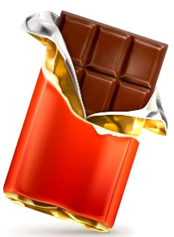
Answer the questions.
I‘ve got an apple juice. I haven’t got chocolate.
____________________
Khalid, what have you got in your lunch box?
Click to check your answers
وزارة التربية والتعليم –الفصل الدراسي الثاني 2020-2021م

Slide 9


Write sentences using (I’ve got and haven’t got).
I’ve got bananas.
I’ve got an apple juice.
I haven’t got chocolate.
I haven’t got a sandwich.
Click to check your answers
وزارة التربية والتعليم –الفصل الدراسي الثاني 2020-2021م

Slide 10
Open your workbook P.48
and answer the questions
وزارة التربية والتعليم –الفصل الدراسي الثاني 2020-2021م

Slide 11

End of lesson 5
Grade (2) unit (5) lesson (5)
Good job dear !
وزارة التربية والتعليم –الفصل الدراسي الثاني 2020-2021م

