Slide 1
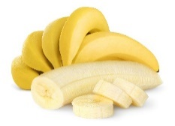
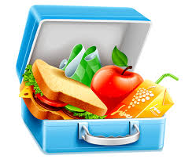
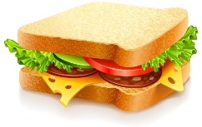
Unit 5
Lunchtime!
Semester (1)
Family and Friends 2
Grade 2
Lesson (2)
P. 38

Slide 2
Grade (2) unit (5) lesson (2) Grammar
OBJECTIVES
By the end of the lesson, you will be able:
to recall some food items
to write sentences using I’ve got/ I haven’t got correctly

Slide 3
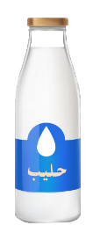
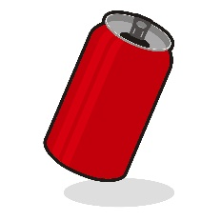
Grade (2) unit (5) lesson (2) Grammar
Look and say!
apple
bananas
drinks
sandwich
click and read
Lunch box
biscuit

Slide 4
Grade (2) unit (5) lesson (2) Grammar
Let’s play
Save the flower
l
u
n
c
h
b
o
x
a
b
c
d
e
f
g
h
i
j
k
l
m
n
o
p
q
r
s
t
u
v
w
x
y
z
Next
help

Slide 5
Grade (2) unit (5) lesson (2) Grammar
Save the flower
Let’s play
a
p
p
l
e
a
b
e
f
r
s
l
m
o
p
t
u
w
y
Next
help

Slide 6
Grade (2) unit (5) lesson (2) Grammar
Let’s play
Save the flower
b
i
s
c
u
i
t
a
b
c
d
e
f
g
h
i
j
k
l
m
n
o
p
q
r
s
t
Next
u
v
w
x
y
z
help

Slide 7
Grade (2) unit (5) lesson (2) Grammar
Let’s play
Save the flower
d
r
i
n
k
s
a
b
c
d
e
f
g
h
i
j
k
l
m
n
o
p
q
r
s
t
u
v
w
x
y
z
help

Slide 8
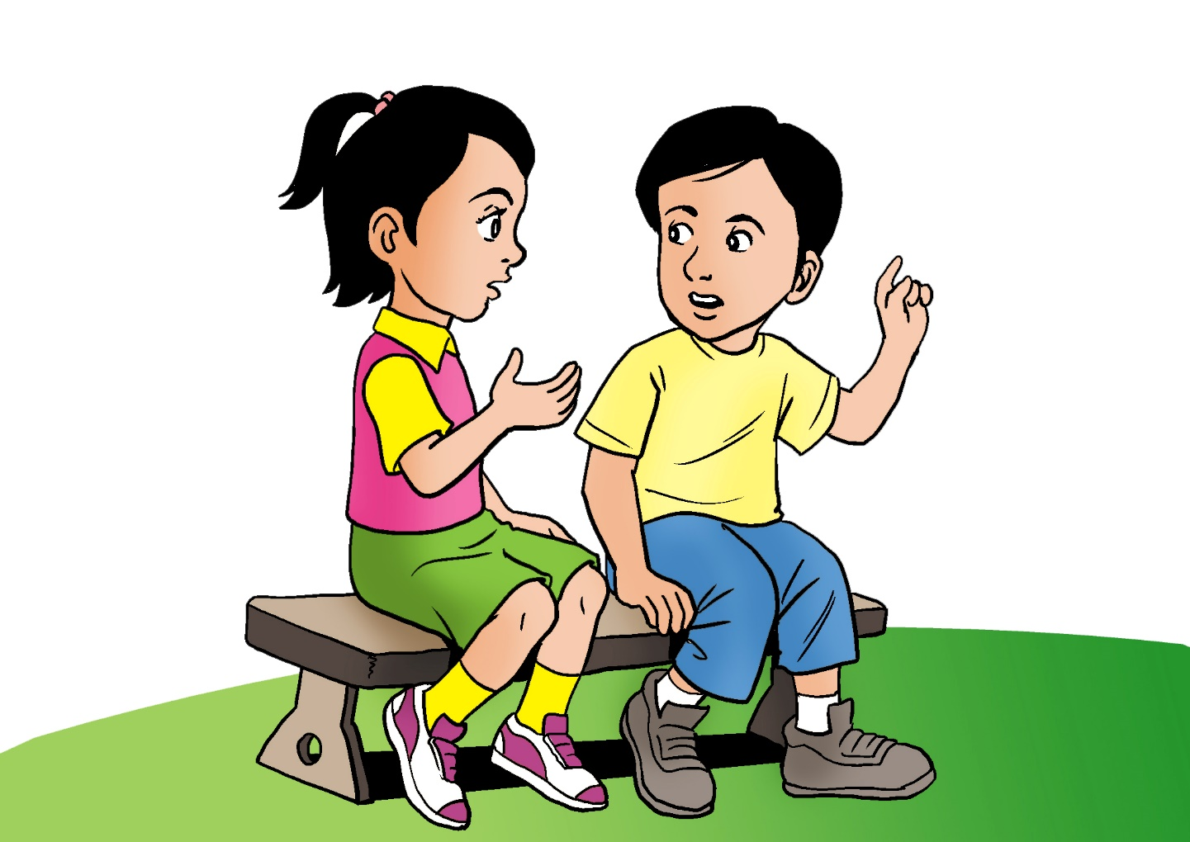
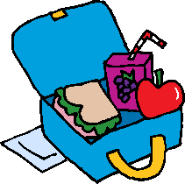
Grade (2) unit (5) lesson (2) Grammar
Let’s learn!
I’ve got two drinks. Here you are.
I haven’t got my orange juice!

Slide 9
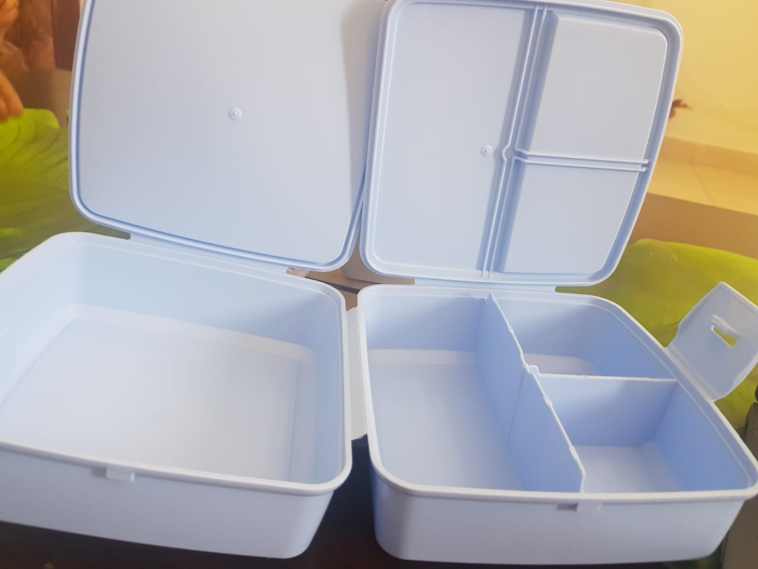
Grade (2) unit (5) lesson (2) Grammar
Let’s learn!
I’ve got a sandwich.
I’ve got water.
I’ve got milk.
I haven't got biscuit.

Slide 10
Grade (2) unit (5) lesson (2) Grammar
Let’s learn!
I’ve got a sandwich.
I’ve = I have got

Slide 11
Grade (2) unit (5) lesson (2) Grammar
Let’s learn!
I haven’t got a sandwich.
Haven’t = have not

Slide 12
Grade (2) unit (5) lesson (2) Grammar
Click for answer
Let’s practice!
Read and choose
I _________got biscuit.
‘ve
‘ve
I ______________ got cake.
haven’t
haven’t
I _________ got orange juice.
haven’t
I _______ got bananas.
‘ve

Slide 13
Grade (2) unit (5) lesson (2) Grammar
Click for the answer
Let’s practice!
Reorder the following
.
an
‘ve
orange
I
got
.
I
‘ve
Orange.
an
got

Slide 14
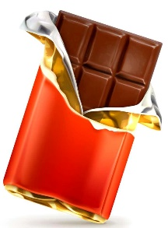
Grade (2) unit (5) lesson (2) Grammar
Write sentences
I’ve got grapes.
I’ve got orange juice.
I haven’t got chocolate.
I haven’t got olives.
Click to check your answers

Slide 15
End of lesson 2
Grade (2) unit (5) lesson (2) Grammar
Good job dear!

