Slide 1
Unit 1
It’s a pen
Family and Friends 2
Grade 2
Lesson 3
P 12
Semester 1

Slide 2
Grade 2 unit1 lesson 3
OBJECTIVES
By the end of the lesson, you will be able to
identify five school items.
recognize five school items .

Slide 3
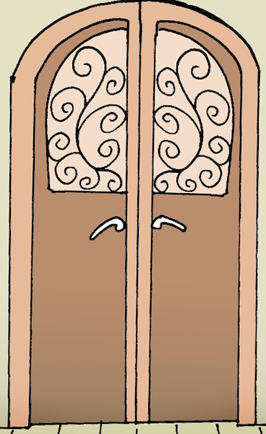
Grade 2 unit1 lesson 3
Listen , point and repeat.
bag
bookcase
door
folder
window

Slide 4
Grade 2 unit1 lesson 3
Listen and repeat.
bag

Slide 5
Grade 2 unit1 lesson 3
Listen and repeat.
folder

Slide 6
Grade 2 unit1 lesson 3
Listen and repeat.
door

Slide 7
Grade 2 unit1 lesson 3
Listen and repeat.
window

Slide 8
Grade 2 unit1 lesson 3
Listen and repeat.
bookcase

Slide 9
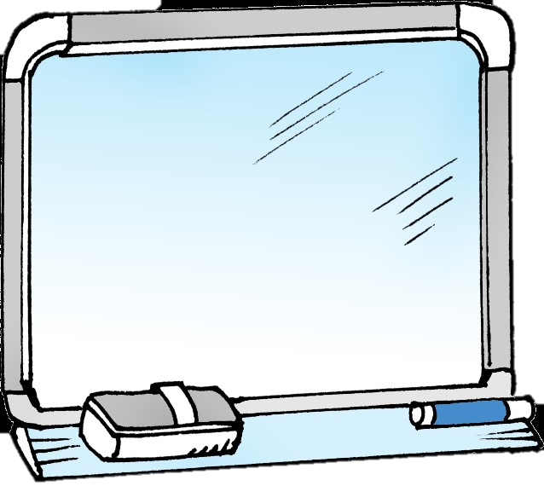
Grade 2 unit1 lesson 3
Use your mini board
Read and choose.
door
window
Click to check your answer

Slide 10
Grade 2 unit1 lesson 3
Read and choose.
Use your mini board
bookcase
bag
Click to check your answer

Slide 11
Grade 2 unit1 lesson 3
Use your mini board
Read and choose.
bookcase
folder
Click to check your answer

Slide 12
Grade 2 unit1 lesson 3
Use your mini board
Read and choose.
door
bag
Click to check your answer

Slide 13
Grade 2 unit1 lesson 3
Use your mini board
Read and choose.
window
bag
Click to check your answer

Slide 14
Grade 2 unit1 lesson 3
Open your workbook P.12
and answer the questions.

Slide 15
End of lesson 3
Grade 2 unit1 lesson 3
Good job dear !

