Slide 1
Grade 2 Family and Friends 2 Lesson 6 Page 11
Starter
A B C D E F G H I J K L M N O P Q R S T U V W X Y Z
Semester (1)
English

Slide 2
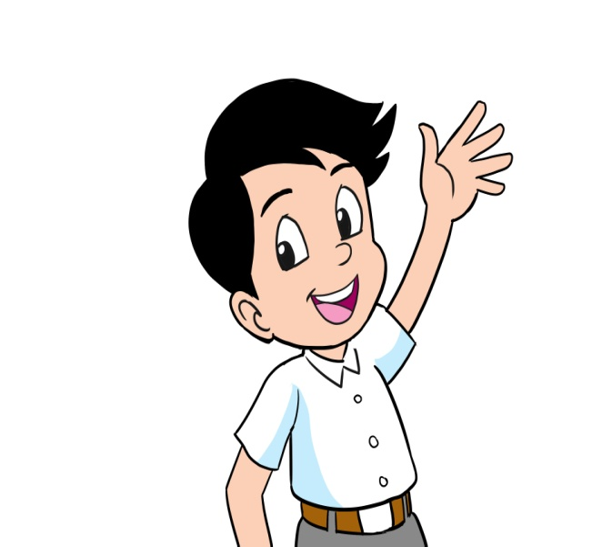
Grade 2 starter lesson 6
Objectives
By the end of the lesson, you will be able to:
1- recognize numbers.
2- write numbers correctly.

Slide 3
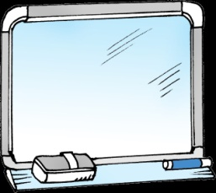
Grade 2 starter lesson 6
Listen ,point and write.
11
12
13
14
15
eleven
twelve
thirteen
fourteen
fifteen
________________________________________________________________________________________________________________________________________________
Ministry of Education-2020

Slide 4
Grade 2 starter lesson 6
Listen ,point and write.
16
17
18
19
20
sixteen
seventeen
eighteen
nineteen
twenty
________________________________________________________________________________________________________________________________________________
Ministry of Education-2020

Slide 5
Grade 2 starter lesson 6
Read and write.
11
12
13
14
15
eleven
twelve
thirteen
fourteen
fifteen
16
17
19
20
18
sixteen
seventeen
eighteen
nineteen
twenty
Click to check your answers
________________________________________________________________________________________________________________________________________________
Ministry of Education-2020

Slide 6
Grade 2 starter lesson 6
Match
16
18
14
17
twelve
nineteen
19
12
13
fourteen
20
15
sixteen
11
seventeen
eleven
eighteen
thirteen
twenty
fifteen
Click to check your answers
________________________________________________________________________________________________________________________________________________
Ministry of Education-2020

Slide 7
End of lesson 6
Grade 2 starter lesson 6
Good job dear!
_________________________________________________________________________________________________________________________________________________
Ministry of Education-2020

