Slide 1
Grade 2 Family and Friends 2 Lesson 4 Page 9
Starter
A B C D E F G H I J K L M N O P Q R S T U V W X Y Z
Semester (1)
English

Slide 2
Grade 2 starter lesson 4
Objectives
By the end of the lesson, you will be able to
1- recognize seven colours.
2- write them correctly.

Slide 3
Grade 2 starter lesson 4
Colours
Listen, point and repeat.
red
yellow
pink
green
purple
orange
blue
________________________________________________________________________________________________________________________________________________
Ministry of Education-2020

Slide 4
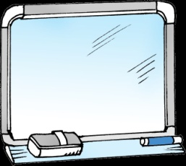
Grade 2 starter lesson 4
Read and match .
yellow
green
purple
orange
pink
red
blue
Click to check your answers
________________________________________________________________________________________________________________________________________________
Ministry of Education-2020

Slide 5
Grade 2 starter lesson 4
Write the missing letters .
ora..ge
..ink
..reen
re..
yell..w
pu..ple
b..ue
orange
pink
green
red
yellow
purple
blue
Click to check your answers
________________________________________________________________________________________________________________________________________________
Ministry of Education-2020

Slide 6
Grade 2 starter lesson 4
Look and write
green
orange
pink
purple
yellow
blue
red
Click to check your answers
________________________________________________________________________________________________________________________________________________
Ministry of Education-2020

Slide 7
End of lesson 4
Grade 2 starter lesson 4
Good job dear !
_________________________________________________________________________________________________________________________________________________
Ministry of Education-2020

