Slide 1
Grade 2 Family and Friends 2 Lesson 1 Page 6
Starter
A B C D E F G H I J K L M N O P Q R S T U V W X Y Z
Semester (1)
English

Slide 2
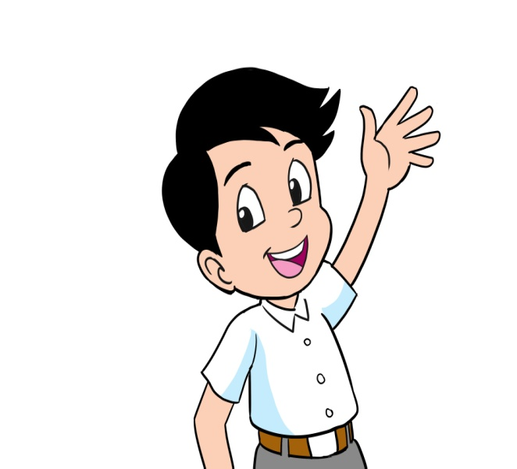
Grade 2 starter lesson 1
Objectives
By the end of the lesson, you will be able to:
greet other people.

Slide 3
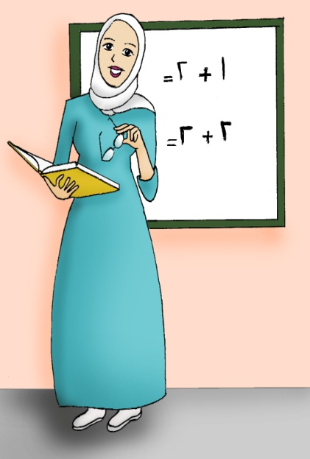
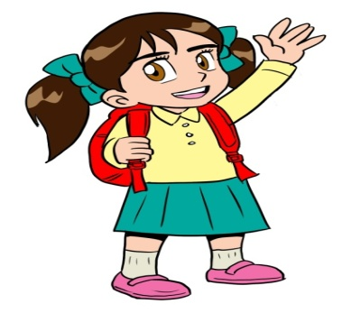
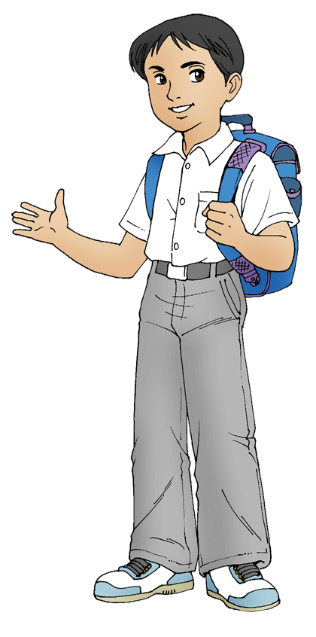
Grade 2 starter lesson 1
Hello / Goodbye
Listen, point and repeat.
Hello, class. My name’s miss Nada. What’s your name?
My name’s Noor.
My name’s Ali.
My name’s Khalid.
Miss Nada
Noor
Ali
Khalid

Slide 4
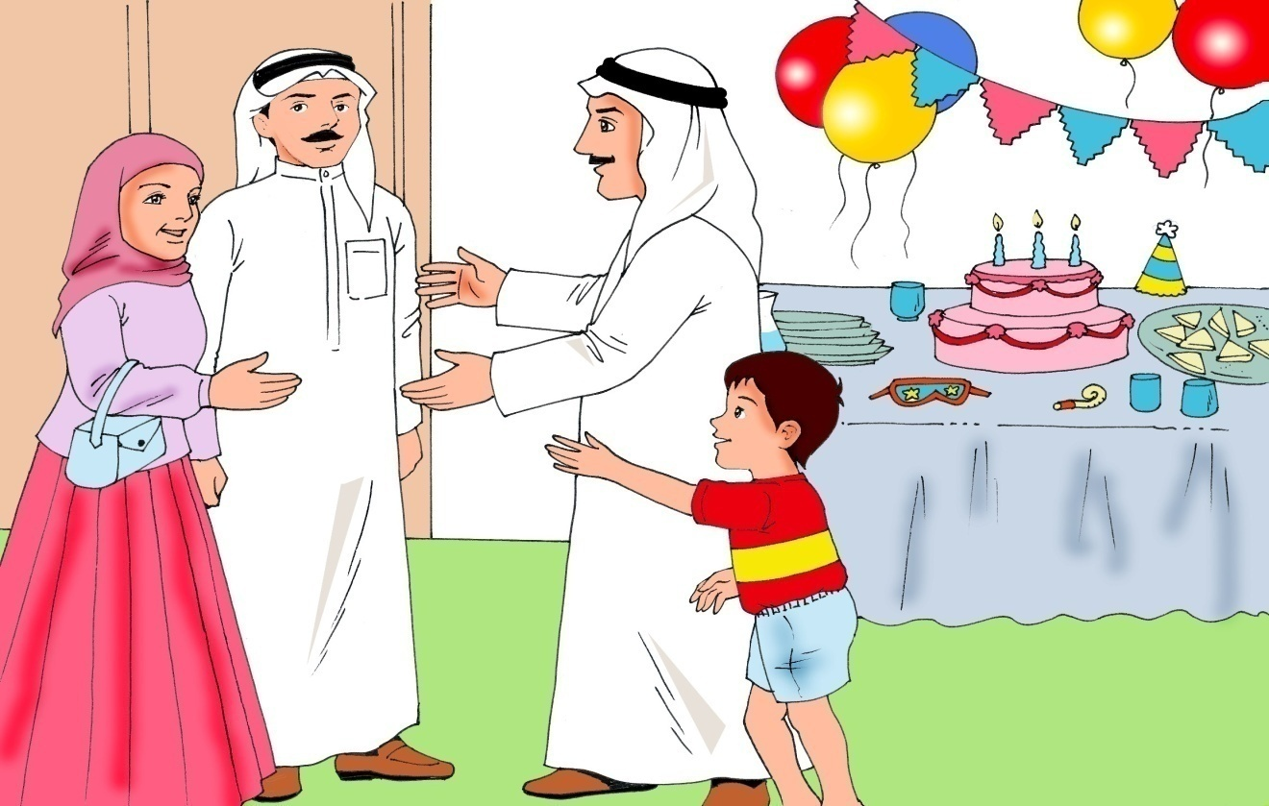
Grade 2 starter lesson 1
Hello
Hello, Father.
Hello, Nada and Fahad.
Hello, Aunt Nada.

Slide 5
Grade 2 starter lesson 1
Hello /Goodbye
Hello, thank you.
What’s your name?
Hello, can I help you?
My name’s Sami.
Thank you, Sami. Goodbye.

Slide 6
Grade 2 starter lesson 1
Hello /Goodbye
Hello, My name’s
Dr. Amal. How are you today?
Hello, Dr Amal.
I am good. Thank you very much.
Happy for you, goodbye.

Slide 7
End of lesson1
Grade 2 starter lesson 1
Good job dear!
_________________________________________________________________________________________________________________________________________________
Ministry of Education-2020

