Slide 1
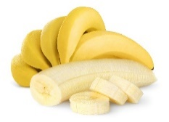
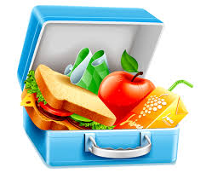
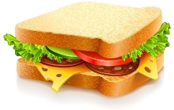
Unit 5
Lunchtime!
Semester (1)
Family and Friends 2
Grade 2
Lesson (1)
P. 38

Slide 2
Grade (2) unit (5) lesson (1) words
OBJECTIVES
By the end of the lesson, you will be able:
to recognize some food items
to write sentences using some food items correctly

Slide 3
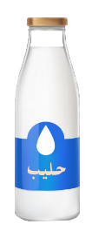
Grade (2) unit (5) lesson (1) words
Listen and repeat
apple
bananas
drinks
sandwich
Click to listen and read
Lunch box
biscuit

Slide 4
Grade (2) unit (5) lesson (1) words
Look, point and say
Click to check your answers

Slide 5
Grade (2) unit (5) lesson (1) words
Look and read
apple
bananas
drinks
sandwich
Lunch box
biscuit
click to check your answers

Slide 6
Grade (2) unit (5) lesson (1) words
Look and write the missing letters
Use your mini board
apple
San - - -c-
a- - l -
- ana---
bananas
d- -n - s
Sandwich
drinks
biscuit
---- b--
bis----
Lunch box
Click to check your answers

Slide 7
Grade (2) unit (5) lesson (1) words
Look and write the words
Use your mini board
apple
bananas
drinks
sandwich
Click to check your answers
biscuit
Lunch box

Slide 8
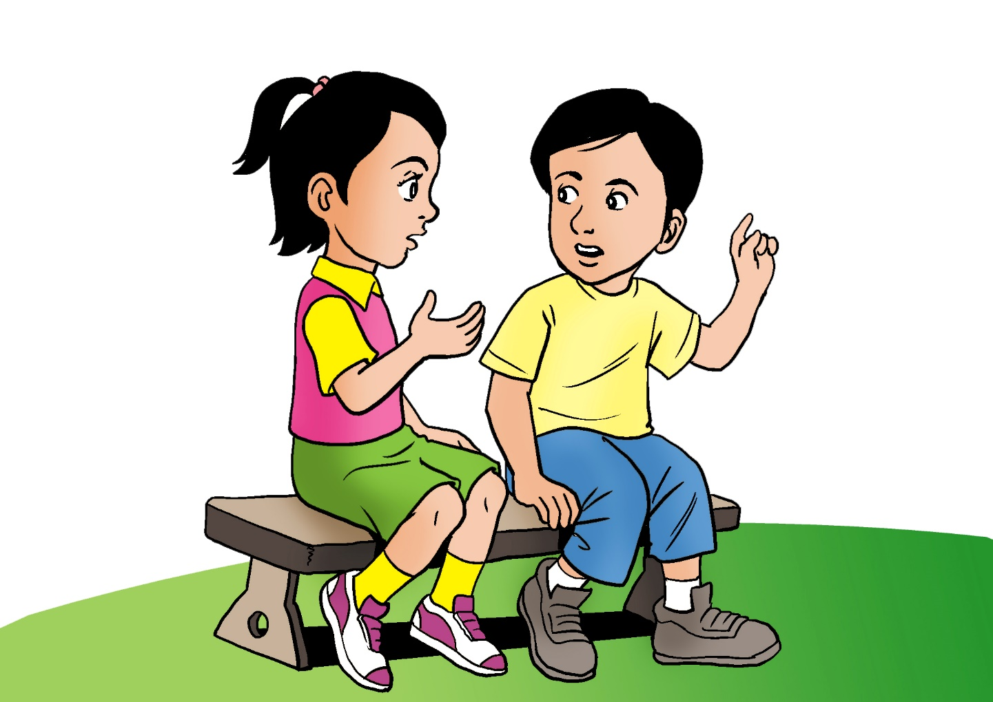
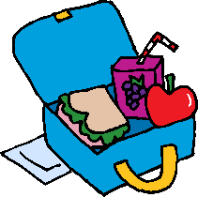
Grade (2) unit (5) lesson (1) words
Listen and repeat
I’ve got two drinks. Here you are.
Oh no! I haven’t got my juice!

Slide 9
Grade (2) unit (5) lesson (1) words
Read and write the missing words
_________two drinks. Here you are.
I’ve got two drinks. Here you are.
Oh no! I haven’t got my juice!
Oh no! I _______ got my juice!
Click to check your answers

Slide 10
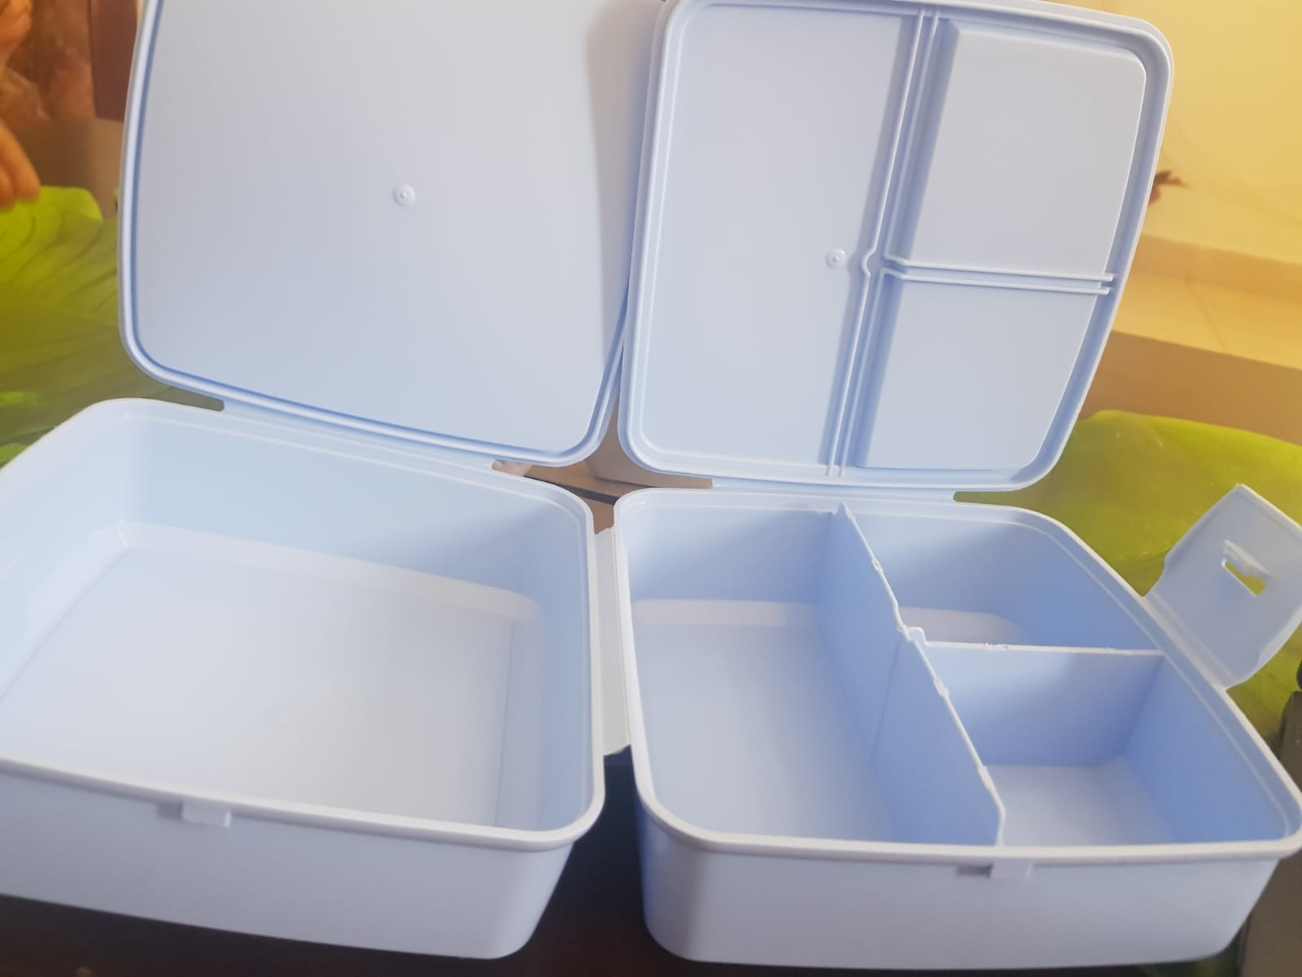
Grade (2) unit (5) lesson (1) words
What do you have in the lunch box?
I’ve got an apple juice.
I’ve got a sandwich.
I’ve got milk.
I’ve got an apple.
Write more sentences
I’ve got water.
________________________
I’ve got a biscuit.
_______________________.
Click to check your answers

Slide 11
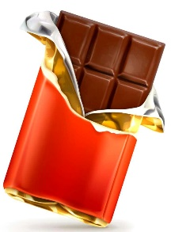
Grade (2) unit (5) lesson (1) words
Prepare your own lunch box.
Write sentences
I’ve got _______________
________________________
________________________
________________________
grapes
water
sandwich
olives
biscuit
orange juice
chocolate
peach
apple juice
milk
apple

Slide 12
A
B
C
D
E
F
G
H
I
J
K
L
M
N
O
P
Q
R
S
T
U
V
W
X
Y
Z
It’s a fruit. It is red or green
help
A
A
P
P
L
E
A
B
B
B
B
B
B
B
B
B
B
A
B
A
A
A
A
A
A
A
A
A
C
C
C
C
C
C
C
C
C
C
C
D
D
D
D
D
D
D
D
D
D
D
E
E
E
E
E
E
E
E
E
E
K
K
K
K
K
K
K
K
K
K
L
L
L
L
L
L
L
L
F
J
K
L
F
L
F
F
F
F
F
F
F
F
F
J
J
J
J
J
J
J
J
J
H
J
H
H
H
H
H
H
H
H
H
G
H
G
G
G
G
G
G
G
G
G
G
I
I
I
I
I
I
I
I
I
I
I
P
P
Q
Q
Q
Q
Q
Q
Q
Q
Q
M
Q
M
M
M
M
M
M
M
M
M
M
O
P
P
P
P
P
P
P
O
O
O
O
O
O
O
O
Q
R
X
X
X
X
X
X
X
X
X
X
R
X
R
R
R
R
R
R
R
R
O
R
S
S
S
S
S
S
S
S
S
S
S
T
T
T
T
T
T
T
T
T
T
T
W
W
W
W
W
W
W
W
W
V
W
V
V
V
V
V
V
V
V
V
N
V
N
N
N
N
N
N
N
N
N
N
U
U
U
U
U
U
U
U
U
U
O
U
W
Z
Z
Z
Z
Z
Z
Z
Z
Z
Y
Z
Y
Z
Y
Y
Y
Y
Y
Y
Y
Y
Y
______________________________________________________________________________________________________
Ministry of Education -2020
Ministry of Education -2020

Slide 13
A
B
C
D
E
F
G
H
I
J
K
L
M
N
O
P
Q
R
S
T
U
V
W
X
Y
Z
It’s a kind of sweets.
help
A
B
I
S
C
U
I
T
A
B
B
B
B
B
B
B
B
B
A
B
A
A
A
A
A
A
A
A
A
A
C
C
C
C
C
C
C
C
C
C
D
D
D
D
D
D
D
D
D
D
D
E
E
E
E
E
E
E
E
E
E
K
K
K
K
K
K
K
K
K
E
K
L
L
L
L
L
L
L
L
F
J
K
L
L
F
L
F
F
F
F
F
F
F
F
F
J
J
J
J
J
J
J
J
J
H
J
H
H
H
H
H
H
H
H
H
G
H
G
G
G
G
G
G
G
G
G
G
I
I
I
I
I
I
I
I
I
P
P
P
Q
Q
Q
Q
Q
Q
Q
Q
Q
M
Q
M
M
M
M
M
M
M
M
M
M
O
P
P
P
P
P
P
P
O
O
O
O
O
O
O
O
P
Q
R
X
X
X
X
X
X
X
X
X
X
R
X
R
R
R
R
R
R
R
R
O
R
S
S
S
S
S
S
S
S
S
S
T
T
T
T
T
T
T
T
T
T
W
W
W
W
W
W
W
W
W
V
W
V
V
V
V
V
V
V
V
V
N
V
N
N
N
N
N
N
N
N
N
N
U
U
U
U
U
U
U
U
U
O
U
W
Z
Z
Z
Z
Z
Z
Z
Z
Z
Y
Z
Y
Z
Y
Y
Y
Y
Y
Y
Y
Y
Y
______________________________________________________________________________________________________
Ministry of Education -2020
Ministry of Education -2020

Slide 14
End of lesson 1
Grade (2) unit (5) lesson (1) words
Good job dear!

