Slide 1
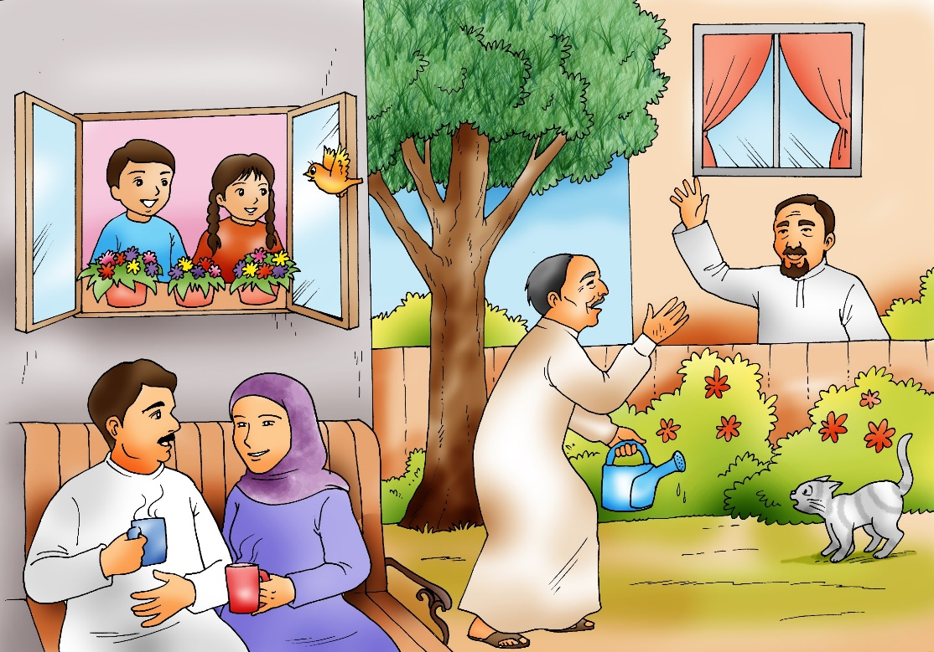
Unit 4
This is my mum!
Semester 1
Family and Friends 1
Grade 1
Lesson 6
P 43

Slide 2
Grade 1 unit 4 lesson 6
OBJECTIVES
By the end of the lesson, you will be able to:
- answer questions after reading a story.

Slide 3
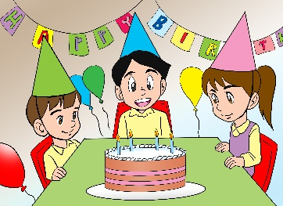
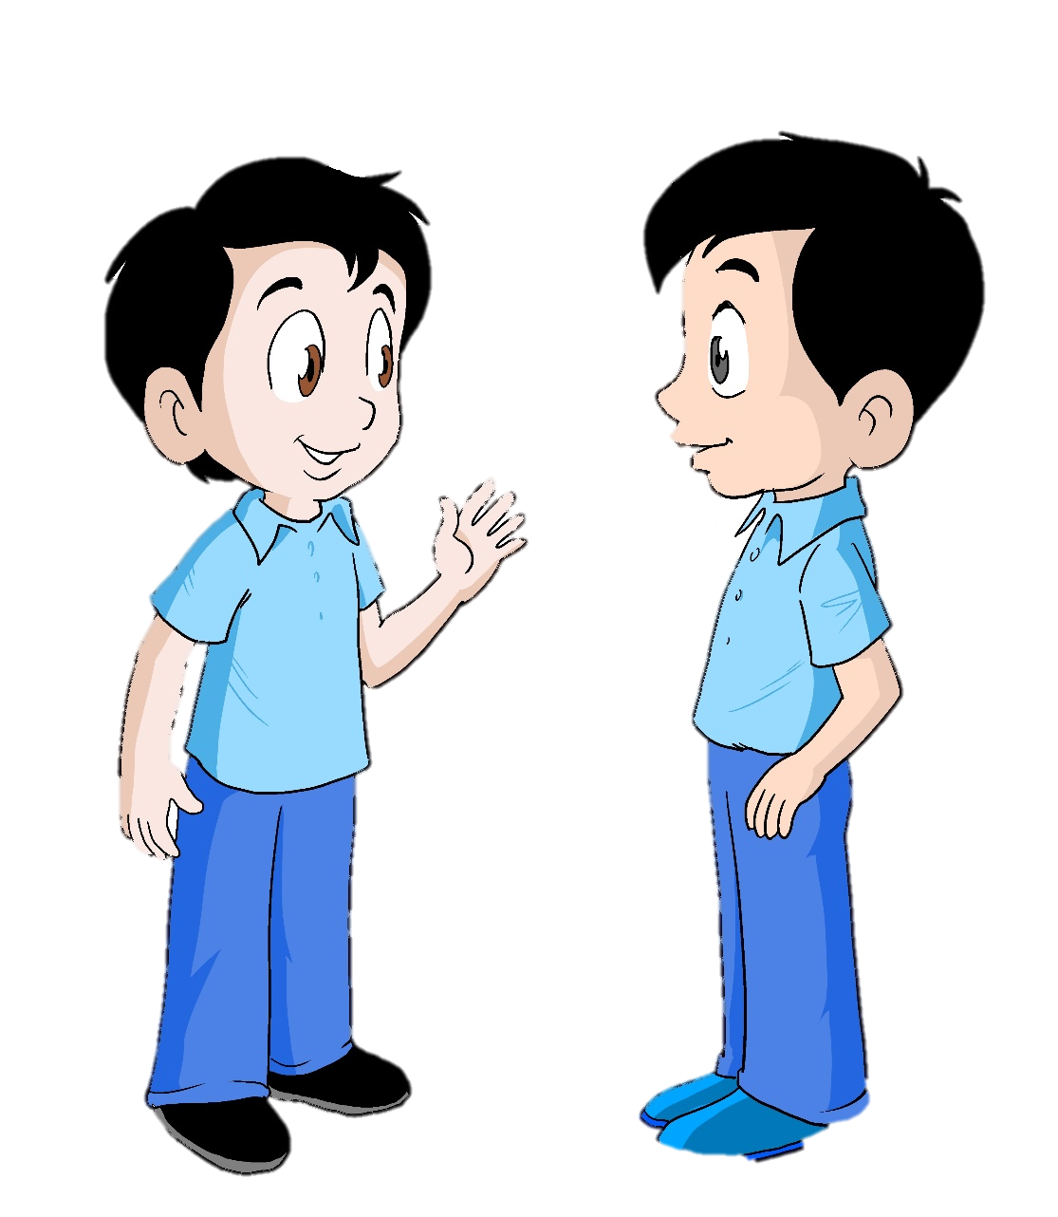
Listen then read
Dictionary
celebrate
1
Hello Ahmad.
Happy Birthday!
2. Hi Hasan.
Thank you.
I celebrated it with my family last night. It was fun.
Grade 1 unit 4 lesson 6

Slide 4
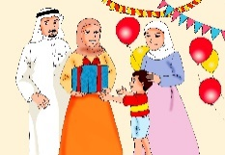
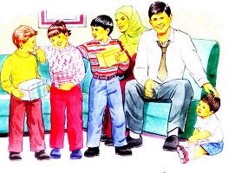
Grade 1 unit 4 lesson 6
Dictionary
photo
Listen then read
family
2
That’s great !
Do you have a photo?
2. Yes! Here it is.
This is my family.

Slide 5
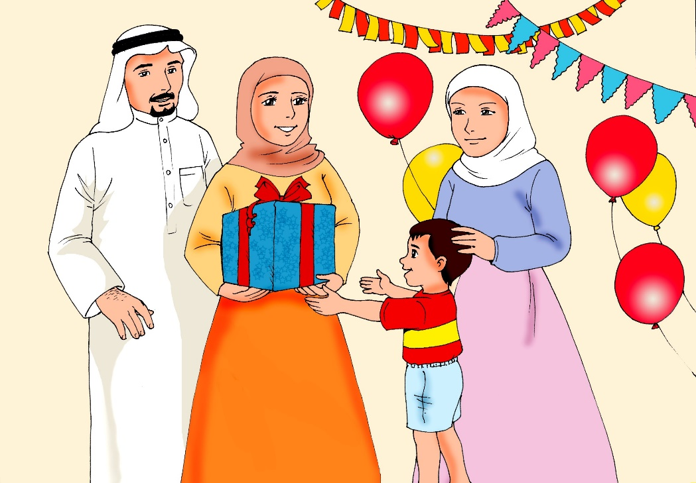
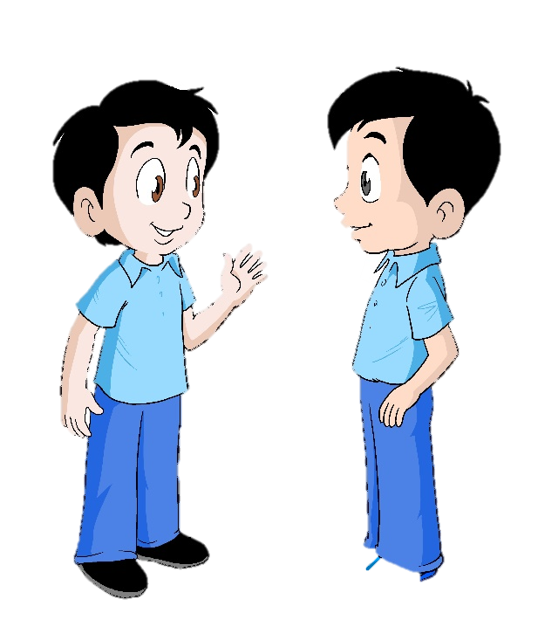
Listen then read
Dictionary
3
dad
Great photo!
Who is in it?
2. This is my dad.
His name is Mohamed.
Grade 1 unit 4 lesson 6

Slide 6
Listen then read
Dictionary
mum
4
1. This is my mum.
Her name is Mariam.
Grade 1 unit 4 lesson 6

Slide 7
Listen then read
Dictionary
5
sister
Is this your sister?
2. Yes!
This is my elder sister, Sara.
Grade 1 unit 4 lesson 6

Slide 8
Listen then read
Dictionary
brother
6
1. And this is my younger brother, Ali.
Grade 1 unit 4 lesson 6

Slide 9
Listen then read
Dictionary
glad
7
2. Sure, I will.
I’m glad you had fun last night.
1.
Bring a photo of your family tomorrow, Ahmad.
I would like to see them.
Grade 1 unit 4 lesson 6

Slide 10
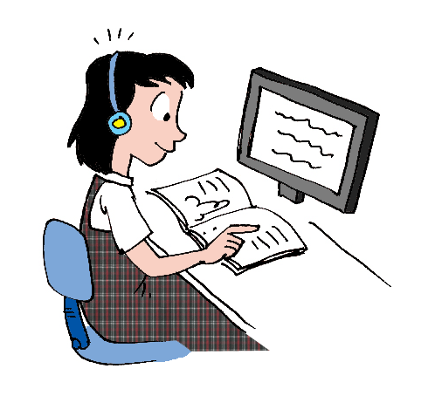
Grade 1 unit 4 lesson 6
Open your class book
P. 43
for another story.

Slide 11
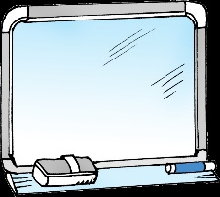
Let’s practice !
Look and write.
grandpa - mum – sister – dad – grandma - brother
3
sister
_ _ _ _ _ _
1
5
_ _ _
dad
grandpa
_ _ _ _ _ _ _
2
_ _ _
6
mum
grandma
_ _ _ _ _ _ _
Click for the answer
4
brother
_ _ _ _ _ _ _
Grade 1 unit 4 lesson 6

Slide 12
Let’s practice !
Write a sentence.
1- This is my dad.
2- This is ………………….… .
3- …………..……………..... .
4- ………………………….... .
5- …………………………… .
6- ………………………….… .
my mum
This is my sister.
This is my grandpa.
This is my brother.
Click for the answer
This is my grandma.
Grade 1 unit 4 lesson 6

Slide 13
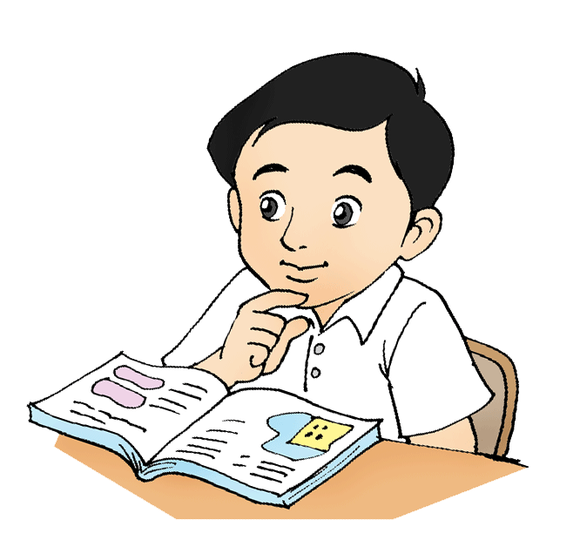
Grade 1 unit 4 lesson 6
Let’s practice !
Open your workbook
p.41 and answer the questions.

Slide 14
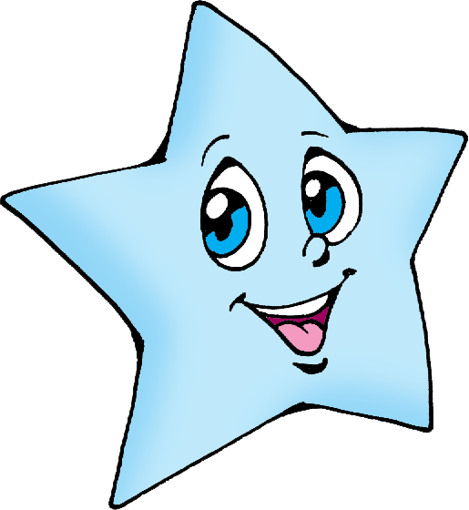
End of lesson 6
Grade 1 unit 4 lesson 6
Keep it up!

