Slide 1
Grade 1 Family and Friends 1 Lesson 6 Page 11
Starter
A B C D E F G H I J K L M N O P Q R S T U V W X Y Z
Semester (1)
English

Slide 2
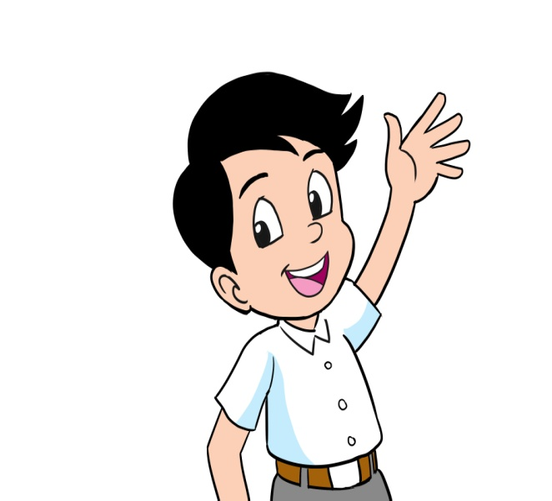
Grade 1 starter lesson 6
Objectives
By the end of the lesson, you will be able to
1- ask about somebody’s name.
2- greet someone.

Slide 3
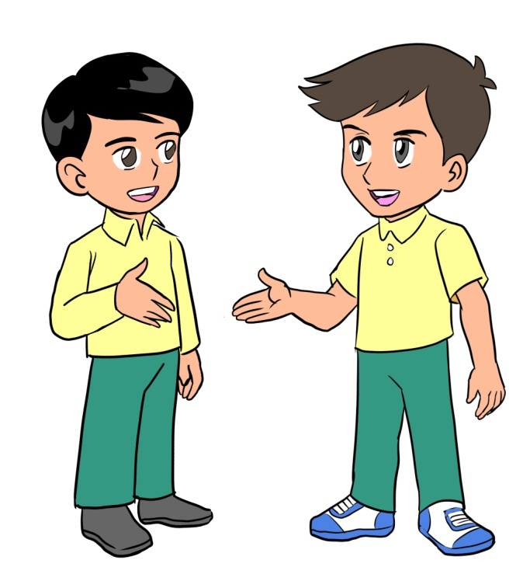
Grade 1 starter lesson 6
Read the story.
Hello, I’m Mohamed.
What’s your name?
Hello, I’m Ali.

Slide 4
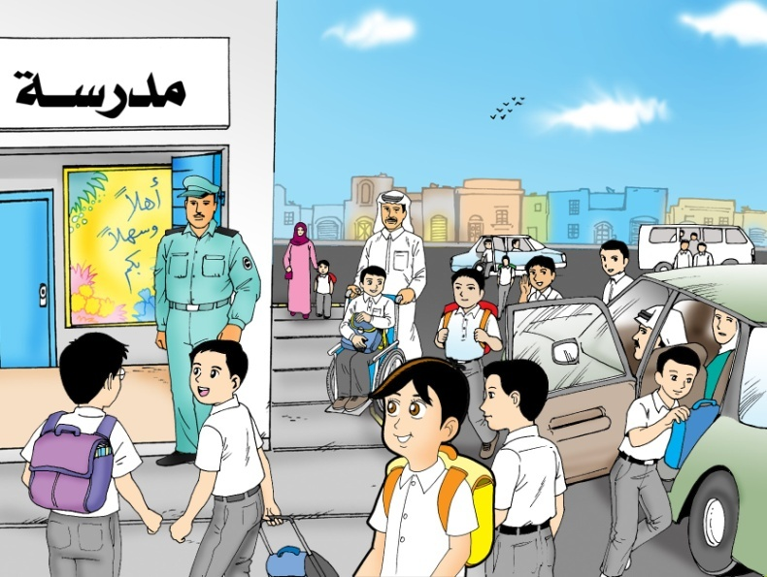
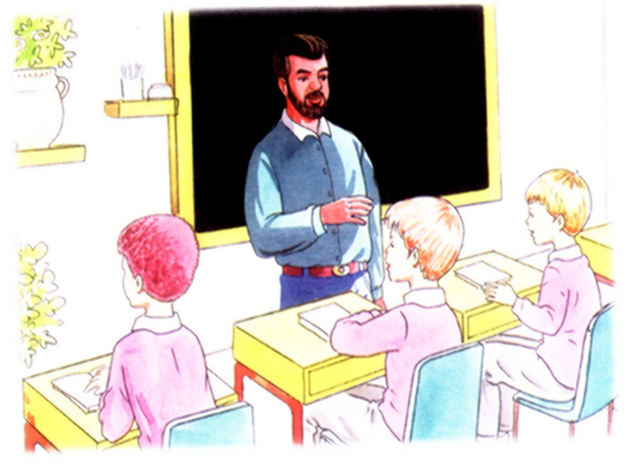
Grade 1 starter lesson 6
Read the story.
Hello, what’s your name?
Hello!
Hello!
I’m Mohamed
I’m Salman.

Slide 5
Grade 1 starter lesson 6
Look and trace.
Hello!
Hello, what’s your name?
Hello!
I’m Mohamed
I’m Salman.

Slide 6
End of lesson 6
Grade 1 starter lesson 6
Good job dear !
_________________________________________________________________________________________________________________________________________________
Ministry of Education-2020

