Slide 1
Unit 7
Are they teachers?
Family and Friends 1
Grade 1
Lesson 3
P 66

Slide 2
Guess !
S
I’m a letter.
I come after the letter R.
I come before the letter T.
Who am I?
Letter S

Slide 3
The Objectives
1- Identify the letter S.
2- Practice writing the letter S.
3- Learn new words with letter S.

Slide 4
The letter S
Say the letter S out loud.
S
Upper case
s
Lower case

Slide 5
The letter S
Trace the letter S in the air.
Upper case

Slide 6
The letter S
Trace the letter S in the air.
Lower case

Slide 7
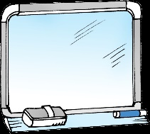
The letter S
Practice writing the letter on your board.
Upper Case
Start from the big dot.
1
Use the arrows to help
you write it correctly.
2
3
Start from the left.
4

Slide 8
The letter S
Practice writing the letter on your board.
Lower case
Start from the big dot.
1
Use the arrows to help
you write it correctly.
2
3
Start from the left.
4

Slide 9
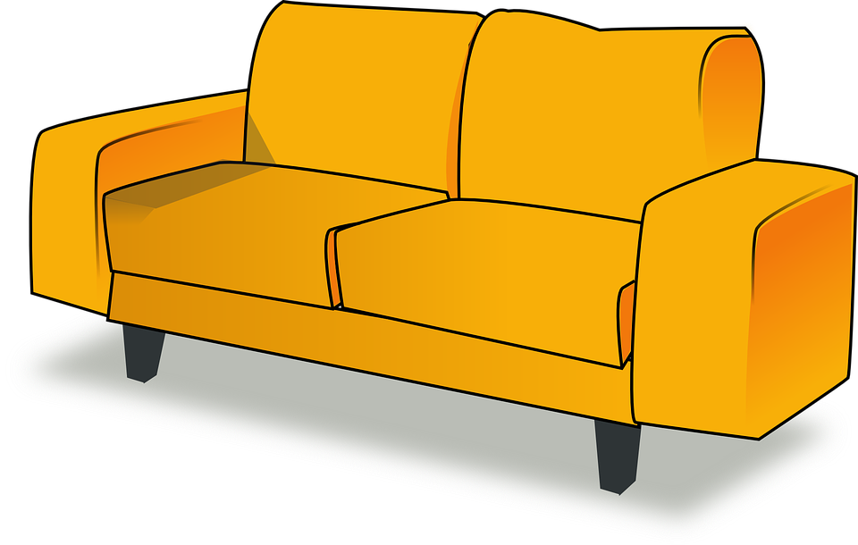
The letter S
Read the word with the letter S s. Point to the letter S s on the screen.
It’s a sofa.

Slide 10
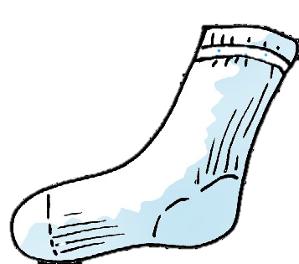
The letter S
Read the word with the letter S s. Point to the letter S s on the screen.
It’s a sock.

Slide 11
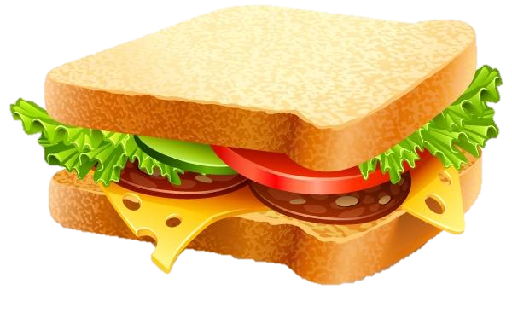
The letter S
Can you think of other words with (S)?
1
2
It’s a sandwich.
It’s a skirt.

Slide 12
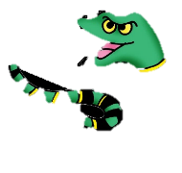
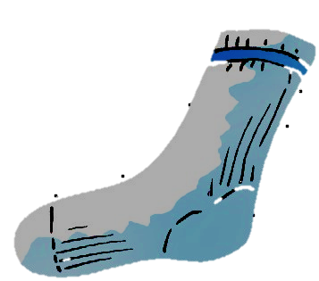
Now let’s practice
Silly snake, silly snake, sing
your very best
Sing about the things you know
that start with letter S
Stinky sock,
Soapy soup
Sailboats in the snow
Sorry, but I have to stop
That’s all the stuff I know
Read and
write the words that start with letter ( s )
in the text.
soap

Slide 13
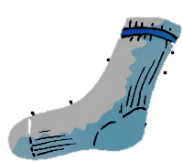
Now let’s practice
Silly snake, silly snake, sing
your very best
Sing about the things you know
that start with letter S
Stinky sock,
Soapy soup
Sailboats in the snow
Sorry, but I have to stop
That’s all the stuff I know
Read and
write the words that start with letter ( s )
in the text.
soap

Slide 14
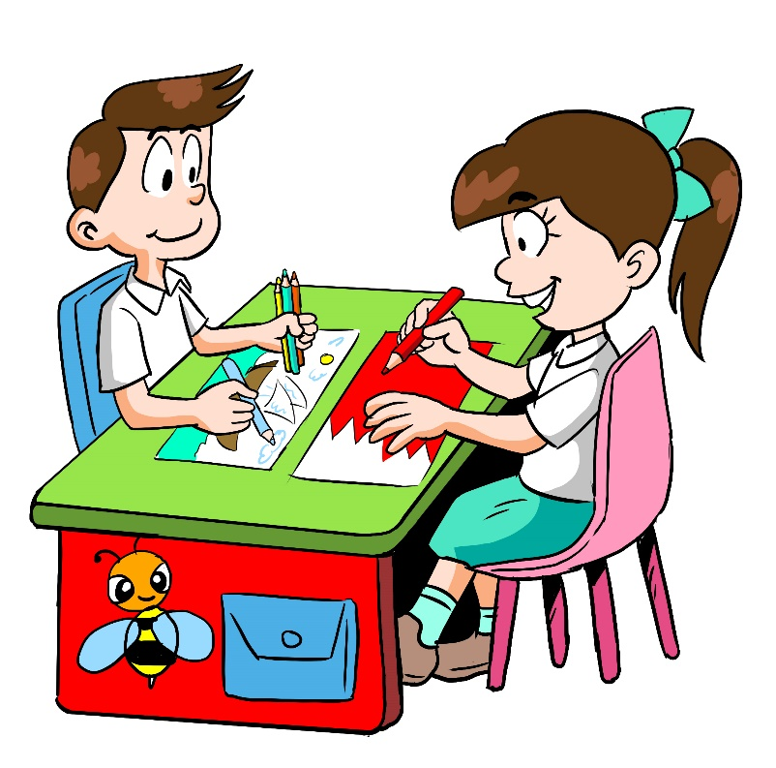
Now let’s practice
Circle the letter Ss.
Rr Ss Tt Uu Vv
Ww Xx Yy Zz

Slide 15
Now let’s practice
Answer the exercises in your workbook. P 56
1
2
Upper case
3
4
1
2
Lower case
3
4

Slide 16
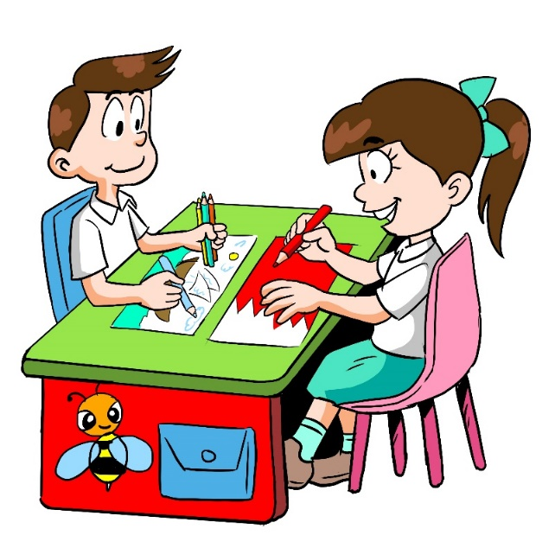
Now let’s practice
Don’t forget to answer letter S worksheet.

Slide 17
End of lesson 3
Good job dear!

